Slide 1
DOJ Settlement Agreement
An Overview
Notes:
Intro (Who I am, Purpose of Presentation ), First Poll Question

Slide 2
In the Beginning…
2008 DOJ started investigations at CVTC
Under Civil Rights of Institutionalized Persons Act
2010 - Broadened investigation to all training centers and community supports and services under ADA and Olmstead
2011- DOJ issued findings
2011- DBHDS entered into negotiations with Department of Justice
1/26/2012 DBHDS and DOJ entered a Settlement Agreement
Consent Decree signed 8/2012 following opportunity of stakeholders opportunity to file
Amicus Briefs and letters highlighting Pros and Cons of SA

Slide 3
Section III: The Settlement Agreement Population
Currently reside at any of the training centers,
Meet the criteria for the Intellectual Disability (ID) waiver or Developmental Disability (DD) waiver wait lists,
Currently reside in a nursing home or ICF.

Slide 4
Section III: Waiver Slots
Required by DOJ
Approved Through GA

Slide 5
Section III: Case Management
Critical role in achieving the intention and outcomes of the SA
SA focus on collaboration, comprehensive ISP development, meeting needs, monitoring, and assuring choice
Established a single point of entry for Developmental Disability Case Management (CM) with Waiver redesign (2016)
Increased focus on CM
Established a Case Management Steering Committee (2018)
Funded a CM System Study (2018)
Enhanced CM Training Modules (2019)
Created an online DD CM Manual (2019)
Funded a Transactional CM pilot (2019)
Established an electronic data exchange for centralized ISPs (2019)
Implemented a Support Coordination Quality Review process (2019)
Implemented standardized assessments for crisis risk, health risks, changes in status, and appropriate service implementation (2020)

Slide 6
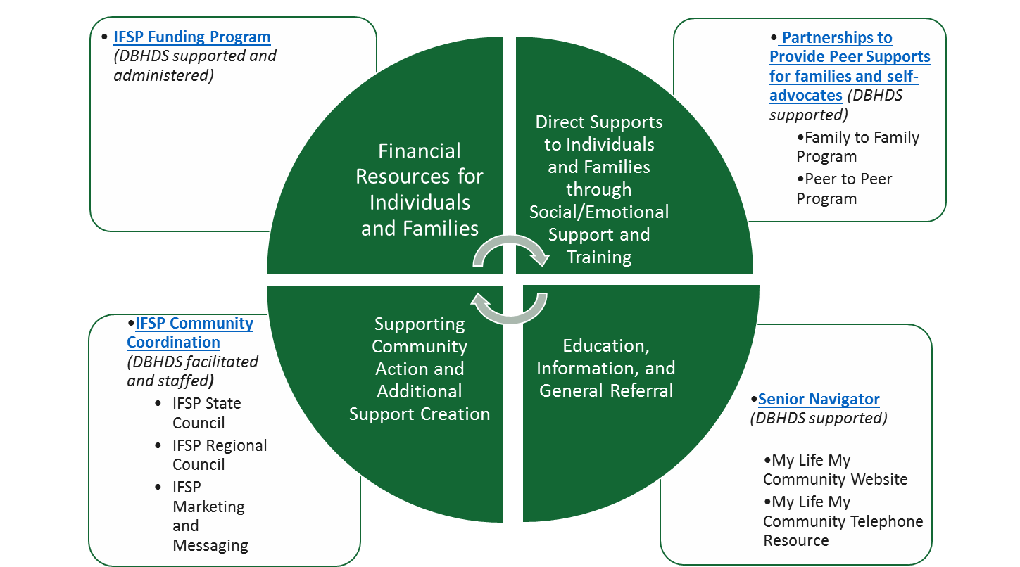
Individual and Family Support Program (IFSP)

Slide 7
Section III: Crisis Services
Brief History
What REACH provides
Developed to address need of supporting individuals with a developmental disability through crisis events in the community
Adult programs began in FY12, short term residential launched FY16
Child programs began FY16, short term residential launched FY20
A 24/7 mobile crisis response
Crisis line
24/7 face to face response
Community-based mobile crisis services
Implementation of crisis stabilization plans in the natural setting
Development of a Crisis Education and Prevention Plan (CEPP)
Coaching/Mentoring the system of support
Prevention services & linkages
Crisis Therapeutic Home
Residential crisis stabilization for up to 10 days for children, 30 days for adults
Step down transition from hospitals, jail, training center
Prevention stays to add additional support during periods of high stress

Slide 8
Section III: Employment/Integrated Day
Employment First Initiative Proclamation October 2011
Employment First Policy December 2012

Slide 9
Section III: Regional Support TeamS
Five Regional Support Teams were developed in 2013 with a focus on supporting people in the most integrated setting consistent with their informed choice and needs
Reviews referrals for people with DD in the target population when established criteria are met
Difficulty finding services
Considering a congregate setting of five or more people
Considering a nursing home or ICF-IID
Pattern of being removed from home
Diverse stakeholder and professional membership
Seeks to resolve barriers to more integrated settings
Makes recommendations to SCs/planning teams
Contributes data related to gaps in services

Slide 10
Section IV: Discharge Planning and Training Centers
A Community Integration Manager was placed at each Training Center to provide support and direction for transition/discharge operations and coordinate the implementation of policies, procedures, regulations, and other initiatives related to ensuring individuals residing in Training Centers are served in the most integrated setting appropriate to their needs and desires.
The implementation of a 12 Week Discharge Process that includes collaboration between all support partners to establish essential supports and identify viable, more integrated options for residential care, day activity services and employment.
Development of a robust post move monitoring process completed by Training Center staff, the Community Services Board and Office of Human Rights to ensure the provision of essential supports following discharge
Incident Review Follow Up process to track and trend serious incidents and offer additional support to community providers as needed to ensure the health, safety and wellbeing of individuals discharged from Training Centers

Slide 11
Section V: Quality and Risk Management
Quality and Risk Management
Create Quality and Risk Management System
Leveraged work from Licensing
Focus on Risk Mitigation
Risk Triggers and Thresholds
Incident Reporting
Corrective Action Plans
Created Division of Quality
Focus on Quality Improvement
Quality Improvement Committee
Regional Quality Councils
Data Reliability and Validity including gap Analysis
Quality Service Reviews

Slide 12
Key Accomplishments
1. Completely redesigned the waivers-(created new waivers that met peoples needs, redesigned the waiting list, created new services that did not previously exist, and did this all in a fiscally responsible way (rate study))
2. Developed a crisis system for individuals with DD
3. Improved data and reports
4. Have provided over 5,000 new waivers to people
5. Closed 4 training centers
6. Created a new waiver management system
7. Created an IFSP program
8. Created a quality system where one did not previously exist
9. Created an incident management unit where one did not previously exist
10. Improved consistency in the way licensing reviews were complete
11. Created Jump Start funding for provider to initiate new services
12. Developed new providers for specialty care
13. Developed Office of Integrated Health/DD Health Support Network

Slide 13
Big picture view – Project Management
Avoiding
Crises
Choice and Self-Determ-ination
Physical, Mental
Behavioral Health/Well-being
Provider Capacity
Access to Services
Safety/Freedom from harm
Community
Inclusion
Goals (KPAs)
Physical, mental, behavioral
health and well-being
Safety/
Freedom From Harm
Stability
Avoiding Crises
Health, Safety Provider Competency Community Integration
and Wellbeing and Capacity and Inclusion
Drivers
CMS Requirements, Regulations
Case Management
Performance Standards
RSTs
Crisis Management
Performance Standards
Integrated Settings
Employment
Transpor-tation
Community Living
Provider Partnership
Licensing
Incident Reporting
Corrective Actions
Inspections
Investiga-tions
Communi-cations/
Training
CSB
Other Pro-viders
Supervisor
Family Outreach
DOJ Library
Business areas
Measures
QM/RM

Slide 14
Department of Justice (DOJ) Settlement Agreement
“Build the Run”
Completing the Build Summaries to document compliance
Operationalize what was built
Performance Management Dashboard
Show progress against the measures (quantitative compliance indicators)
Demonstrate successful surveillance (qualitative compliance indicators)
Data Management
Data as a controlled asset
Sustainability Backlog
Build out the mid-to-long-term solutions to replace minimum viable product
Heavily reliant on Phase 1 data gap analysis and process opportunities from “Build the Run”
Public Launch Document Library
Shows evidence of compliance
Updated over time to ensure ongoing compliance

Slide 15
The End

