Slide 1
The State of the State
Presented by the Office of Provider Development
July 23, 2020
Eric Williams, Provider Development Director
Notes:
Welcome to the semi-annual State of the State Webinar, presented by the DBHDS Office of Provider Development, where we will be reviewing the information from the Provider Data Summary from May 2020.

Slide 2
What we will cover
Introduction
Provider Development activities
Key Performance Measures & Targets
Regional data
Opportunities
Next steps
Questions and suggestions
7/23/20
Virginia Department of Behavioral Health & Developmental Services
2
Notes:
Today, we will go over an introduction to the Provider Data Summary, Provider Development Activities, our Key Performance Measures and Targets, Regional Data, Opportunities for service expansion, our next steps, and then we will end with the opportunity for you all to pose questions and offer suggestions.

Slide 3
Mission
The Office of Provider Development focuses on developing and sustaining a qualified community of providers in Virginia so that people who have developmental disabilities and their families have choice and access to options that meet their needs.
7/23/20
Virginia Department of Behavioral Health & Developmental Services
3
Notes:
Our mission at The Office of Provider Development is to focus on developing and sustaining a qualified community of providers in Virginia so that people who have developmental disabilities and their families have choice and access to options that meet their needs.

Slide 4
Provider Data Summary Report
Semi-annual Report
Reports, webinar slideshows, and other materials related to Provider Development are available for download online at http://www.dbhds.virginia.gov/developmental-services/provider-development.
7/23/20
Virginia Department of Behavioral Health & Developmental Services
4
Notes:
This is the fourth Provider Data Summary Report that provides updates on the status of DD Waiver service availability and activities completed by the Office of Provider Development (OPD) in the Division of Community Services (DCS) at the Department of Behavioral Health and Developmental Services (DBHDS).
Provider Data Summary webinars continue on a semiannual basis to provide a forum for sharing the results of ongoing analysis of the opportunities for DD services development across all regions.
This webinar will include a basic overview of findings, provide support on using the data provided, and encourage the development of business acumen in the DD provider community.
Reports, webinar slideshows, and other materials related to Provider Development can downloaded from the provider development page on the DBHDS website.

Slide 5
Services Considered
Benefits Planning
Community Coaching
Community Engagement
Community Guide
Electronic Home-Based Services
Employment and Community Transportation
Independent Living Supports
In-home Supports
Peer Mentoring
Shared Living
Supported Living
Crisis Support Services
Private Duty Nursing
Skilled Nursing
Sponsored Residential
7/23/20
Virginia Department of Behavioral Health & Developmental Services
5
Notes:
As with the last report, there is consideration of a subset of DD Waiver services considered to be more integrated or critical, which include: Benefits Planning, Community Coaching, Community Engagement, Community Guide, Electronic Home- Based Services, Employment and Community Transportation, Independent Living Supports, In-home Supports, Peer Mentoring, Shared Living, Supported Living, Crisis Support Services, Private Duty Nursing, Skilled Nursing, and Sponsored Residential.

Slide 6
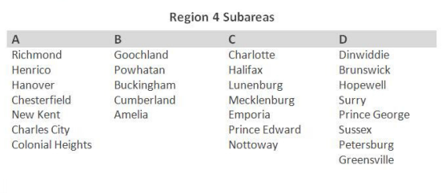
For this report
June 2018
May 2020
Baseline
7/23/20
Virginia Department of Behavioral Health & Developmental Services
6
Notes:
Much of the data in this report are compared across two points in time – June 2018 (which is the date of our baseline data) and May 2020 - so that a more meaningful understanding of progress can be achieved.
Also considered in the data are regional subareas that are defined for you in the Provider Data Summary Report, and are identical to the previous report.
This report provides a means to share Virginia's success in meeting measures established under the Settlement Agreement, as well as for other state and federal purposes, and quality improvement.

Slide 7
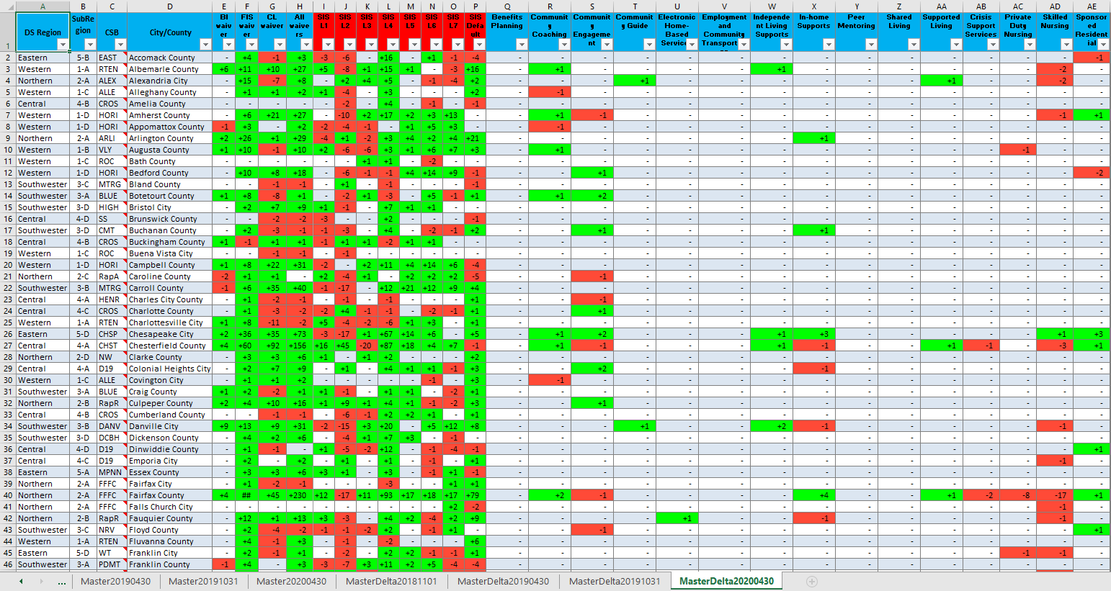
Baseline Measurement Tool
Virginia Department of Behavioral Health & Developmental Services
Notes:
As with previous reports, the focus is on identifying service development needs based on a review of DD waiver population and authorization data in each locality in Virginia. The “Baseline Measurement Tool ( or BMT),” which is used by the Office of Provider Development in conducting this review, has been updated to include the most recent six months of data.
Providers are encouraged to download and use the Baseline Measurement Tool in conducting market research and in strategic planning efforts, which contains Waiver Management System data from current waiver authorizations, . The BMT provides baseline and subsequent data on integrated services, collected at six month intervals, across all cities and counties in Virginia. The BMT also considers the DD Waiver population in each locality including type of waiver and Supports Intensity Scale© (SIS©) level.

Slide 8
Provider Development Activities
Community Resource Consultants met with 9 providers seeking to diversify or expand services.
Notable additions:
5 new Therapeutic (Behavior Support) providers with 2 more considering adding DD Waiver, and
1 new Electronic Home Based Services provider.
Barriers:
COVID-19, time involved in agency planning to make changes, waiting on licensing approval, out of state providers starting services in Virginia having to complete additional requirements, and the lack of regulations and a policy manual.
7/23/20
Virginia Department of Behavioral Health & Developmental Services
8
Notes:
Provider Development Activities in the third quarter of FY20 included Community Resource Consultants meeting with 9 unique providers seeking to diversify or expand services. Region 1 had four providers, Region 3 had one provider, Region 4 had three providers, and one provider is offering services statewide. Five new Therapeutic Consultation (Behavioral Supports) have started providing services. Two additional providers have been contacted and are considering offering Therapeutic Consultation (Behavioral Supports) under the DD Waiver. In addition, a new Electronic Home Based Services provider has completed the last steps to become an active provider in Virginia. Barriers included COVID-19, time involved in agency planning to make changes, waiting on licensing approval, out of state providers starting services in Virginia having to complete additional requirements, and, as with the last report, the lack of regulations and a policy manual.

Slide 9
Provider Development Activities
Provider Roundtables and Support Coordination Meetings:
January 2020:
In-person meetings held in all 5 regions with 333 provider representatives and 138 Support Coordination representatives.
April 2020:
Due to COVID-19 a statewide webinar was held with more than 500 attendees consisting of both providers and SCs.
7/23/20
Virginia Department of Behavioral Health & Developmental Services
9
Notes:
Provider Roundtables and Regional Support Coordination Meetings were held in all regions in January 2020. Roundtables were attended by a total of 333 provider representatives and SC Meetings by 138 Support Coordination representatives. These meetings serve as a forum to exchange information about topics impacting providers and support coordination, as well as provide space for shared learning. In April 2020, the Office of Provider Development held a statewide Provider and Support Coordinator webinar in lieu of in-person, regional meetings due to the COVID-19 pandemic, which had more than 500 attendees.

Slide 10
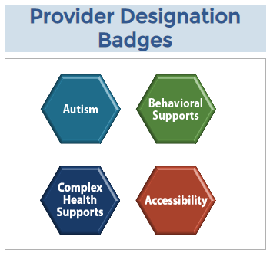
My Life My Community Provider Database and Designation Process
Launched November 15, 2019.
As of May 2020, 60 providers have registered.
Provider Designation:
-4 providers hold badges in Autism, Behavioral Support, and Complex Health Supports
-22 have passed surveys with next step of submitting evidence.
http://mylifemycommunityvirginia.org/taxonomy/mlmc-menu-zone/verify-or-register-new-provider-profile
Virginia Department of Behavioral Health & Developmental Services
10
Notes:
The My Life My Community (MLMC) Provider Database and Provider Designation Process were launched on November 15, 2019. All DD Waiver providers are encouraged to register on the database, which will serve as the centralized location for finding DD services in Virginia. As of May 2020, approximately 60 providers registered and have DD Professional Membership at the MLMC Provider Database. In addition, four surveys became available to registered providers. This afforded DBHDS the opportunity to identify provider expertise and give public recognition for having program features that support Accessibility, Autism, Complex Health Supports, and Complex Behavioral Supports. Collectively, four providers hold badges in Autism, Behavioral Support and Complex Health Supports. To date, twenty–two providers have passed surveys and the next step is to submit the required evidential documents. Providers can check their status on the database and, if needed, register at the website on the slide (link is also available in the Data Summary report).

Slide 11
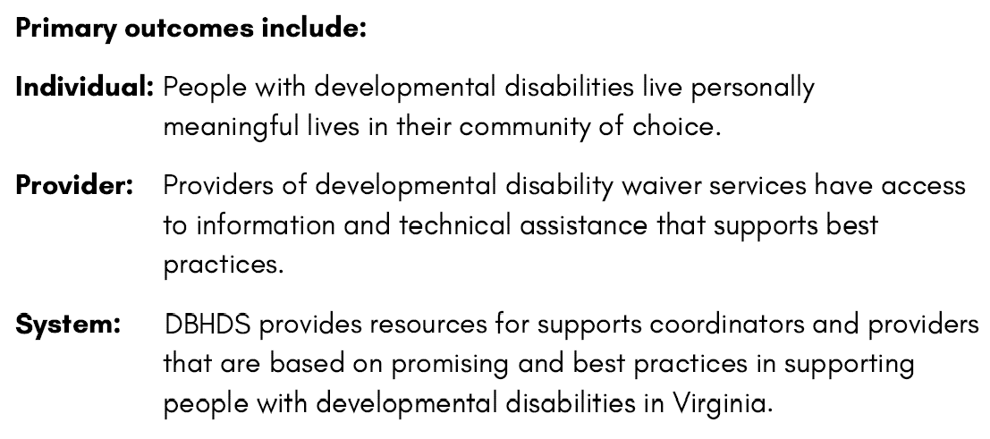
CRC Assignments Recap
Individual
Capacity-Building
Provider
Capacity-Building
System
Capacity-Building
7/23/20
Virginia Department of Behavioral Health & Developmental Services
11
Notes:
In February 2020, the reassignment of Community Resource Consultants (CRCs) occurred across these three areas, providing access to one CRC in each capacity-building area per region.
Primary outcomes include:
Individual: People with developmental disabilities live personally meaningful lives in their community of choice.
Provider: Providers of developmental disability waiver services have access to information and technical assistance that supports best practices.
System: DBHDS provides resources for supports coordinators and providers that are based on promising and best practices in supporting people with developmental disabilities in Virginia.

Slide 12
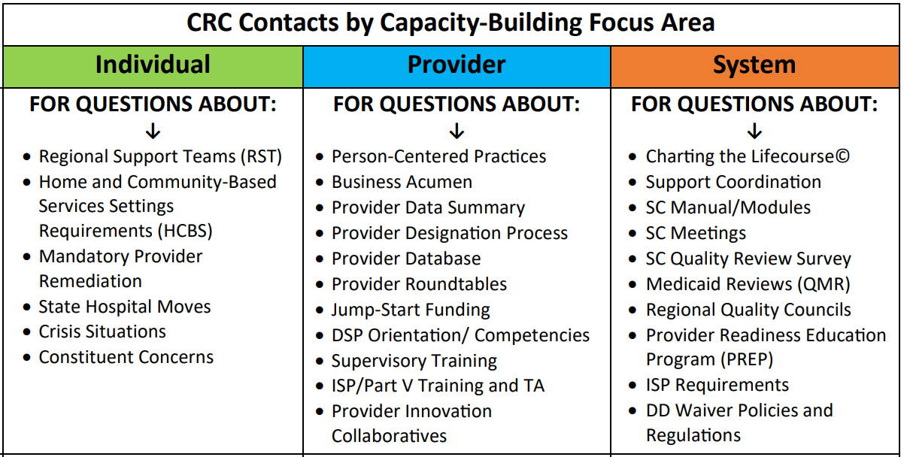
CRC Assignments Recap http://www.dbhds.virginia.gov/developmental-services/provider-development
7/23/20
Virginia Department of Behavioral Health & Developmental Services
12
Notes:
Each region has 1 assigned CRC for each focus area. You can access the chart with who to contact in your region by going to the DBHDS website, click on, “getting help,” then “Provider Development,” and click on “Contacts” at the bottom of the page. Should you contact a CRC for a situation not in their focus area, they will direct you to the appropriate CRC in your region.

Slide 13
Jump-Start Funding Program
Awarded approximately $55,490 in Fiscal Year 2020 to create integrated residential and day options in underserved areas.
Provider Roundtables
Open House
If interested in applying for funding to start or expand integrated services in an underserved area, visit: http://www.dbhds.virginia.gov/developmental-services/provider-development
7/23/20
Virginia Department of Behavioral Health & Developmental Services
13
Notes:
The Jump-Start Funding Program has awarded approximately $55,490 for Fiscal Year 2020. We are continuing to create more integrated residential and day services options in underserved areas. Funds are available to assist providers with service expansion in all regions. Provider Development staff have presented program information at regional Provider Roundtables and held an “open house” to meet directly with interested providers. Information on how to apply is located on the Provider Development webpage.

Slide 14
DSP Supervisory Training
Updated to meet indicators of the DOJ Settlement Agreement.
Available on Commonwealth of Virginia Learning Center (COVLC) on July 1, 2020.
3 modules that take approximately 2 ½ hours collectively to complete.
Mandatory for new DSP Supervisors and optional for DSP Supervisors who have already received a certificate from completing the previous version in COVLC.
7/23/20
14
Notes:
The DSP Supervisory Training has been updated and expanded to meet indicators of the DOJ Settlement Agreement, and it is now available on the Commonwealth of Virginia Learning Center (COVLC) as of July 1, 2020. This training consists of 3 modules that take approximately 2 ½ hours to complete. It will be mandatory for new DSP Supervisors and optional for DSP Supervisors who have already received a certificate from completion of the previous version of the training in COVLC.

Slide 15
Virtual Training
Interactive virtual Part V Plan for Supports Training coming soon!
Instructor Led Remote (ILR) Community Connections and Person Centered Thinking Training developed by The Learning Community for Person Centered Practices (TLCPCP), available beginning in July 2020.
Training and orientation for
other TLCPCP-credentialed
instructors around the
Commonwealth.
15
Notes:
In order to adapt to distance learning needs in the face of the COVID-19 pandemic, the Office of Provider Development has been working to create virtual methods of providing training to providers throughout the Commonwealth. An interactive virtual version of the Part V Plan for Supports Training has been developed and will be made available in the near future. In addition, an Instructor Led Remote (virtual) version of the Community Connections and Person Centered Thinking classes have been developed by The Learning Community for Person Centered Practices. The Partnership for People with Disabilities at VCU in collaboration with TLCPCP credentialed instructors at DBHDS will be scheduling the classes starting in July. In addition, they will be providing orientation and training to other Learning Community-credentialed instructors around the Commonwealth.

Slide 16
Key Performance Measures
7/23/20
Virginia Department of Behavioral Health & Developmental Services
16
Notes:
This section contains information about the results of various performance measures and additional data that helps in understanding the DD system of supports and services in Virginia. This content will be included in future reports to provide a more comprehensive understanding of services and people who access them.

Slide 17
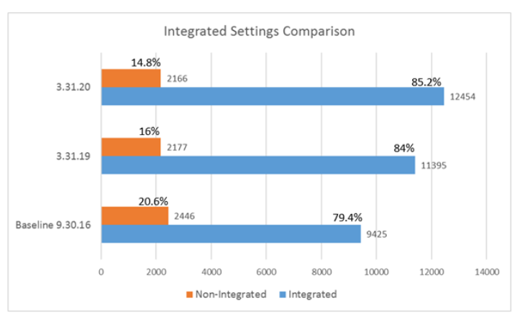
Key Performance Measures
Data continues to indicate an annual 2% increase in the overall DD waiver population receiving services in the most integrated settings.
7/23/20
Virginia Department of Behavioral Health & Developmental Services
17
Notes:
Our first Key Performance Measure is that “Data continues to indicate an annual 2% increase in the overall DD waiver population receiving services in the most integrated settings.”
This chart illustrates the overall trend in living situations for people with DD Waiver from March 31, 2019 to March 30, 2020 compared to baseline on September 30, 2016. Over the course of the last year included in the table, there has been an overall shift of 1.2% toward more integrated settings. From baseline, there has been a total increase toward integrated settings of 5.8%. This measure has not been met.

Slide 18
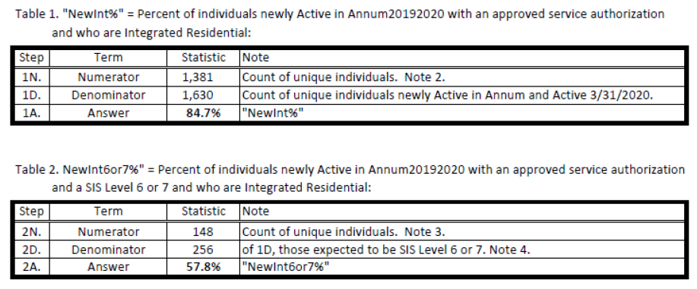
Key Performance Measures
Data continues to indicate that at least 90% of individuals new to the
waivers, including for individuals with a “supports need level” of 6 or 7, since FY16 are receiving services in the most integrated setting.
7/23/20
Virginia Department of Behavioral Health & Developmental Services
18
Notes:
Key Performance Measure 2 is that “Data continues to indicate that at least 90% of individuals new to the
waivers, including for individuals with a “supports need level” of 6 or 7, since FY16 are receiving services in the most integrated setting.”
These tables provide annual data that illustrates that 84.7% of all people new to the DD waivers reside in integrated settings and among those, 57.8% of people with Supports Intensity Scale 6 or 7 receive services in integrated settings. At 84.7%, measure not met.

Slide 19
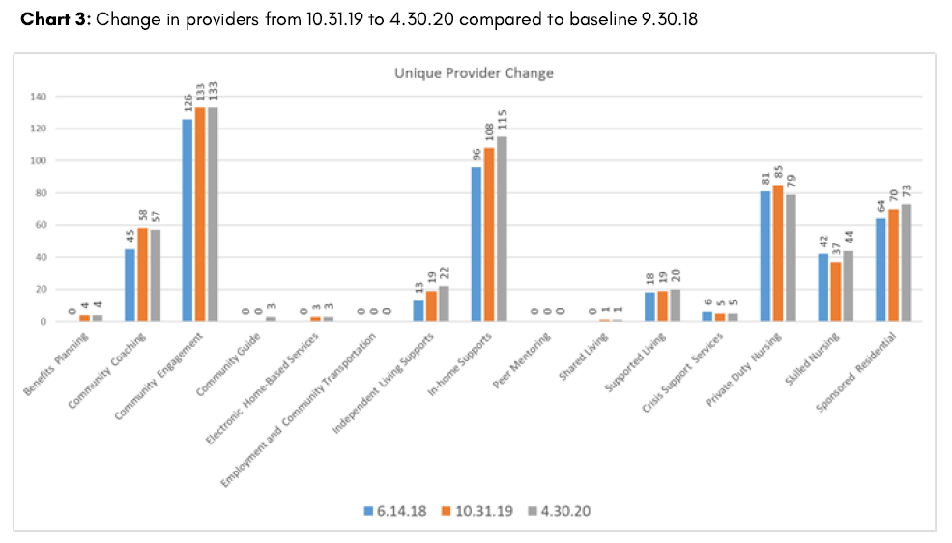
Key Performance Measures
The Data Summary indicates an increase in services available by
locality over time.
7.12.19
Virginia Department of Behavioral Health & Developmental Services
12
Notes:
Our third measure is that “The Data Summary indicates an increase in services available by locality over time.”
Provider Development, through the support of the Office of Integrated Support Services at DBHDS, makes available a Baseline Measurement Tool on a semi-annual basis for provider use in conducting market research and strategic planning efforts. Small to modest increases have been noted across all regions with the exception of Crisis Support Services (where there was the loss of one unique provider) and Private Duty Nursing (where there was a loss of two unique providers) since June 2018 as seen in this chart. Of significance is the lack of providers for two of the services: Peer Mentoring and Employment and Community Transportation. Development activities for these two services are nearing completion. This measure partially met.

Slide 20
Key Performance Measures
The Commonwealth ensures that at least 86% of individuals who are assigned a waiver slot are enrolled in a service within 5 months, per regulations.
7.12.19
Virginia Department of Behavioral Health & Developmental Services
12
Notes:
Our 4th measure is that “The Commonwealth ensures that at least 86% of individuals who are assigned a waiver slot are enrolled in a service within 5 months, per regulations.” For this measure, the numerator includes the number of individuals who had a service with an authorized begin date prior to the 5 month maximum and the denominator includes the number of individuals who went active on a waiver for the first time in fiscal year 2019. Current results in this table indicate a result of 91.5%. This measure has been met.

Slide 21
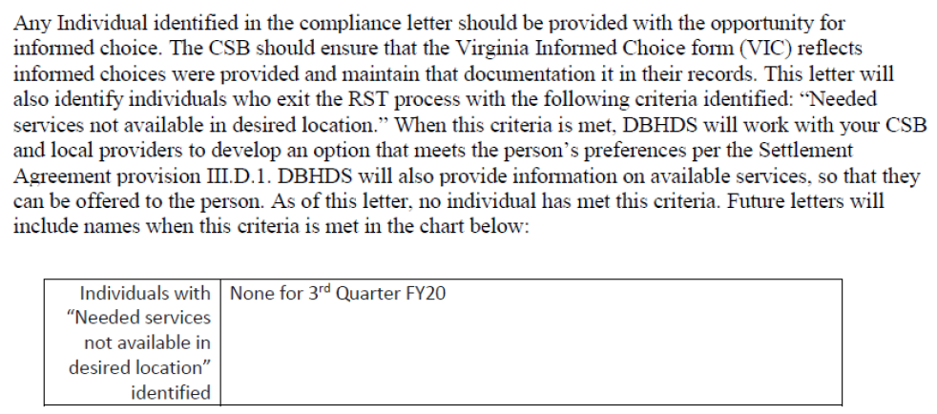
Key Performance Measures
86% of people with a DD waiver, who are identified through indicator #13 of III.D.6, desiring a more integrated residential service option (defined as independent living supports, in-home support services, supported living, and sponsored residential) have access to an option that meets their preferences within nine months.
7.12.19
Virginia Department of Behavioral Health & Developmental Services
12
Notes:
Our 5th measure is that “86% of people with a DD waiver, who are identified through indicator #13 of III.D.6, desiring a more integrated residential service option (defined as independent living supports, in-home support services, supported living, and sponsored residential) have access to an option that meets their preferences within nine months.”
To date no individual has met criteria for this measure. In preparation, the language in this slide was added to all quarterly RST compliance letters provided to CSBs. In summary, it indicates that any individual in the compliance letter should be provided with informed choice, which should be reflected in the Virginia Informed Choice form. When individuals are identified in the letter who exit the RST process with the criteria of “Needed services not available in desired location,” DBHDS will work with the CSB and local providers to develop an option that meets the person’s needs and preferences per the Settlement Agreement provision III.D.1.

Slide 22
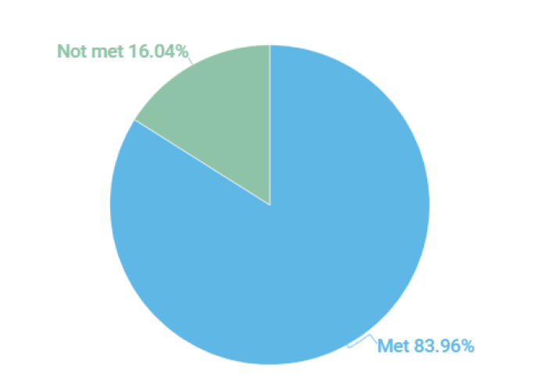
Key Performance Measures
86% of provider agency staff meet provider orientation training requirements
7.12.19
Virginia Department of Behavioral Health & Developmental Services
12
Notes:
Measure 6 is that “86% of provider agency staff meet provider orientation training requirements.
As reported in the FY19 Quality Review Team End of Year report, this performance measure seeks to demonstrate that provider agency staff had completed the annual DSP orientation training and documentation is present in the provider’s record. The aggregate total for all waivers for 2019 is 83.96%, which is below the required threshold of 86% (as seen in this chart). This measure is not met.

Slide 23
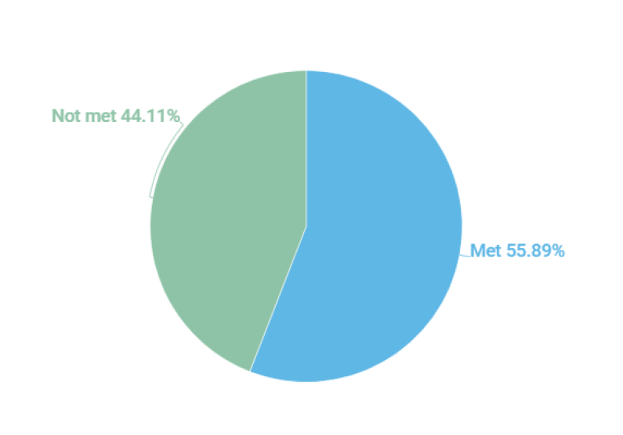
Key Performance Measures
86% of provider agency direct support professionals (DSPs) meet competency training requirements
7.12.19
Virginia Department of Behavioral Health & Developmental Services
12
Notes:
Measure 6 is that “86% of provider agency direct support professionals (DSPs) meet competency training requirements.”
As reported in the FY19 Quality Review Team End of Year report, this performance measure seeks to ensure that all provider agency DSP’s completed competency training requirements and that this documentation is present in the provider’s record. The aggregate total for all waivers for 2019 is 55.89%, which is below the required threshold of 86% (as noted in the chart on this slide). This Measure has not been met.

Slide 24
Demographic Data
Waitlist
-by region and priority
-by time on waitlist and age
Residential setting size and type
Day Services by type
Data specific to types of services received by region
Availability of specific services
Waiver Service Authorizations by region.
7.12.19
Virginia Department of Behavioral Health & Developmental Services
12
Notes:
The May 2020 Provider Data Summary Report contains demographic data you can use to make decisions on starting or expanding services. In the report you will find demographic data on:
The Waitlist
-by region and priority, and
-by time on waitlist and age
Residential setting size and type
Day Services by type
Data specific to types of services received by region
Availability of specific services, and
Waiver Service Authorizations by region.

Slide 25
Net Losses (unique)
Since June 2018…
Private Duty Nursing = -2 providers; +45 people
Crisis Services = -1 providers; +87 people
Note: These account for the only net losses by unique providers
7/23/20
Virginia Department of Behavioral Health & Developmental Services
25
Notes:
In the upcoming regional data, you will see that since June 2018, there has been a net loss of 2 unique Private Duty Nursing providers, with an increase of 45 people authorized for that service.
Also, Crisis Services have lost 1 unique provider since June 2018, with an increase of 45 people authorized for those services.

Slide 26
Notable Updates
All services tracked through this report have experienced an increase in the number of people supported since June of 2018 (with exception of Peer Mentoring and ECT).
A significant expansion in the data provided through this report to support a better understanding of Virginia's DD system of supports and services and achieve compliance with the Settlement Agreement
A reduction in Virginia's training centers to one location with a census of 78 in the past six months the first authorizations (15) were authorized for Community Guide Services
Use of Electronic Home-based Services more than doubled from 24 to 49 authorizations in the past 6 months.
DSP supervisory training has been expanded and loaded into the Virginia Learning Center for supervisor access.
7/23/20
Virginia Department of Behavioral Health & Developmental Services
26
Notes:
Some notable updates from the report are that
-With the exceptions of Peer Mentoring and Employment and Community Transportation, all services tracked through this report have experienced an increase in the number of people supported since June of 2018
-there has been a significant expansion in the data provided through this report to support a better understanding of Virginia's DD system of supports and services and achieve compliance with the Settlement Agreement
-data reflects a reduction in Virginia's training centers to one location with a census of 78 in the past six months the first authorizations (15) were authorized for Community Guide Services
-in the past six months use of Electronic Home-based Services more than doubled from 24 to 49 authorizations, and
-DSP supervisory training has been expanded and loaded into the Virginia Learning Center for supervisor access

Slide 27
Regional Data
For each more integrated or critical service:
Change in non-unique providers by regional sub-area.
Total of people authorized.
Change in number of authorizations.
Net gains/losses of providers.
Total number of providers by regional sub-area.
7/23/20
Virginia Department of Behavioral Health & Developmental Services
27
Notes:
The following charts review the change in non-unique providers for each more integrated or critical service by regional subarea, followed by total people authorized for that service, change in number of authorizations, as well as net gains and losses of providers by that service, and total number of providers by regional subarea.

Slide 28
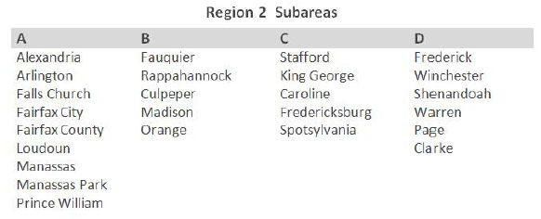
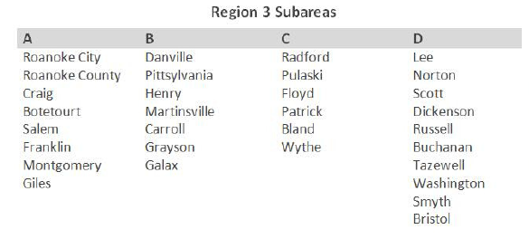
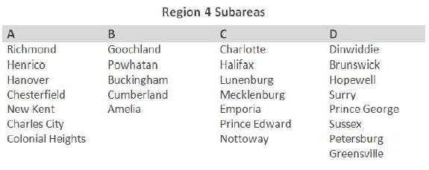
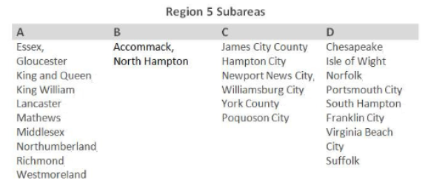
Regional Subareas
7/23/20
28
Notes:
For the following data, each of the 5 regions throughout the state are broken into 4 subareas. Take a second to look at these tables to determine which subarea your location falls.

Slide 29
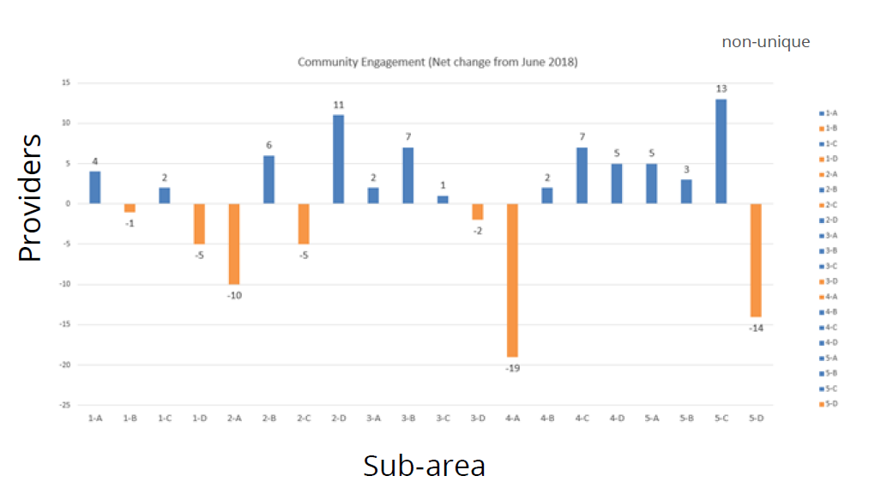
Community Engagement
7/23/20
Virginia Department of Behavioral Health & Developmental Services
29
Notes:
This is the non-unique data for Community Engagement. In regards to the non-unique data we will be looking at, it is possible that the provider shows up repeatedly across subareas.
As you can see, we lost 19 non-unique providers in subarea 4-A (which is the Greater Richmond Area) and 14 in 5-D (which is the Hampton Roads area South of Norfolk), and 10 in 2-A (which is Northern Virginia), while gaining 11 in 2-D (the Northwestern CSB catchment area), and 13 in subarea 5-C (which is Williamsburg and the Hampton Roads area South of Norfolk).

Slide 30
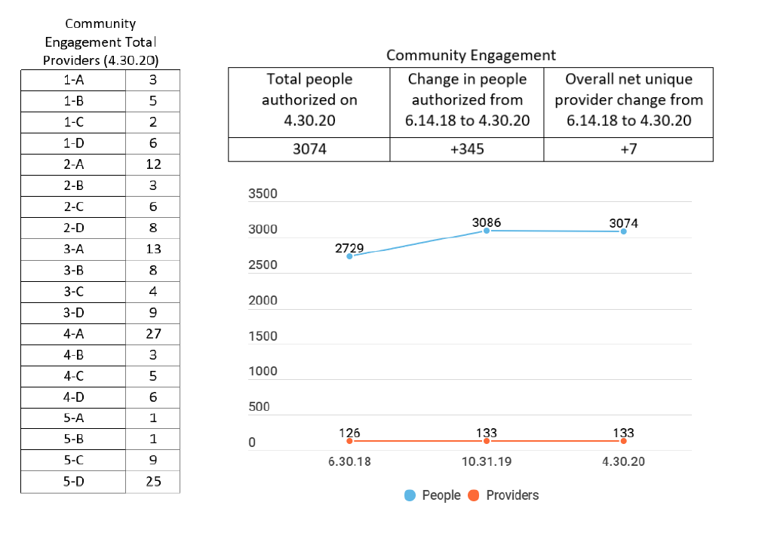
Community Engagement
7.12.19
Virginia Department of Behavioral Health & Developmental Services
22
Notes:
Here you see that as of the end of April, 3074 people were authorized for Community Engagement Services, which is an increase of 345 people since June 2018. Also, you can see there has been an overall net increase of 7 Community Engagement Providers in the state.

Slide 31
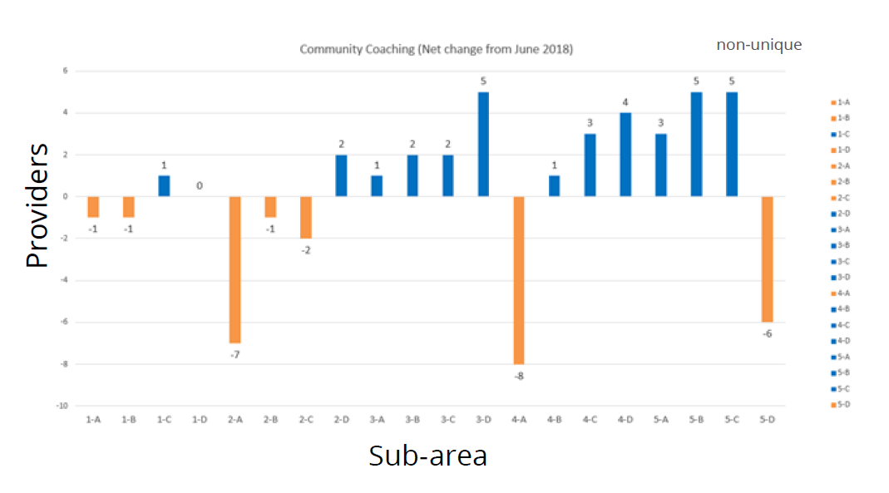
Community Coaching
7/23/20
Virginia Department of Behavioral Health & Developmental Services
31
Notes:
As for Community Coaching, the non-unique loss of providers are in the same regions as Community Engagement, and may have likely been some of those same providers. You see there was in increase of 5 non-unique providers in 3-D (or far southwest VA), as well as 5-B (Eastern Shore) and 5-C (Williamsburg and Hampton Roads west of Norfolk.

Slide 32
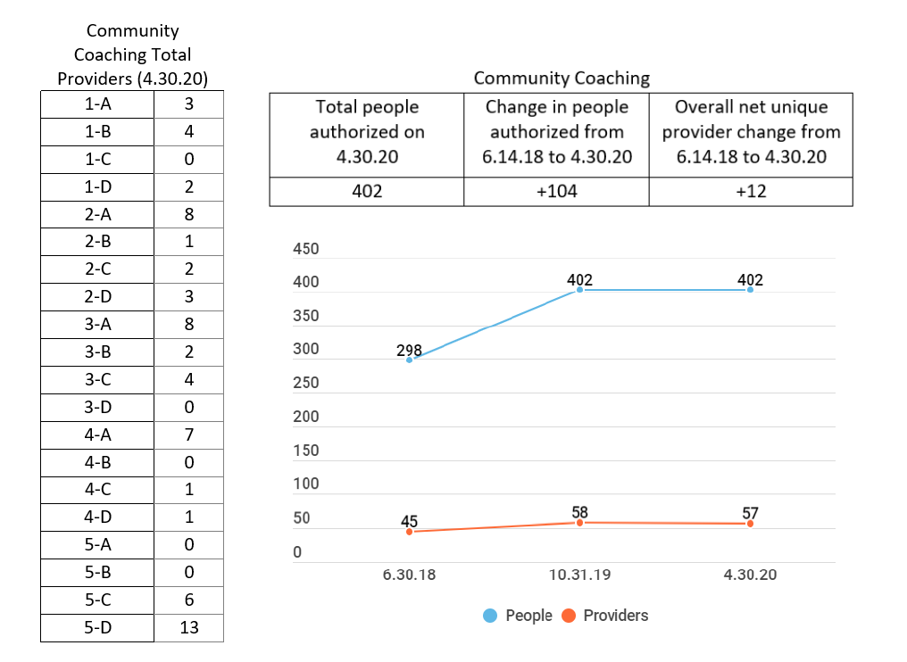
Community Coaching
7.12.19
Virginia Department of Behavioral Health & Developmental Services
23
Notes:
As we look at the data about unique authorizations and providers, we can see that as of 4/30/20, there were a total of 402 people with Community Coaching as a service, which is an increase of 104 since June 2018 with an overall increase of 12 providers.
As you can see to the left, that there is a lack of Community Coaching providers in 1-C, 3-D, 4-B, 5-A, and 5-B.

Slide 33
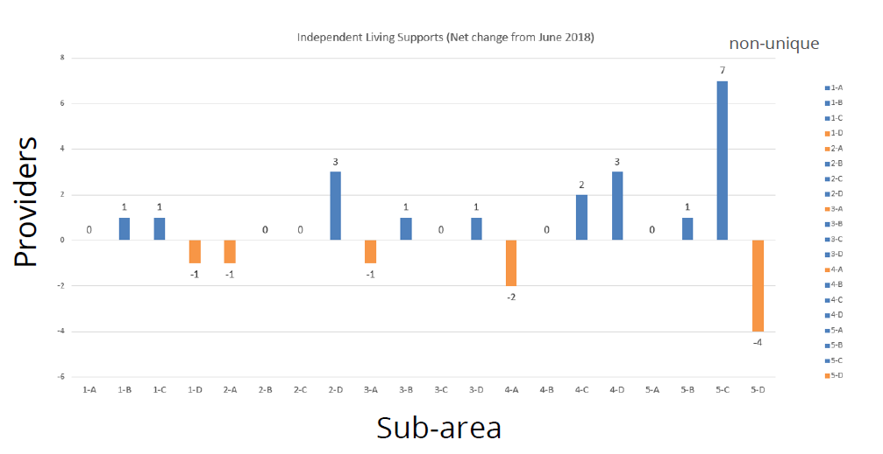
Independent Living Supports
7/23/20
Virginia Department of Behavioral Health & Developmental Services
33
Notes:
When we look at Independent Living supports, we can see an increase of 7 providers in the 5-C, with a loss of 4 in 5-D.

Slide 34
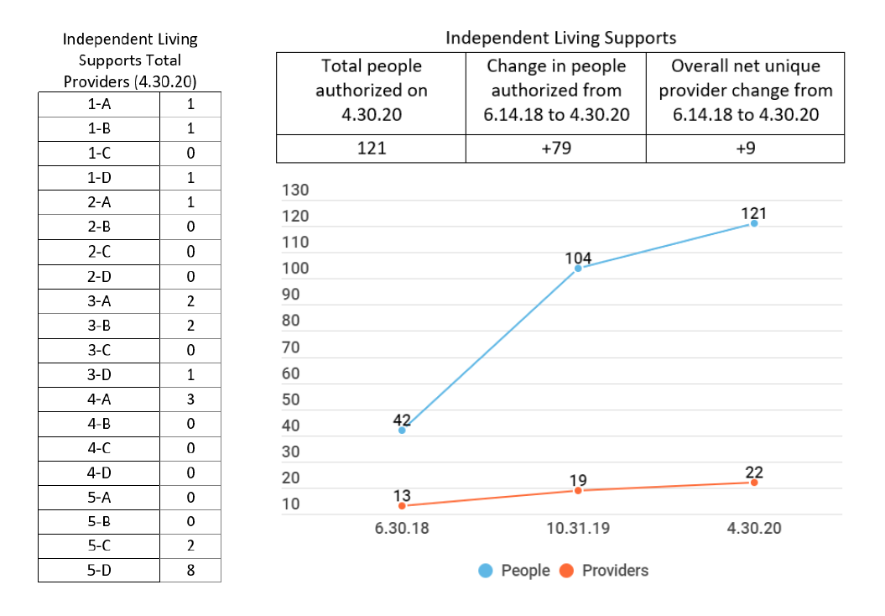
Independent Living Supports
7.12.19
Virginia Department of Behavioral Health & Developmental Services
23
Notes:
The unique authorization and provider data shows 121 people authorized for Independent Living, which is an increase of 79 people. There has been a net increase of 9 unique providers since June 2018.
As you look at the Total number of providers per subarea on the left, you will see there is a wide opportunity for expansion into Independent Living Supports throughout the entire Commonwealth. For those providers who have a license for Supportive In-home and would like to add Independent Living Supports in one of these subareas, JumpStart funding is available.

Slide 35
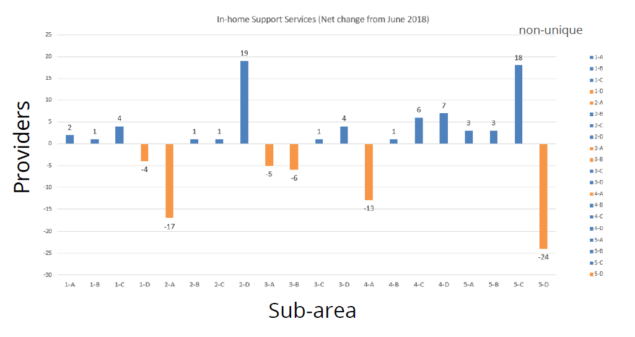
In-Home Support Services
7/23/20
Virginia Department of Behavioral Health & Developmental Services
35
Notes:
In Home Support Services have seen a decrease of non-unique providers, most notably in subareas 2-A, 4-A, and 5-D, with notable increases in 2-D and 5-C.

Slide 36
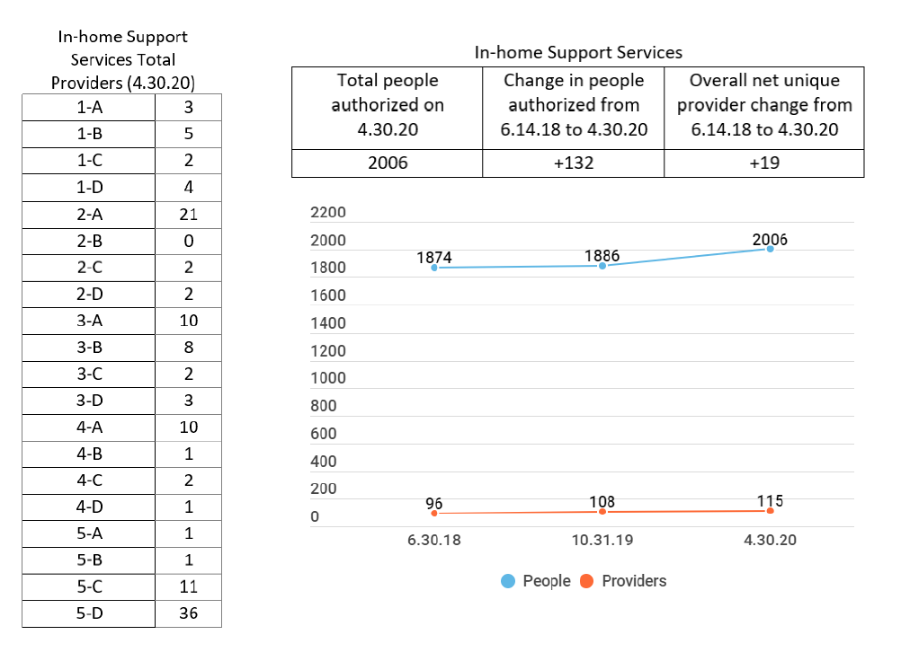
In-Home Support Services
7.12.19
Virginia Department of Behavioral Health & Developmental Services
24
Notes:
You can see here that total authorizations for In-Home as of the end of April are 2006, which is an increase of 132 since June 2018. There has been an overall net increase of 19 providers.
As the more people move from congregate settings into independent living situations and as the number of FIS Waivers awarded increases, there is going to continue to be a need for more In-Home providers throughout the state. As you look at the providers per subarea to the left, you can see that while there is a great opportunity to expand services in even some of the more densely populated areas of the Commonwealth.

Slide 37
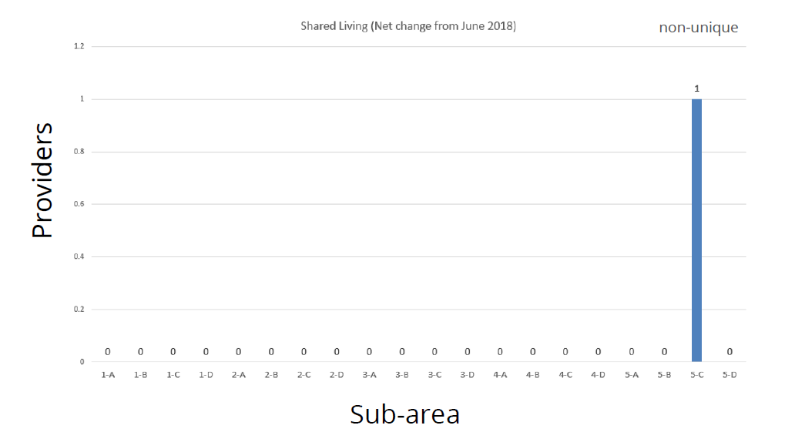
Shared Living
7/23/20
Virginia Department of Behavioral Health & Developmental Services
37
Notes:
This and the next chart both show that there is still currently only one provider of Shared Living here in Virginia.

Slide 38
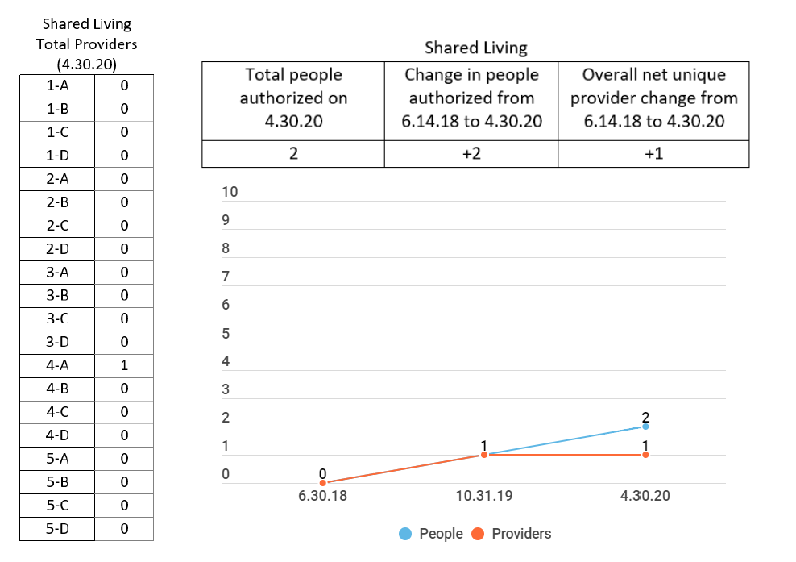
Shared Living
7.12.19
Virginia Department of Behavioral Health & Developmental Services
25
Notes:
That one provider serves 2 people, and they appear to be located in the Greater Richmond Area.
If you are interested in providing this service, please contact your Provider Team CRC to discuss how to get started and applying for JumpStart funding.

Slide 39
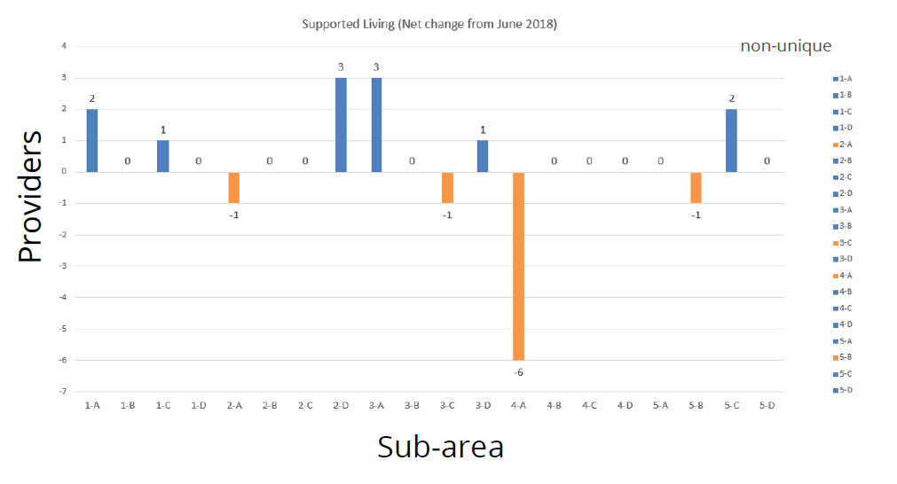
Supported Living
7/23/20
Virginia Department of Behavioral Health & Developmental Services
39
Notes:
You will see here that there has been a net change of negative 6 Supported Living providers in the Greater Richmond area.

Slide 40
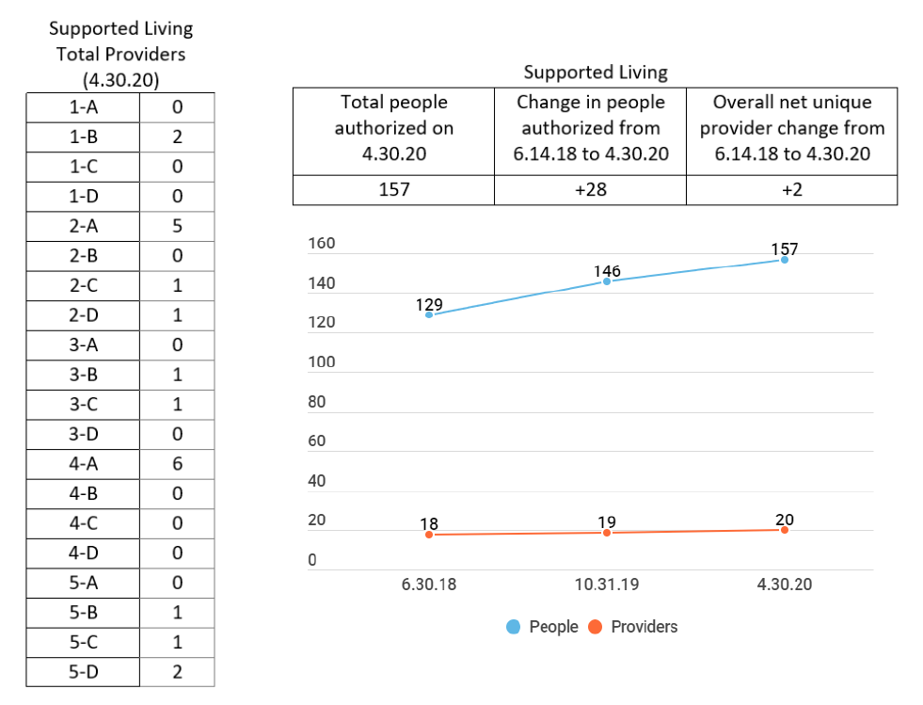
Supported Living
7.12.19
Virginia Department of Behavioral Health & Developmental Services
27
Notes:
As of the end of April, there were 157 people authorized for Supported Living, which is an increase of 28, with a net increase of 2 unique providers.
You can see to the left that there continues to be a need for Supported Living providers throughout the Commonwealth, as this service is one of the 2 residential support options for people with the FIS waiver.

Slide 41
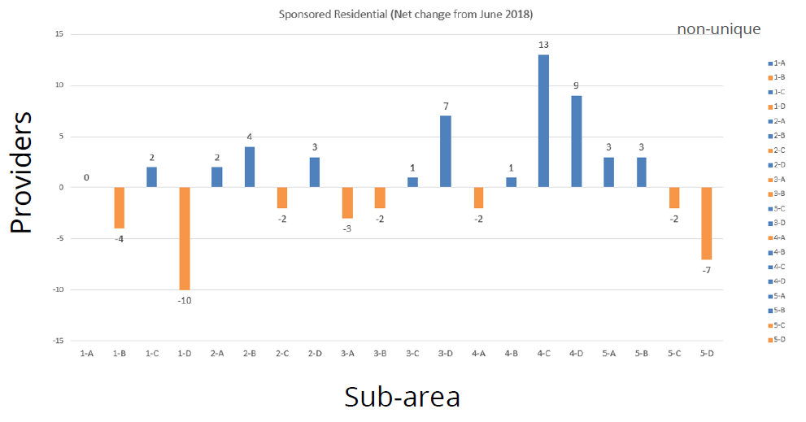
Sponsored Residential
7/23/20
Virginia Department of Behavioral Health & Developmental Services
40
Notes:
Notable non unique net changes in Sponsored Residential Services, are a net loss of 10 providers in subarea 1-D (Northwestern CSB catchment) and 7 in 5-D (Hampton Roads South of Norfolk). There were, however, a net gain of 13 non-unique providers in 4-C (Southside) and 9 in 4-D (District 19)

Slide 42
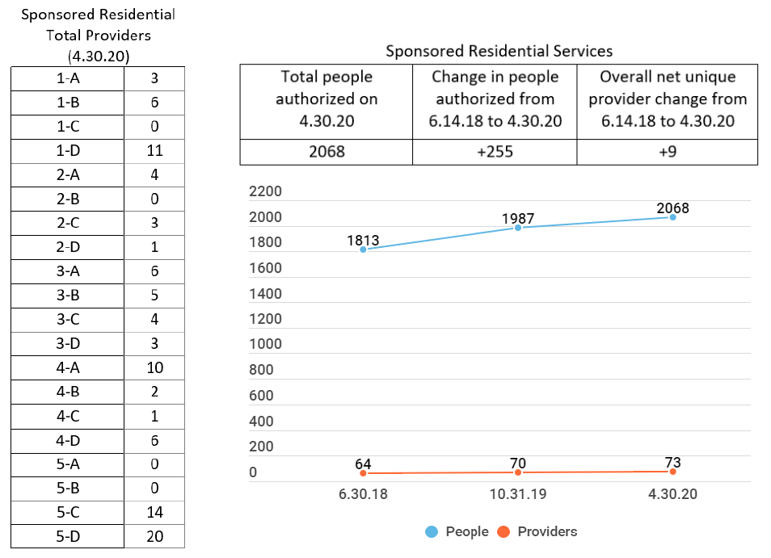
Sponsored Residential
7.12.19
Virginia Department of Behavioral Health & Developmental Services
28
Notes:
As we look at unique information, you can see that as of the end of April, there were 2068 people authorized for Sponsored Residential, an increase of 255 people from June 2018 and a net increase of 9 unique providers in that time period.
Subareas with no Sponsored Residential Providers are 1-C, 2-B, 5-A, and 5-B.

Slide 43
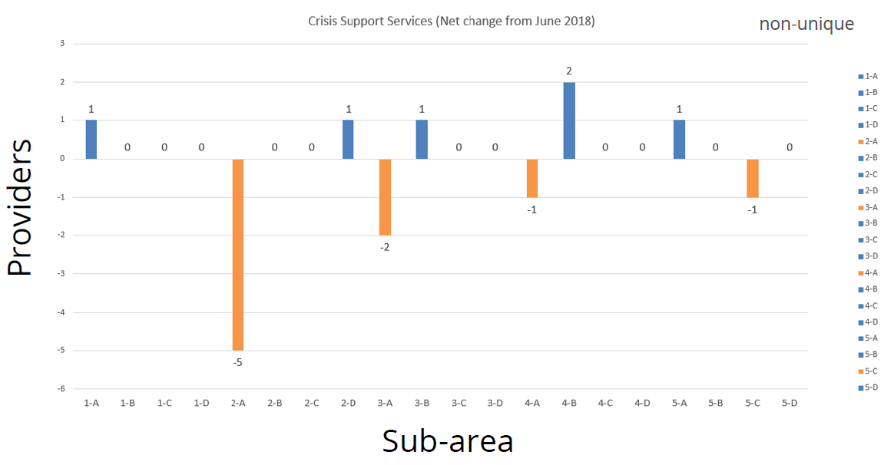
Crisis Support Services
7/23/20
Virginia Department of Behavioral Health & Developmental Services
43
Notes:
Most notable with Crisis Support Services was a loss of 5 non unique providers in 2-A (Northern VA)

Slide 44
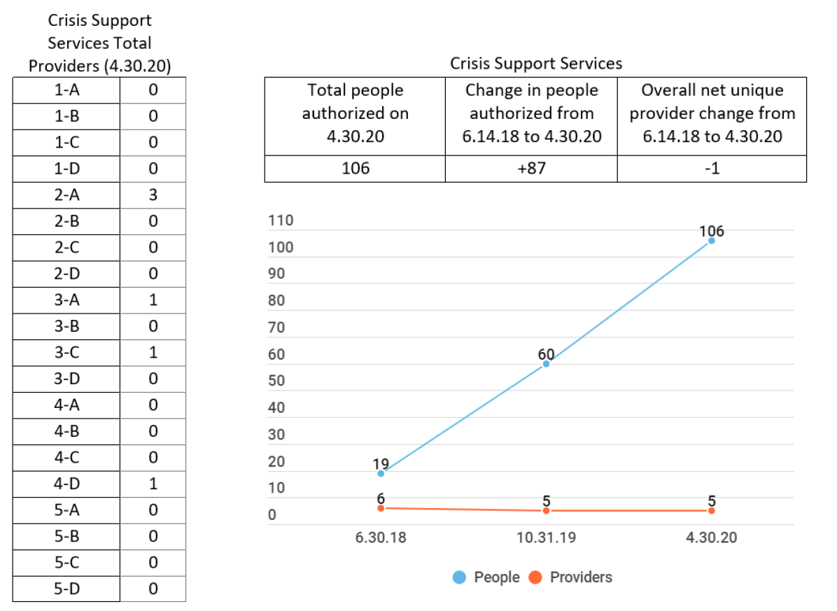
Crisis Support Services
7.12.19
Virginia Department of Behavioral Health & Developmental Services
31
Notes:
With a total number of authorizations for Crisis Support Services, that is an increase of 87 people, with a net loss of 1 unique provider.

Slide 45
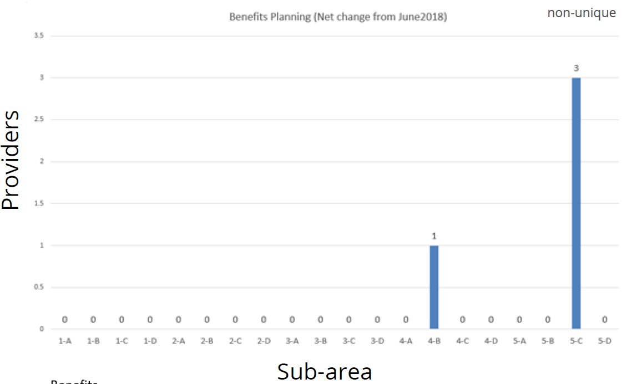
Benefits Planning
7/23/20
Virginia Department of Behavioral Health & Developmental Services
45
Notes:
Benefits planning shows an increase of 1 non-unique provider in 4-B (Goochland-Powhatan) and 3 in 5-C (Williamsburg and Western Hampton Roads)

Slide 46
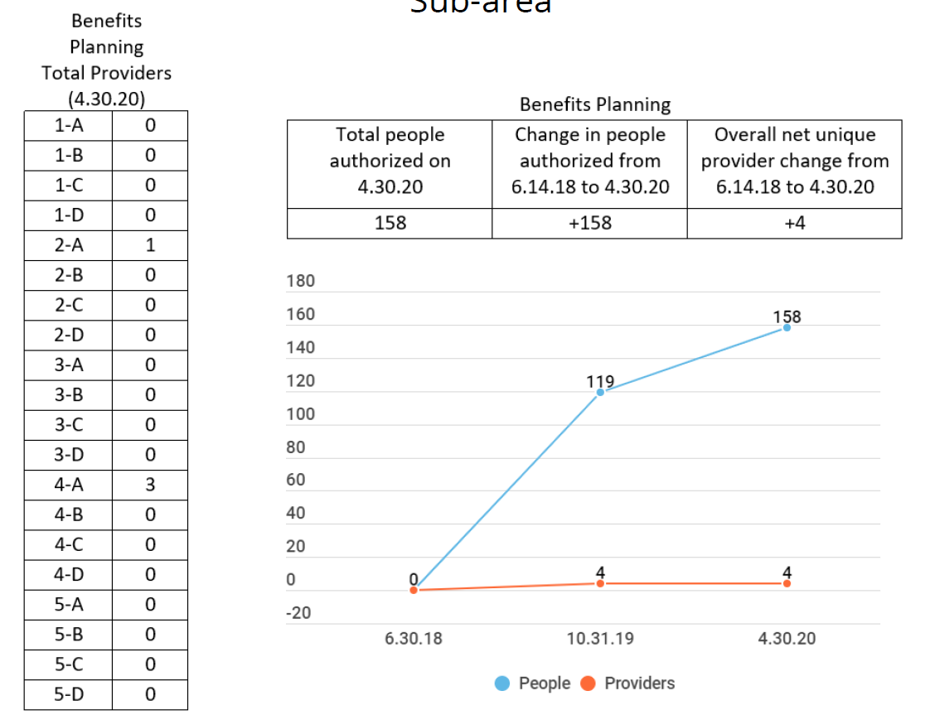
Benefits Planning
7.12.19
Virginia Department of Behavioral Health & Developmental Services
29
Notes:
Since Benefits Planning just started as a DD waiver service fairly recently, the total people authorized of 158 are all new authorizations, with 4 unique providers.

Slide 47
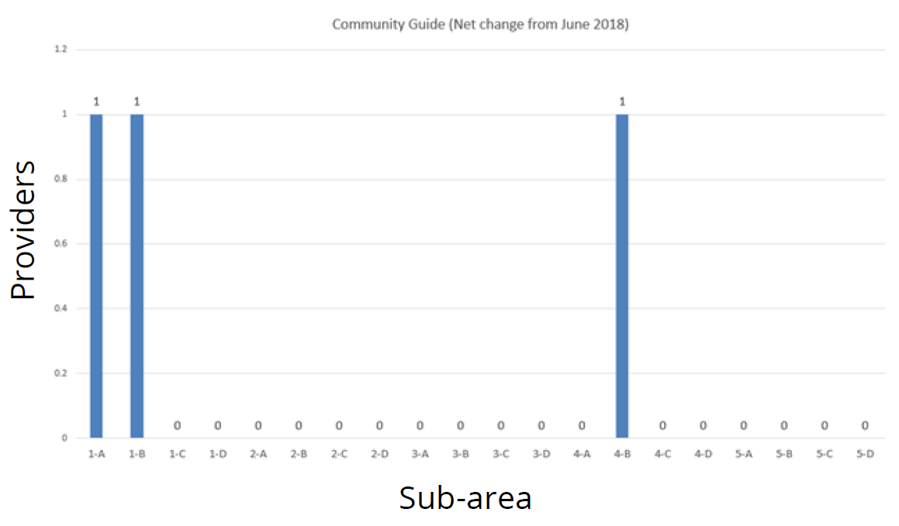
Community Guide
non-unique
7/23/20
Virginia Department of Behavioral Health & Developmental Services
46
Notes:
Community Guide is also a fairly new services with an increase of 1 non-unique provider in 1-A, 1-B, and 4-B.

Slide 48
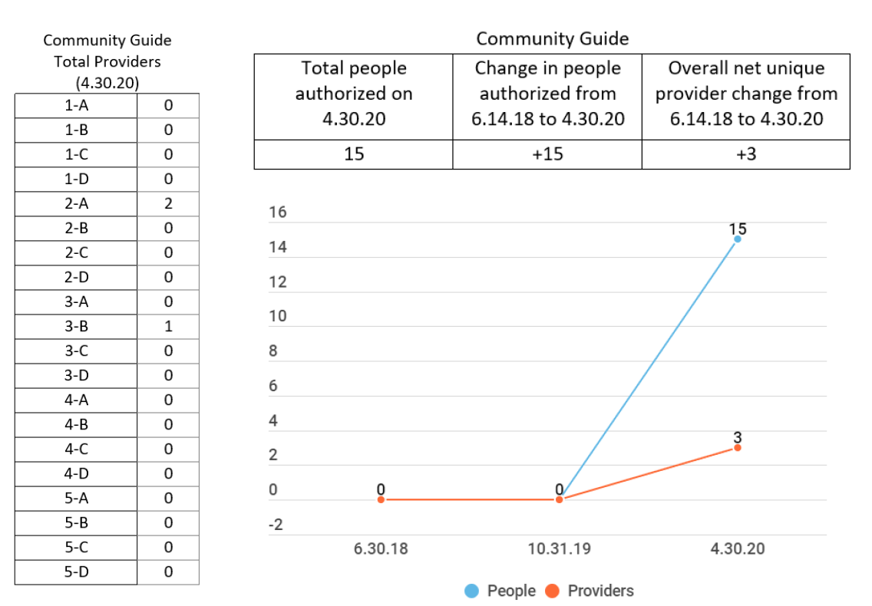
Community Guide
7.12.19
Virginia Department of Behavioral Health & Developmental Services
30
Notes:
With a total of 15 people authorized, there are 3 unique providers of this service, operating in Northern Virginia and the Danville-Pittsylvania area.

Slide 49
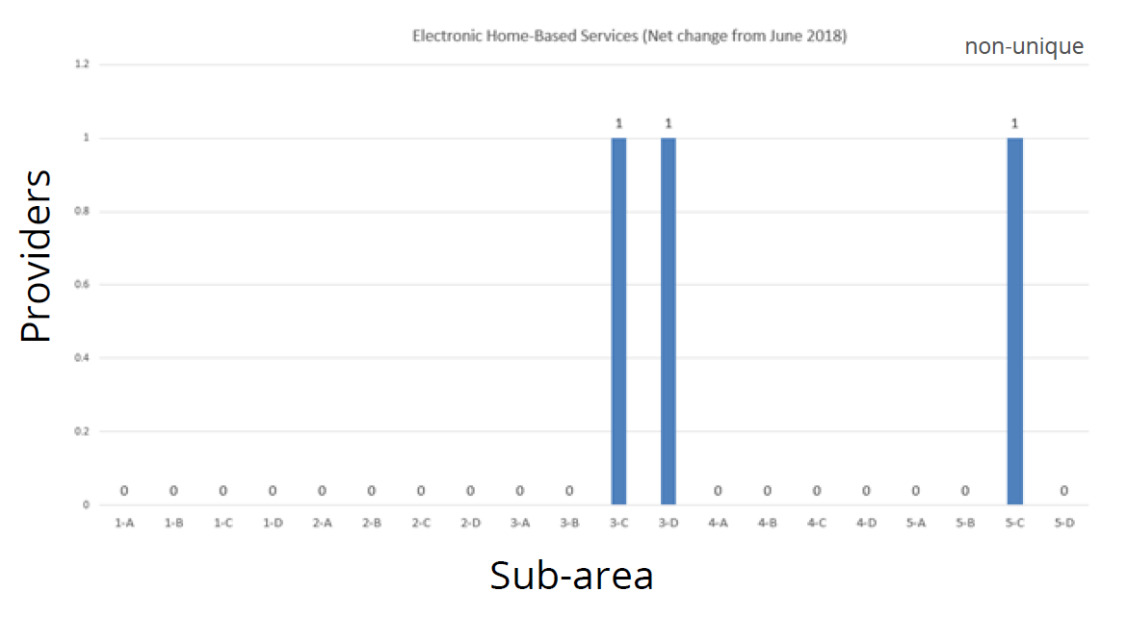
Electronic Home-Based Services
7/23/20
Virginia Department of Behavioral Health & Developmental Services
49
Notes:
Non-unique information for Electronic Home Based Services show an increase of 1 provider in each 3-C, 3-D, and 5-C.

Slide 50
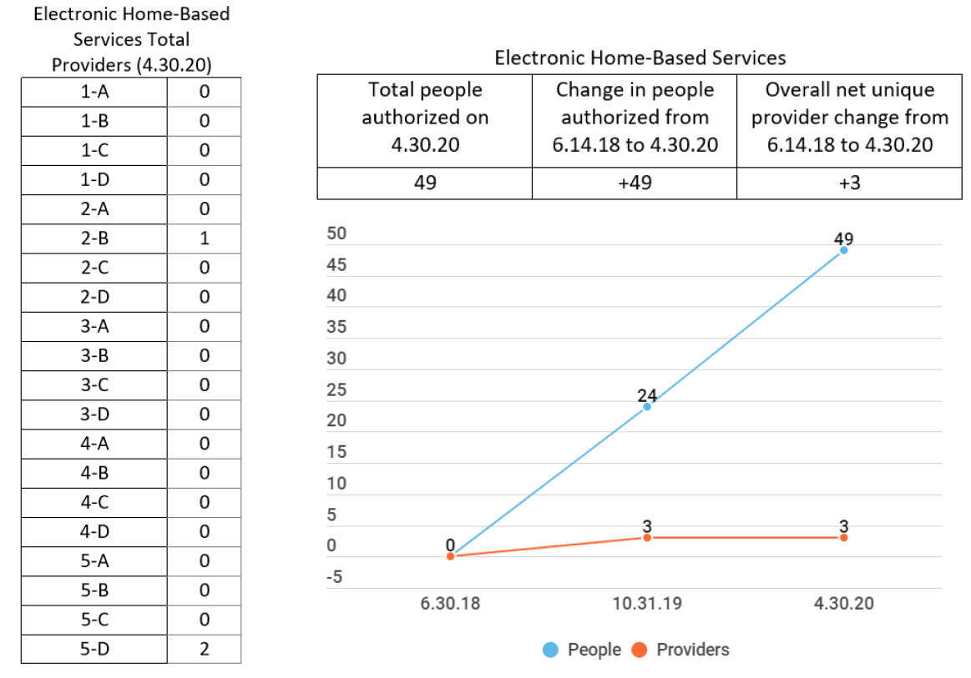
Electronic Home-Based Services
7.12.19
Virginia Department of Behavioral Health & Developmental Services
32
Notes:
Totals for Electronic Home Based Services are a total of 49 authorizations and there were 3 total unique providers as of 4/30.
Our CRC provider team has been in contact with some national companies who are considering offering their Electronic Home Based Services in our state in order to expand choices for individuals who want to live independently.

Slide 51
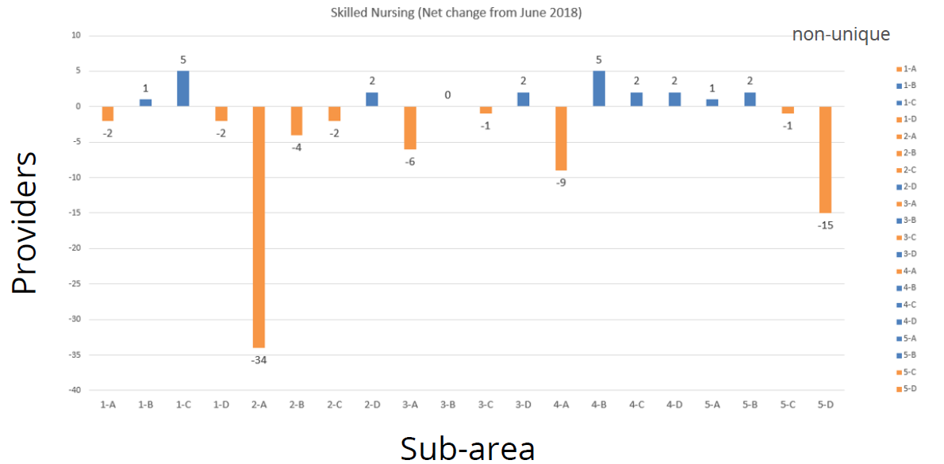
Skilled Nursing
7/23/20
Virginia Department of Behavioral Health & Developmental Services
51
Notes:
Most notable in the non-unique data for Skilled nursing was a loss of 34 providers in Northern Virginia and a loss of 15 for Southern Hampton Roads.

Slide 52
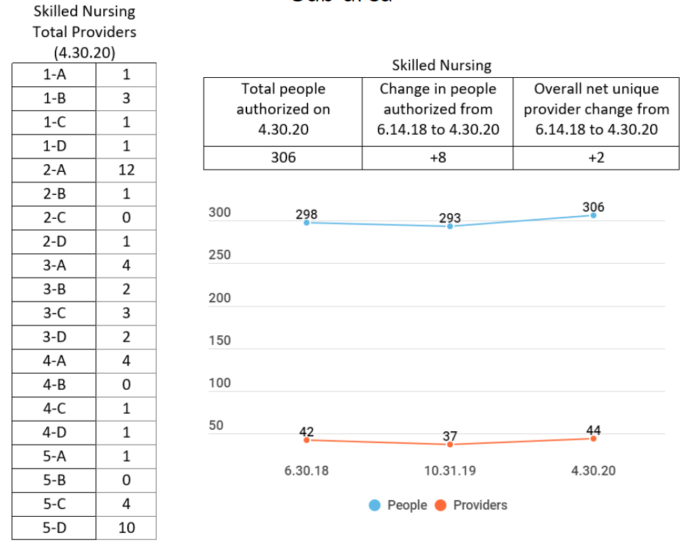
Skilled Nursing
7.12.19
Virginia Department of Behavioral Health & Developmental Services
33
Notes:
With a total number of authorizations being at 306 people, we see a net increase of 8. And while the previous report from November indicated a loss of 5 unique providers throughout the state, it appears we recovered those and then some with a net increase of 2 Skilled Nursing providers throughout the Commonwealth.

Slide 53
Private Duty Nursing
7/23/20
53
Notes:
Private Duty Nursing also shows a notable loss of 51 non-unique providers in Northern Virginia and 14 in Southern Hampton Roads; however, there was an increase of 23 non-unique providers in the Northwestern CSB catchment area.

Slide 54
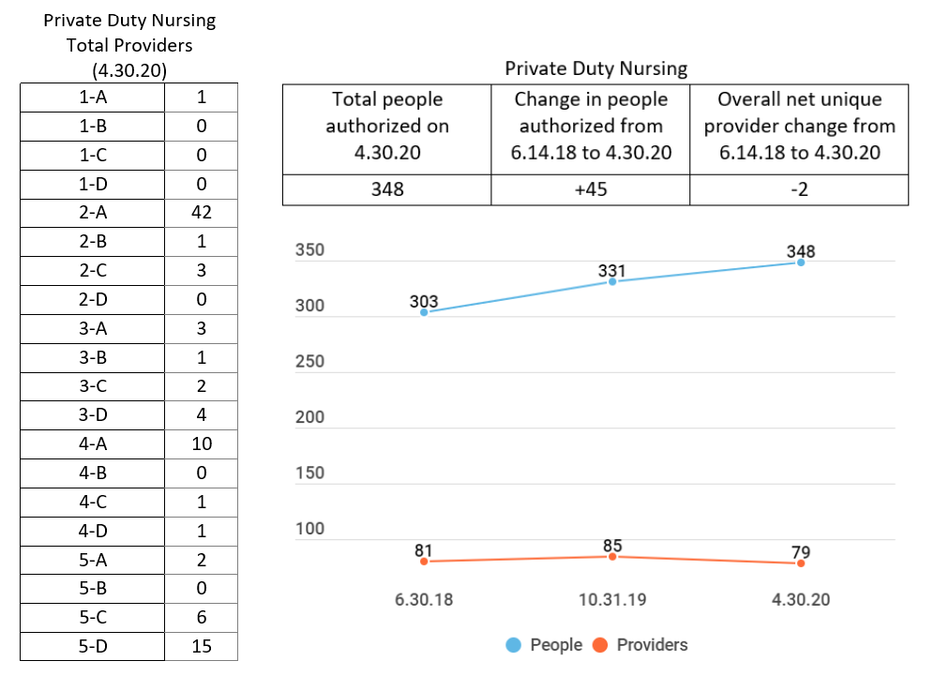
Private Duty Nursing
36
Notes:
Looking at unique data, there were a total of 348 people authorized for Private Duty Nursing as of 4/30, which is an increase of 45. There was an overall net loss of 2 unique Private Duty Providers.

Slide 55
Regional Support Teams
2nd and 3rd Quarters of 2020: 266 referrals
No individual moved into a less integrated setting when a more integrated setting was desired.
Most frequent barrier: Individual/SDM Choice includes:
Individual/ SDM/LG chooses less integrated option;
Individual/Substitute Decision Maker (SDM)/Legal Guardian (LG) not interested in discussing/exploring options/refuses supports;
Individual/SDM/LG does not choose provider after visit/still exploring community options
7/23/20
Virginia Department of Behavioral Health & Developmental Services
55
Notes:
Provider Development leads five Regional Support Teams (RSTs) designed to provide support with ensuring informed choice and with removing barriers to more integrated service options across Virginia. This section highlights findings from RST processes.
DBHDS is working to integrate the RST referral process into the Waiver Management System to ease communication, tracking and data reporting and is now incorporating RST barrier data in this Provider Data Summary report.
During the second and third quarters FY20, there was a combined total of 266 RST referrals. No individual moved into a less integrated setting when a more integrated setting was desired.
The barriers for the most integrated services were evaluated for frequency and location. The most frequent barrier was Individual/Substitute Decision Maker choice, and that includes:
Individual/ SDM/LG chooses less integrated option;
Individual/Substitute Decision Maker (SDM)/Legal Guardian (LG) not interested in discussing/exploring options/refuses supports;
Individual/SDM/LG does not choose provider after visit/still exploring community options
You will find charts relating to the frequency of each barrier organized by integrated service in the Provider Data Summary Report.

Slide 56
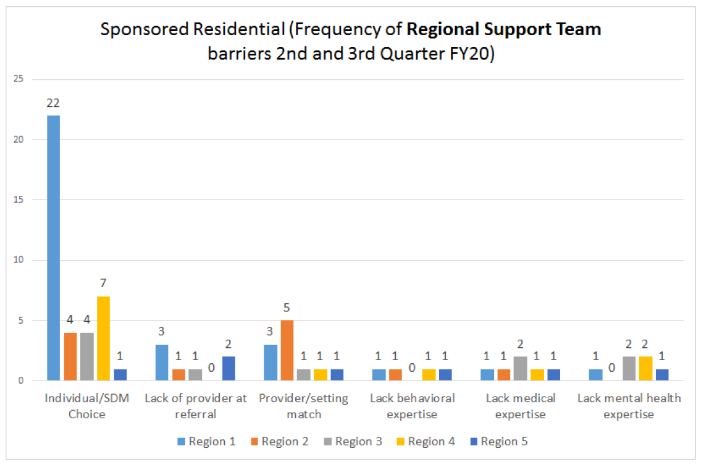
Regional Support Teams
RST Barrier Themes
Individual/SDM Choice
Lack of provider at referral
Provider/setting match
Lack behavioral expertise
Lack medical expertise
Lack mental health expertise
7/23/20
Virginia Department of Behavioral Health & Developmental Services
56
Notes:
Charts are included in the May 2020 report that provide details on five themes identified in the RST referral process and the distribution across
regions during the 2nd and 3rd quarter RST reports FY20. The data results were consolidated into the categories provided. Barriers counts are not inclusive of all possible barriers and may be
duplicated across referrals. These charts represent the frequency a barrier was reported by region, upon initial referral, and within one of five given themes.

Slide 57
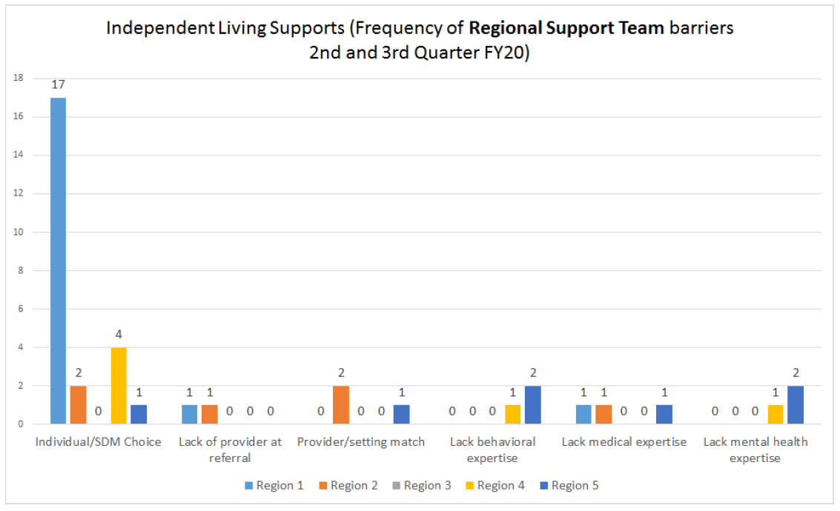
Regional Support Teams
7/23/20
Virginia Department of Behavioral Health & Developmental Services
57
Notes:
RST barrier theme frequencies for Independent Living Supports.

Slide 58
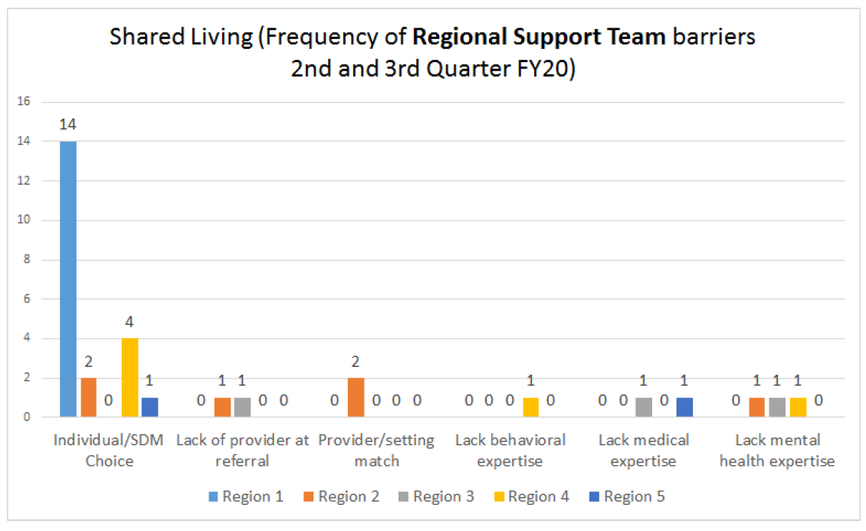
Regional Support Teams
7/23/20
Virginia Department of Behavioral Health & Developmental Services
58
Notes:
RST barrier theme frequencies for Shared Living.

Slide 59
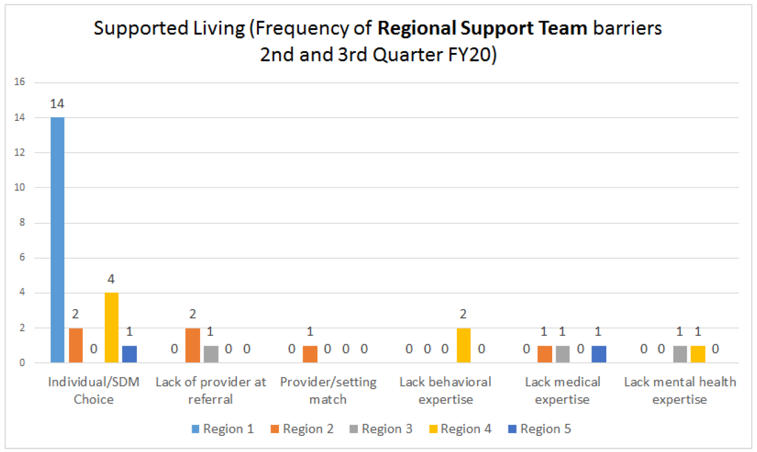
Regional Support Teams
7/23/20
Virginia Department of Behavioral Health & Developmental Services
59
Notes:
RST barrier theme frequencies for Supported Living.

Slide 60
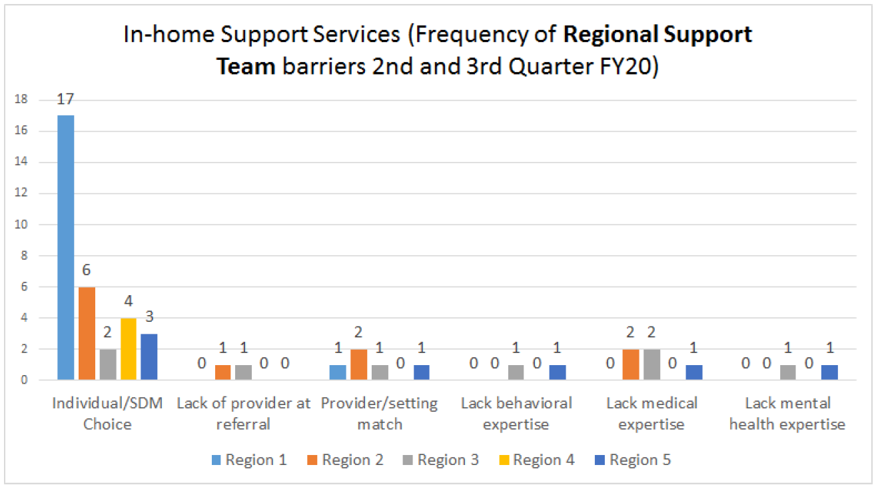
Regional Support Teams
7/23/20
Virginia Department of Behavioral Health & Developmental Services
60
Notes:
RST barrier theme frequencies for In-home Support Services.

Slide 61
Regional Support Teams
7/23/20
Virginia Department of Behavioral Health & Developmental Services
61
Notes:
RST barrier theme frequencies for Sponsored Residential.

Slide 62
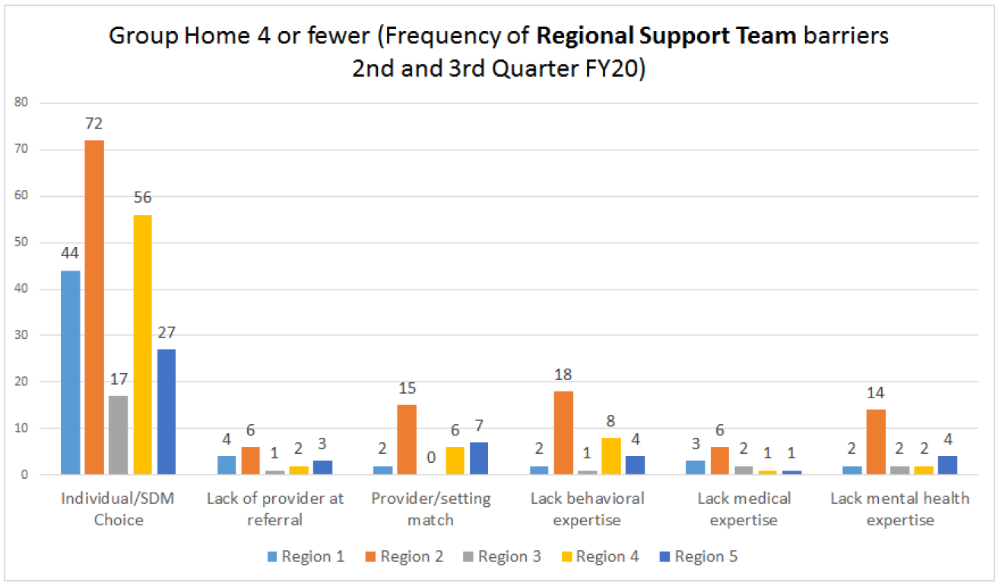
Regional Support Teams
7/23/20
Virginia Department of Behavioral Health & Developmental Services
62
Notes:
RST barrier theme frequencies for Group Home <5.

Slide 63
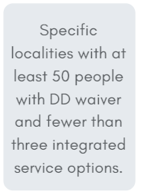
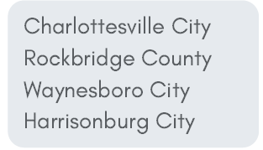
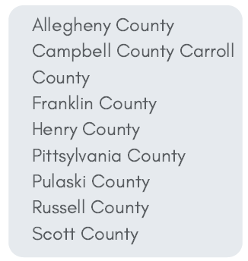
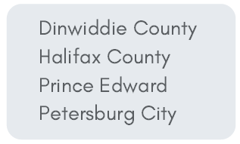
Opportunities
1
2
3
5
4
7/23/20
Virginia Department of Behavioral Health & Developmental Services
63
Notes:
Opportunities to start or expand services are available in these localities that have at least 50 people with DD Waiver and fewer than 3 integrated service options.

Slide 64
Next Steps
quality improvement initiative to increase the number of individuals in independent housing
in partnership with CSBs, establish a standard process to assess for changes in a person's status and to confirm that the ISP is implemented appropriately
increase the availability of remote instruction for person-centered practices trainings work directly with providers to address barriers to service provision with a concentrated focus on Community Guide, Employment and Community Transportation, Peer Mentoring, Crisis Supports Services, and Skilled Nursing,
continued participation in the community of practice initiative around Charting the Lifecourse©,
develop plans for the next Provider Innovation Collaborative to be held in the Spring of 2021 (depending on the state of emergency),
increasing the number of providers per region identified as having expertise to support people with complex needs, and
centralizing access to training resources for providers and Support Coordinators.
7/23/20
Virginia Department of Behavioral Health & Developmental Services
64
Notes:
Next steps for Provider Development include:
assist the DBHDS Housing office with a quality improvement initiative to increase the number of individuals in independent housing
in partnership with CSBs, establish a standard process to assess for changes in a person's status and to confirm that the ISP is implemented appropriately
increase the availability of remote instruction for person-centered practices trainings work directly with providers to address barriers to service provision with a concentrated focus on Community Guide, Employment and Community Transportation, Peer Mentoring, Crisis Supports Services, and Skilled Nursing,
continued participation in the community of practice initiative around Charting the Lifecourse©,
develop plans for the next Provider Innovation Collaborative to be held in the Spring of 2021 (depending on the state of emergency),
increasing the number of providers per region identified as having expertise to support people with complex needs, and
centralizing access to training resources for providers and Support Coordinators.

Slide 65
Questions & Suggestions
For more information, visit Provider Development online at
http://www.dbhds.virginia.gov/developmental-services/provider-development
7/23/20
Virginia Department of Behavioral Health & Developmental Services
65
Notes:
Now we’d like to open the floor for any questions and suggestions you all might have.
(To end) You can find the May 2020 Provider Data Summary report and other information regarding the initiatives of the Office of Provider Development at the webpage on your screen.

