Slide 1

Waiver Redesign Informational Series
June 2016
Office of Provider Development
Division of Developmental Services
Department of Behavioral Health and Developmental Services

Slide 2
People with developmental disabilities living, working, and participating in their own communities is becoming the norm,
not the exception.

Slide 3
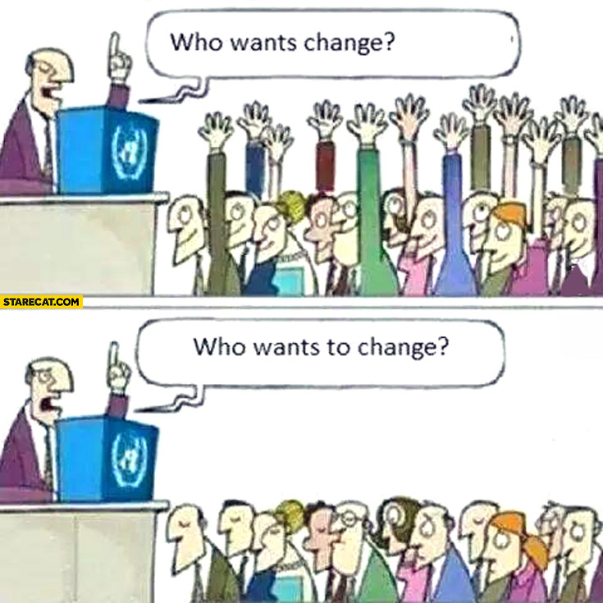
My Life, My Community
Notes:
Notes:
Lots of people want change, but they themselves don’t want to change. But, in Virginia, we must change. We must change our current system and way of thinking in order to achieve a better result. We cannot honestly continue with the current structure and expect better results, and better results are expected! They are expected by the DOJ (Settlement Agreement), CMS (HCBS Setting Requirements and Person Centered Practices), and more importantly, by families and individuals.

Slide 4
My Life, My Community
Beginning July 1, 2016
or upon CMS approval
Amended waivers with new services
New group home rates
CSBs assume single point of entry for all DD waivers
New eligibility process and tool (VIDES)
New slot assignment procedures
New support levels and reimbursement tiers
New Waiver Management System to replace IDOLS
Single statewide priority-based waitlist

Slide 5
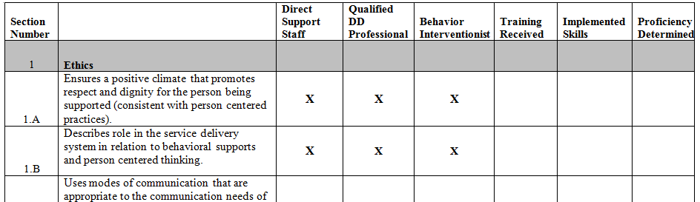
My Life, My Community
Beginning July 1, 2016
or upon CMS approval
Updated orientation manual to include health risks and related staff competencies
Behavioral and Autism Competencies currently available

Slide 6
My Life, My Community
Coming Soon!
Employment and Day Services Training Video
Waiver Management System Training
Virginia Individual DD Eligibility Survey (VIDES)online training
Community Connections training

Slide 7
My Life, My Community
What we will cover today…
My Life, My Community
Wait List, eligibility & slot assignments
Individual levels & reimbursement tiers
HCBS Settings Regulations and Housing Choice Vouchers
Services and support options across all DD waivers
Integrated Supports & The Planning Calendar
Introduction to Provider Competencies
Notes:
Notes:
We are adopting the overarching term “DD,” which includes ID.

Slide 8






My Life, My Community
Our opportunities are impacted on how strong or weak our links are to others in the greater community in which we live.
Employment and Alternate Day Options
Self-Directed Options
Residential Options
Crisis Support Options
Medical and Behavioral Support Options
Additional Options
Notes:
Notes:
A chart of new services is included near the end of the presentation and more information can be found on the DBHDS website – a website address is also included at the end of the presentation.
NOTE: The new services described here have not yet been approved by CMS. Similarly, changes to existing services have not yet been approved. Be aware that all additions and changes are still in the PROPOSED state for now.

Slide 9
My Life, My Community
Since 2013
DMAS and DBHDS have worked diligently – engaging the expertise of consultants and stakeholders across the Commonwealth in redesign efforts.
These efforts have led to amending the ID, DD and DS waivers and increasing services and options that promote community integration and engagement.
Notes:
Notes:
The Department of Medical Assistance Services (DMAS) and Department of Behavioral Health Developmental Services (DBHDS) have worked diligently for two years, engaging the expertise of consultants as well as stakeholders across the Commonwealth, to redesign Virginia’s Home and Community Based Services waivers (HCBS) for individuals with intellectual and other developmental disabilities. The redesign combines the target population of individuals with both intellectual disability and other developmental disabilities and offers services that promote community integration and engagement. These waivers are now referred to DD Waivers.

Slide 10
My Life, My Community
Since 2013
Families, advocates, self-advocates, providers and CSBs have joined with DBHDS to redesign Virginia’s DD Waiver system.
They focused on maximizing each individual’s life in his or her community with increased flexibility, new options and improved access.
Many stakeholders were involved on committees and sub-committees to design the new waivers.
Notes:
Notes:
Since 2013, families, advocates, self-advocates, providers and community services boards have joined with the Department of Behavioral Health and Developmental Services to redesign Virginia’s waiver system for individuals with intellectual and developmental disabilities. The goal is to help maximize each individual’s life in his or her community with increased flexibility, new options and improved access to waiver supports and services.

Slide 11

My Life, My Community
Provides individuals and families with…
More targeted, needs-based services
Increased flexibility in service options
Easier navigation through the waiver process
The ability to more easily change options as needs change
Notes:
Notes:
What does this mean for individuals and families?
The redesign of the intellectual and developmental disability waivers will provide more targeted, needs-based services for individuals and families and increase flexibility in service delivery options. These efforts will ease navigation through the waiver process. The resulting benefits will enable people to change services more easily as their needs evolve.

Slide 12

My Life, My Community
Gives providers…
Enhanced service delivery options
Increased flexibility in service design
Rates that better ensure qualified, well-trained staff to support individuals’ changing needs
Rates that incentivize and support smaller, more community integrated residential settings
Notes:
Notes:
What does this mean for providers?
For providers, the intellectual and developmental disability waivers’ redesign means that there will be enhanced service delivery options and increased flexibility in service design. This will be reflected in rates that promote qualified and well-trained staff to better support individuals with their changing needs.

Slide 13
DD Community Based System
My Life, My Community
Person Centered
Fair and Equitable
Data Accountability
Community Focused
New Services & Supports
Self Direction
Needs Based
Notes:
Notes:
The key elements for the system. In part, this started with the Settlement Agreement, which is about how the system should be. The March 2014 CMS Home & Community Based Waivers is also an aspirational directive. The move to one system is the focus instead of having one for large facilities and one for community. The changes also merge two different systems ID and DD into a single community-based system of person-centered services and supports for people with ID and DD.

Slide 14
Proposed Integrated DD Waiver Redesign
Day Support Waiver
DD Waiver
ID Waiver
Building Independence Waiver
For adults (18+) able to live independently in the community. Individuals own, lease, or control their own living arrangements and supports are complemented by non-waiver-funded rent subsidies.
Family & Individual Supports Waiver
For individuals living with their families, friends, or in their own homes, including supports for those with some medical or behavioral needs. Available to both children and adults.
Community Living Waiver
Includes residential supports and a full array of medical, behavioral, and non-medical supports. Available to adults and children. May include 24/7 supports for individuals with complex medical and/or behavioral support needs through licensed services.

Slide 15

My Life, My Community
Waiver Experts
Notes:
Notes:
Each CSB will have Waiver Experts
Experts will train their SCs on adult VIDES before the SCs use the survey.
CRCs will provide children's VIDES materials later to Experts to train their staff.
CRCs will combine both trainings and place on LMS.

Slide 16
Virginia Individual DD Eligibility Survey (VIDES)

Slide 17
VIDES
Replaces the Level of Functioning Survey (LOF)
Used initially and annually by the SC/CM to confirm functional eligibility for the DD Waivers.
Includes versions for infants, children and adults.

Slide 18
VIDES
The infant VIDES has 5 categories instead of 7.
Infants must met 2 of the 5 categories
The child and adult VIDES have each have 8 categories instead of 7.
Children and Adults must meet 3 categories instead of 2.

Slide 19

VIDES
SCs and CMs will be trained by their Waiver Experts before using the VIDES.
Coming soon online training for the VIDES
Notes:
Notes:
Handouts DBHDS Memo and instructions
Initial VIDES are completed by the CSB. Annual VIDES are completed by the individual’s SC/CM.

Slide 20
Combined Statewide Waiver Wait List

Slide 21

Statewide Waiver Wait List
A significant change in the amended waivers is the eligibility of individuals with developmental disabilities for services through any of the three amended waivers.

Slide 22
Statewide Waiver Wait List
All three amended waivers will serve individuals with a diagnosis of DD (which includes ID).
Individuals seeking waiver services for persons with any developmental disability will have diagnostic and functional eligibility confirmed by their local CSB and, as appropriate, be placed on a single state wide waiting list.
Waiver wait lists will be maintained by the local CSB for all individuals under their jurisdiction, including those served by private DD CM agencies.
Notes:
Notes:
Note that second bullet includes those with ID.

Slide 23
Streamlined, Needs-Based Access
Current Process
Revised Process
Individual with ID
Individual with DD
Individual with ID or DD
CSB
Child Development Clinic
CSB
Private DD CM
Eligibility
Eligibility
Waiting List
(based on urgency)
Waiting List
(based on chronology)
Single, Consolidated Waiting List
(based on priority of need)
Building Independence
OR
Family & Individual Support
OR
Community Living Waiver
Day Support
Waiver
ID
Waiver
DD
Waiver
Notes:
Notes:
At present, the ID Waiver wait list is based on the urgency of a person’s need for services. The DD Waiver wait list is chronological and based on the date a person’s need for waiver services is identified.
An important aspect of waiver redesign is the transition to a single statewide waiting list for all three of the new waivers. The wait list will be based on need and individuals will be grouped into one of the three “priority needs” categories.

Slide 24
Statewide Waiver Wait List
5 DBHDS Regional Supports Specialists (RSSs) based at DBHDS, will assist CSBs to manage this process, and support the Waiver Slot Assignment Committees (WSACs).
The amended waivers separate the eligibility determining entity (CSB SCs) from the slot assignment entity (DBHDS-supported committees of community members).

Slide 25
Waiver Slot Assignment Committees (WSACs)
An impartial body of trained volunteers for each locality/region responsible for assigning waiver slots according to urgency of need.
Comprised of community members who will not be affiliated with a CSB or a private provider
Members have some knowledge and/or experience with persons with DD or the service system.
WSCAs members will receive training, maintain confidential information and meet as required to determine persons with the highest level of need.

Slide 26
Waiver Slot Assignment Committees (WSACs)
DBHDS will review applications and appoint members with
Diverse personal and professional backgrounds
Varied knowledge and expertise
No conflict of interest
A DBHDS-trained facilitator will serve each committee.
DBHDS will work with adjoining CSBs to form unified committees to promote additional consistency.
Notes:
Notes:
Neighboring CSBs are strongly encouraged to form a single committee to cover more than one CSB area.

Slide 27
Waiver Slot Assignment Committees (WSACs)
Additional information about WSACs:
When assigning, slots remain with the Community Services Board or Behavioral Health Authority designated. It is not possible for one CSB to receive another CSB’s slots.
Prior to each committee meeting, WSAC facilitators will confirm that none of the members present knows or believes they might know any of the individuals to be reviewed. If any member knows or believes they might know an individual to be reviewed, they will abstain from decision-making for that slot or slots.

Slide 28
Waiver Slot Assignment Committees (WSACs)
Nominated members may be:
Family members of an individual currently receiving services
Graduate students studying a human services field (e.g., psychology, social work) or special education
University professors of a human services field
Member/staff member/board member of an advocacy agency that does not provide any direct services (e.g., Center for Independent Living, local Arc, autism advocacy agency)
Current special education teachers/transition coordinators

Slide 29
Waiver Slot Assignment Committees (WSACs)
Nominated members may be (cont):
Nurses/physicians
Retired or former (for over one year) CSB, private provider or Health and Human Services state employees
Clergy members
Especially recommended is that at least one member of each committee have experience with individuals with a developmental disability other than ID

Slide 30
Waiver Slot Assignment Committees (WSACs)
Nominated members may not be:
X any person with a direct or indirect interest in the outcome of the proceedings:
Current CSB employees or board members
Current employees, owners, or board members of any agency providing waiver services, unless serving on a WSAC in an area in which the provider does not provide services
Family members of individuals seeking waiver services

Slide 31
Waiver Slot Assignment Committees (WSACs)
Responsibilities of WSAC Members:
Participate in DBHDS training
Review information presented regarding nominees for vacant slots
Hold confidential all information reviewed
WSACs will meet as required to determine persons with the highest level of need.

Slide 32
Waiver Slot Assignment Committees (WSACs)
Additional information about WSACs:
When assigning, slots remain with the Community Services Board or Behavioral Health Authority designated. It is not possible for one CSB to receive another CSB’s slots.
Prior to each committee meeting, WSAC facilitators will confirm that none of the members present knows or believes they might know any of the individuals to be reviewed. If any member knows or believes they might know an individual to be reviewed, they will abstain from decision-making for that slot or slots.

Slide 33
DD Waivers’ Eligibility Factors
Eligibility
Possess a diagnosis of DD
Meet level of care criteria (determined by the VIDES)
Meet Medicaid financial eligibility
Accept services within 30 days
Notes:
Notes:
Diagnostic
Established by psychological or diagnosis determined by a licensed professional evaluator.
Functional
Confirmed as meeting ICF/IID level of care through the completion of the VA Individual DD Eligibility Survey (VIDES).
Financial
Determined by Dept. of Social Services using special institutional deeming rules.
In addition:
Waiver services must be an appropriate alternative to an Intermediate Care Facility for Individuals with Intellectual Disability (ICF/IID)
delay or avoid placement
promote exiting from an ICF/IID or other institutional setting

Slide 34
Eligibility
If a slot is not available, the SC:
Determines the individual’s priority needs level
Places the person’s name on the waiting list via WaMS
Completes a Critical Needs Summary documenting the person’s level of urgency
Notes:
Notes:
The “Critical Needs Summary” form has been revised and is now part of the “Step 1 Review.”

Slide 35
Eligibility
Priority One Status
Priority Two Status
Priority Three Status
Will need waiver services within one year and meets specific criteria
May require waiver services in one to five years and meets specific criteria
May not present for waiver services in over five years as long as the current supports and services remain
Handout: DD Waiver Priority Needs Checklist
Notes:
Notes:
Criteria described on handout .

Slide 36
Eligibility
To be considered for slot assignment, an individual must:
Be determined to meet one of the Priority One criteria
Accept the specific Waiver if it were offered
And continue to…
Meet diagnostic and functional eligibility requirements
Be willing to accept services within 30 days
Notes:
Notes:
For the last bullet, acceptance may also be from the individual's spouse or the parent of an individual who is a minor child

Slide 37
Eligibility
When the CSB has slots available for assignment they contact the WSAC facilitator who calls a meeting. The top scoring Critical Needs Summary individuals (Step 1) are included in the WSAC’s Slot Assignment Scoring Summary (Step 2)
Slot Assignment Review Forms for these individuals are forwarded to the WSAC facilitator for distribution prior to the meeting
After WSAC slot assignment determination, the CSB proceeds with waiver enrollment and completes the Supports Intensity Scale (SIS)

Slide 38
Slot Assignments
Allocation of more than 40 slots
When the General Assembly allocates more than 40 slots for a given waiver, allocations will be made by providing one slot per board then a standard calculation (considering priority numbers per board) will be used to disseminate the remaining slots.

Slide 39
Allocation of fewer than 40 slots
Slot Assignments
When the General Assembly allocates fewer than 40 slots for a given waiver, allocations will be made by combining all WSACs within a region. Each WSAC will be represented by the assigned facilitator and two additional representatives per committee.

Slide 40
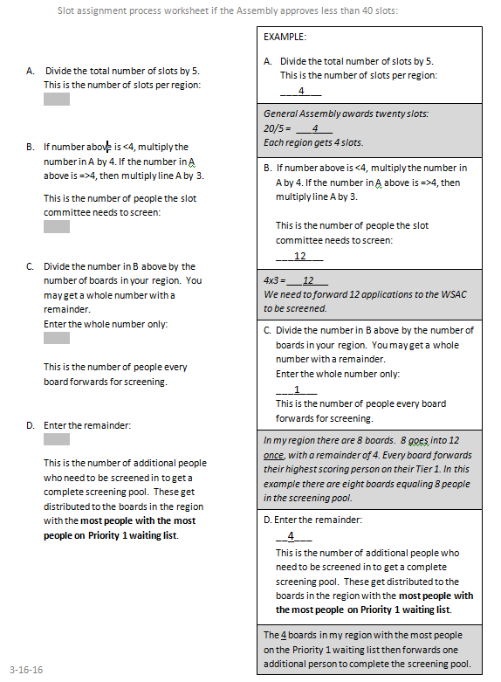
Slot Assignments
Slot Assignment Worksheet when fewer than 40 slots
Handout: Slot Assignment Worksheet

Slide 41
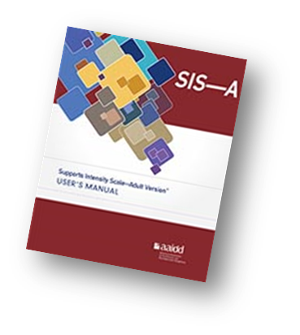

Supports Intensity Scale
Measures support needs in the areas of home living, community living, lifelong learning, employment, health and safety, social activities, and protection and advocacy

Slide 42

Reserve/Emergency Slots
Reserve slots support emergencies and movement between the waivers.
Reserve/emergency slots are managed by DBHDS.
Notes:
Notes:
Emergency Slots will not be repaid by the CSB until the number of available emergency slots has reached 10% of the existing emergency slots (or a minimum of 3 slots). At that point repayment will be required in order to ensure slots remain to be assigned to future emergencies within the fiscal year.
Reserve slots for movement between waivers are to support individuals who are already receiving services in one of the three DD waivers and:
experience a change in their assessed needs requiring services available in a different waiver
choose to live in a more independent setting, such as an apartment, and transfer to a different waiver that better supports this choice. The reserve slots enable a safety net with which an individual can return to the original waiver, if needed.

Slide 43
Reserve/Emergency Slots
Emergency Criteria:
CPS or APS has substantiated abuse/neglect against the primary caregiver and has removed the individual from the home; or for adults, where abuse/neglect has not been substantiated but corroborating information from other sources (agencies) indicate there is an inherent risk present. There are no other caregivers available to provide support services to the individual.
Death of primary caregiver and/or lack of alternate caregiver coupled with the individual’s inability to care for him/herself and danger to self or others without supports.
Notes:
Notes:
Death of primary caregiver and/or lack of alternate caregiver coupled with the individual’s inability to care for him/herself and danger to self or others without supports; or
Protective Services (Child or Adult) has substantiated abuse/neglect against the primary caregiver and has removed the individual from the home; or for adults, where abuse/neglect has not been substantiated but corroborating information from other sources (agencies) indicate there is an inherent risk present. There are no other caregivers available to provide support services to the individual.

Slide 44

The CMS HCBS Settings Regulations

Slide 45
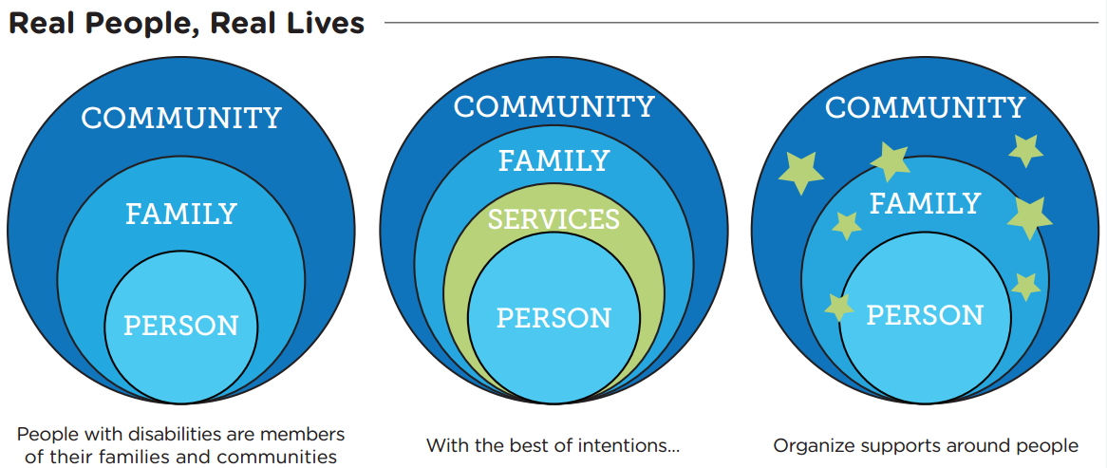
CMS HCBS Settings Regulations
Michelle “Shelli” Reynolds, PhD - UMKC – Institute for Human Development
Notes:
Notes:
We are striving to organize supports around people as depicted in the third circle, rather than have them create a barrier to family and community.

Slide 46
CMS HCBS Settings Regulations
Background
The Home and Community-Based Services (HCBS) settings regulations (previously known as the “Final Rule”) were published in the Federal Register on January 16, 2014; they became effective March 17, 2014.
• Designed to enhance the quality of HCBS, provide additional protections, and ensure full access to the benefits of community living.

Slide 47
CMS HCBS Settings Regulations
Background (cont’d)
Establish requirements for the qualities of settings where individuals live and/or receive Medicaid-reimbursable HCBS services.
• Focus on the quality of individuals’ experiences.
• The intent is that individuals receiving Medicaid-funded HCBS have services that protect individual choice and promote community integration.

Slide 48
CMS HCBS Settings Regulations
Background (cont’d)
Any residential or non-residential setting where individuals live and/or receive HCBS must have the following five qualities:
Integrated in and support full access of individuals to the greater community
Provide opportunities to seek employment, work in competitive integrated settings, engage in community life, control personal resources, and
Ensure that individuals receive services in the community, to the same degree of access as individuals not receiving HCBS.

Slide 49
CMS HCBS Settings Regulations
Background (cont’d)
Selected by the individual from among setting options including non-disability specific settings and options for a private unit in a residential setting.
Person-centered service plans document the options based on the individual’s needs, preferences, and for residential settings, resources available for room and board.

Slide 50
CMS HCBS Settings Regulations
Background (cont’d)
Ensures an individual’s rights of privacy, dignity and respect, and freedom from coercion and restraint.
Optimizes individual initiative, autonomy, and independence in making life choices, including, but not limited to, daily activities, physical environment, and with whom to interact.
Facilitates individual choice regarding services and supports, and who provides them.

Slide 51
CMS HCBS Settings Regulations
A residential setting that is provider-owned or controlled is subject to additional requirements.
A setting is provider-owned or controlled when the setting in which the individual resides is a specific physical place that is owned, co-owned, and/or operated by a provider of HCBS.
Additional requirements relate to ensuring tenant protections, privacy, and autonomy for individuals receiving HCBS who do not reside in their own private (or family) home.

Slide 52
New Tenant Protections in Residential Settings
Under HCBS Final Rule, provider-owned or controlled residential settings must:
Have legally enforceable agreements for individuals who own, rent or occupy specific units/dwellings
Offer same responsibilities/protections from eviction as all tenants under Virginia’s Residential and Landlord Tenant Act

Slide 53
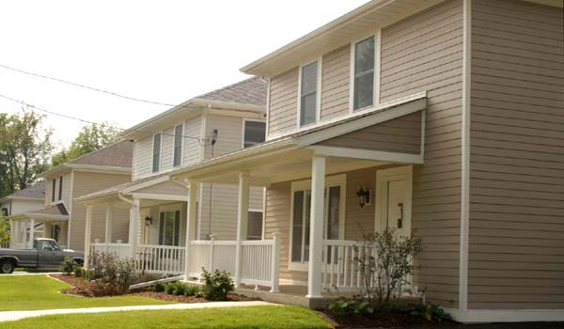


New Tenant Protections in Residential Settings
Settings include
Group homes
Sponsored placements
Supported living residential services

Slide 54
New Tenant Protections in Residential Settings
Tenant responsibilities under VRLTA
Maintenance of unit (housekeeping, pest control, mold avoidance, waste disposal, no tampering w/safety equipment)
No alterations to the unit
Engaging in responsible conduct, allowing neighbors peaceful enjoyment of premises
Following rules/regulations for use & occupancy
Providing access to the unit for inspections, repairs, emergencies
Using unit only as a residence
Surrendering possession unit at termination of tenancy

Slide 55
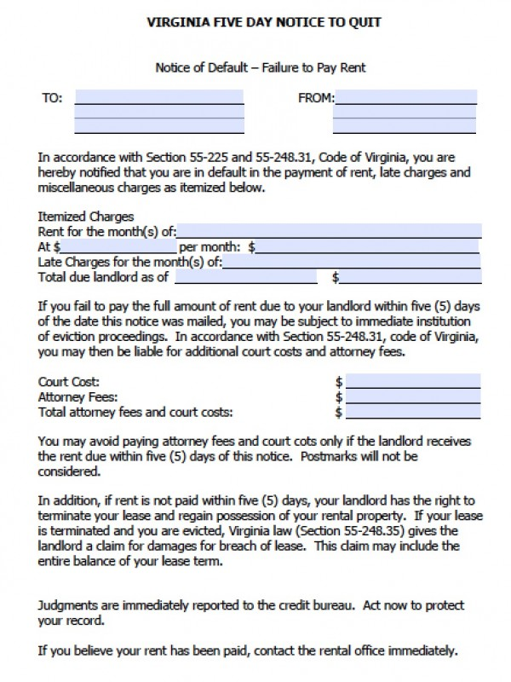
New Tenant Protections in Residential Settings
Tenant protections from eviction under VRLTA
Right to receive written notice of nonpayment of rent & landlord's intent to terminate rental agreement if rent is not paid within 5 days after notice is served
See § 55-248.6. Notice for details on how to give proper notice
Right to cure a lease violation & avoid termination of rental agreement if the violation
is first breach of its kind
is remediable by repairs, payment of damages, etc.
is remedied prior to date specified in landlord’s written notice (e.g., within 21 days of tenant’s receipt of notice)

Slide 56
New Tenant Protections in Residential Settings
Tenant protections from eviction under VRLTA (cont.)
Right to have immediate terminations of rental agreements for non-remediable violations for illegal drug activity or criminal, willful acts that pose a threat to health or safety:
Initially heard in court within 15 calendar days of date tenant is served (or earlier if health/safety emergency affecting other tenants)
Landlord must have “a preponderance of evidence” to obtain order of possession
Subsequently heard or tried no more than 30 days from date tenant is served
Right to recover possession, terminate rental agreement &/or recover damages & attorney fees if unlawfully ousted or utilities are cut off
Right to receive written notice from landlord if absent from the unit for more than 7 days & landlord cannot determine if premises are abandoned
Serve notice in accordance with § 55-248.6
Tenant must notify landlord in writing within 7 days of intent to remain in occupancy

Slide 57
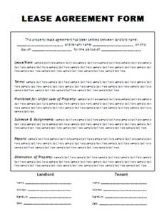
New Tenant Protections in Residential Settings
Legally enforceable agreements can be
a lease (generally for a 12 month period or longer)
a sublease or occupancy agreement
If provider leases, rather than owns the property
If provider’s lease agreement permits subleasing or occupancy agreements
a rental agreement (generally < 12 months)
Agreements should contain certain provisions and avoid others
See the Suggested Occupancy Agreement/Lease Terms & Conditions at http://www.dbhds.virginia.gov/library/developmental%20services/dds_overview%20of%20suggested%20occupancy_lease_agreement_terms_mlmc%20logo%204_11%202016.pdf
Non-profit organizations with landlord-tenant expertise can provide technical assistance. For a list, see pp 2-7 of http://www.dhcd.virginia.gov/images/Housing/Landlord-Tenant-Handbook.pdf
Obtain legal review by an attorney with expertise in VRLTA

Slide 58
CMS HCBS Settings Regulations
States must submit a Statewide Transition Plan for existing 1915(c) and 1915(i) waivers.
Describes the state’s process for ensuring compliance with home and community-based setting requirements.
States must be in full compliance no later than March 17, 2019.

Slide 59
CMS HCBS Settings Regulations
Settings that are not home and community-based are specified in the HCBS Settings Regulation:
Nursing Facility
Institution for Mental Illness
Intermediate Care Facility for Individuals with Intellectual Disabilities
Hospital
Other locations that have qualities of an institutional setting, as determined by the Secretary of US Health and Human Services

Slide 60
CMS HCBS Settings Regulations
The regulations identify other settings that are presumed not to meet the requirements:
Settings in a publicly or privately operated facility that provides inpatient institutional treatment
Settings in a building on the grounds of, or adjacent to, a public institution
Settings with the effect of isolating individuals from the broader community of individuals not receiving Medicaid HCBS

Slide 61



CMS HCBS Settings Regulations
Settings with the Effect of Isolating Individuals: Examples
X A disability-specific farm community
X Residential schools
X Multiple settings co-located and operationally related

Slide 62
CMS HCBS Settings Regulations
Heightened Scrutiny Process
A state may overcome the presumption that a setting has institutional qualities by submitting evidence to CMS.
• CMS reviews the evidence submitted by the state and makes a determination as to whether the evidence is sufficient to overcome the presumption that the setting has the qualities of an institution.

Slide 63
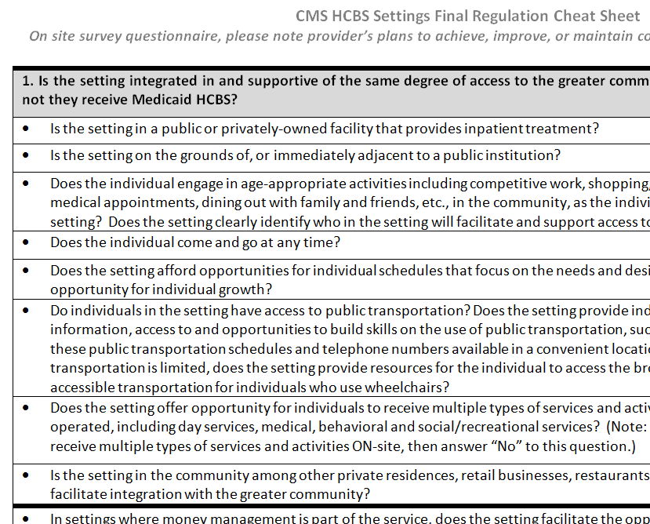
CMS HCBS Settings Regulations
Settings Regulation “Cheat Sheet”
available resource
Notes:
Notes:
To assist providers determine if they meet compliance expectations.

Slide 64
CMS HCBS Settings Regulations
Assessment Processes
States use two types of assessment processes to evaluate whether their standards and settings are in compliance with the regulations.
Systemic: Assessment of the extent to which its regulations, standards, policies, licensing requirements, and other provider requirements ensure settings are in compliance.
Site-Specific: Process by which a state assesses specific settings in which home and community-based services are provided to determine whether the settings are in compliance.

Slide 65
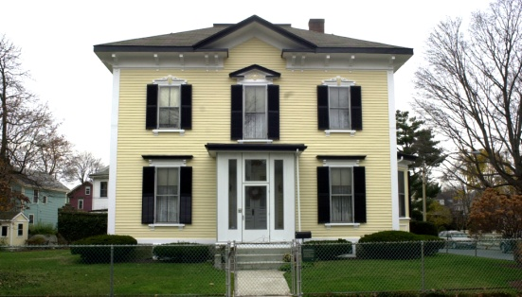
CMS HCBS Settings Regulations
Site-Specific Assessment Process
The site-specific assessments help a state determine:
The category of compliance in which to place each setting, and
The remedial actions that must be taken by the state and providers to bring specific sites into compliance.

Slide 66
CMS HCBS Settings Regulations
Assessment Processes (cont’d)
For both the systemic and site-specific assessments, states should:
Identify all types of home and community-based program settings in their state where HCBS are provided
Describe the outcomes of its assessments by waiver and setting within the waiver
Once completed, the state must amend its Statewide Transition Plan (STP) to include the outcomes of the assessments and provide a public comment period
Notes:
Notes:
The last bullet is where we are now. Amended STP with systemic assessment results due to CMS no later than March 31, 2016. Virginia’s 30-day public comment period to commence 2/22/16.
In order to complete transition no later than March 17, 2019, both assessments completed no later than July 31, 2016; results submitted to CMS no later than September 30, 2016.

Slide 67
CMS HCBS Settings Regulations
Remediation Strategy Overview
A state’s remedial actions should include, as applicable:
Systemic Remediation: remediation of state standards
Site-Specific Remediation: remediation of specific sites or providers
Relocation of individuals when settings cannot be brought into compliance

Slide 68
CMS HCBS Settings Regulations
Remediation Strategy (cont’d)
When relocation of individuals is part of the remediation strategy, the Statewide Transition Plan should include:
A detailed plan for relocation, including a process for providing reasonable notice and due process to individuals
A description of the timeline for the relocation process
The number of individuals impacted

Slide 69
CMS HCBS Settings Regulations
HCBS Settings Regulations
Statewide Waiver Transition Plan available for review:
http://www.dmas.virginia.gov/Content_pgs/HCBS.aspx
Notes:
Notes:
Public Comment ended on April 7th, 2016.

Slide 70
Housing Choice Vouchers

Slide 71
Housing Choice Vouchers
Purpose: to provide the DOJ target population opportunities to move from training centers, ICF-IDD’s, nursing facilities, group homes and family homes into market rental housing.
Individuals:
lease their own units
receive rent assistance to make units affordable (they pay approx 30-40% of adjusted monthly income toward rent and utilities)
get supports from a variety of sources, which are provided separately from their housing

Slide 72
Housing Choice Vouchers
Eligibility: individuals must …
Be age 18 or over
Be the head of household for lease purposes
Have an intellectual or developmental disability, AND
Meet one of the following criteria
Currently reside in a training center, ICF, or nursing facility OR
Receive ID or DD waiver services OR
On a waitlist to receive ID or DD waiver services

Slide 73
Housing Choice Vouchers
Referrals:
Only refer individuals who:
have made an informed decision to lease and live in rental housing;
are or can be ready to move within 120 days of being referred and/or approved for a voucher; and
have or will have adequate waiver, non-waiver and natural supports in place to attain & maintain housing
Referrals for individuals who want to live with parents, grandparents or guardians are not accepted
Individuals can be referred by:
ID or DD Support Coordinators/Case Managers
Community Integration Managers
Center for Independent Living staff

Slide 74
Housing Choice Vouchers
Referrals (cont.):
Referral agent completes referral form
individual, authorized rep/substitute decision maker & agent sign acknowledgements page
Complete entire referral, especially:
info on others who will live with the applicant and
supports to be secured before move-in to help the person live independently in housing
Fax to DBHDS at 804-692-0077
Referrals for vouchers are made based on DOJ priority criteria
For more info, see:
FAQ: http://www.dbhds.virginia.gov/library/developmental%20services/dds_set_aside_vouchers_faq_1_19_16.pdf
Referral Form: http://www.dbhds.virginia.gov/library/developmental%20services/dds_dbhdsvoucherreferral%20form_2_4_16_w_acknowpage.pdf

Slide 75

Individual Levels and Reimbursement Tiers

Slide 76
Language
CLIENT OR CONSUMER -- de-personalizes; instead use person’s name or person who uses support/services or individual.
MY PERSON OR MY GROUP – is possessive or controlling; instead use person I support or this group.
REFERRING TO A PERSON AS A BEHAVIOR OR A WHEELCHAIR – is disrespectful, objectifies; instead use person’s name, and if needed, what supports he/she needs.
FUNCTIONING OR SUPPORT LEVEL -- is disrespectful; instead use how is John? John has level 2 support needs.
Notes:
Notes:
This is just a reminder to use respectful language. Adding levels and tiers into the waivers means risking identifying people as their level/tier: “John is a level 2.” It better to say “John is a person with level 2 support needs.”

Slide 77
Relationship of Individual Levels to Reimbursement Tiers
Support need and Reimbursement Tier
Notes:
Notes:
This slide identifies the seven supports needs levels determined by Supports Intensity Scale and Supplemental Questions and how the 4 reimbursement tiers align with those levels. The first two tiers are directly tied to the first two supports levels, while tiers 3 and 4 are associated with multiple supports levels.
A number of residential services (e.g., group home, sponsored residential, supported living, independent living supports), as well as other services (e.g., group day, community engagement, and group supported employment) will be reimbursed according to these tiers. The reimbursement tiers are tied to individuals’ supports levels, so that service providers are reimbursed at a higher amount for supporting individuals with greater needs.
In addition to tiers, the rate structure of numerous services also reflects higher reimbursement for more integrated and/or smaller settings.

Slide 78
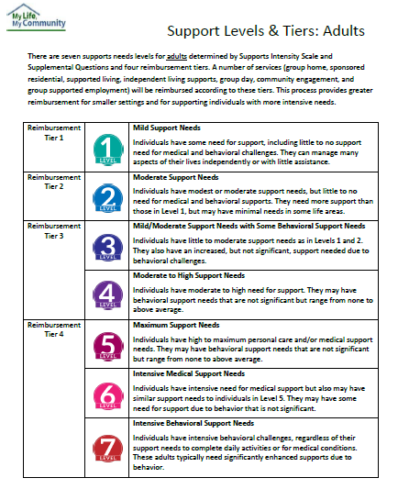
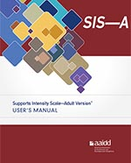
There are seven individual levels for all adults and up to four reimbursement tiers for some services.
Levels and Tiers
Handout: Support Levels & Tiers

Slide 79
Tiered Services
Levels and Tiers
Group Home Residential
Sponsored Residential
Supported Living
Independent Living Residential (2 tiers)
Group Day
Community Engagement
Group Supported Employment
Notes:
Notes:
Still have NOVA/ROS different rates
Other rate differentials for provider reimbursement
Higher reimbursement for smaller settings/staff ratios
Higher reimbursement for supporting individuals with higher level of support needs
Group home residential has different rates depending on size of home:
4 or less up to 12 beds
Community Engagement ratios re: tiers
1:3, 1:2.5, 1:2, 1:1.5
Group SE: three tiers
More than 1, but fewer than 3
More than 3 but fewer than 5
5 – 8

Slide 80








The support need level
Levels and Tiers
Reimbursement increases based on:
Notes:
Notes:
Providers who support people who have higher support needs will receive a higher reimbursement rate in order to accommodate the needed supports.

Slide 81




The size of the licensed home or number of people supported
Levels and Tiers
Reimbursement decreases based on:
Notes:
Notes:
Larger group homes, or day programs with a high number of people served to staff ratio will receive lower rates. This is intended to incentivize smaller, more community integrated supports.

Slide 82

Levels and Tiers
For example:
Tom’s support need level is 4, which means he has moderate to high support needs.

Slide 83

Levels and Tiers
For example:
If Tom moves into a home with 2 people with disabilities, his provider is paid a higher rate than if Tom moves into a home with 8 people.

Slide 84

Levels and Tiers
For example:
But the rate for Tom with level 4 support needs will always be higher than someone with a lower support need level in the same setting for any service he chooses where the tiered rates apply.

Slide 85
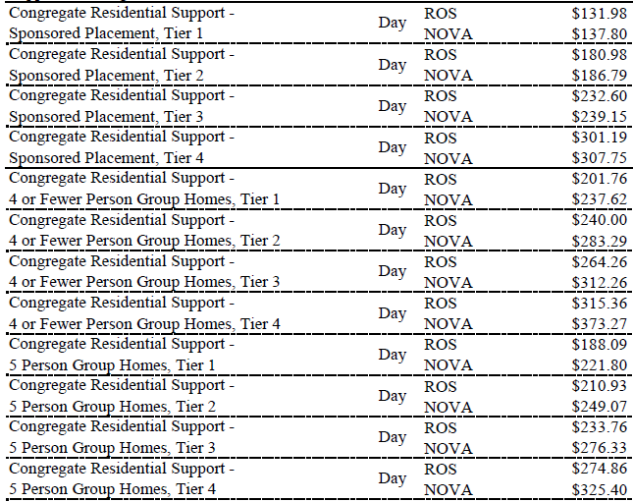
example
Notes:
Notes:
This is also an illustration of some of the proposed rates that factor in tier, size of homes, and NOVA vs. ROS. Possible reimbursement amount based on license not individuals currently in home.

Slide 86
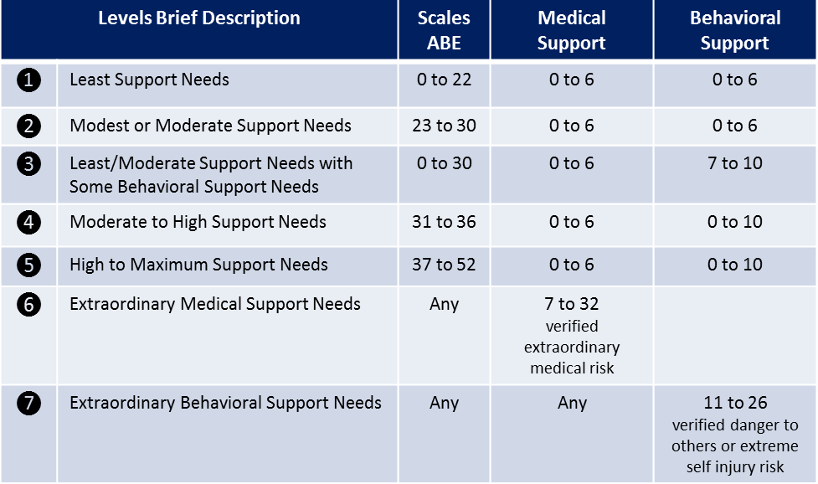
Levels and Tiers
Notes:
Notes:
This slide illustrates how reimbursement tiers relate to support needs levels. Additionally, it identifies how scores on assessment scales relate to identifying a person’s support needs level.

Slide 87
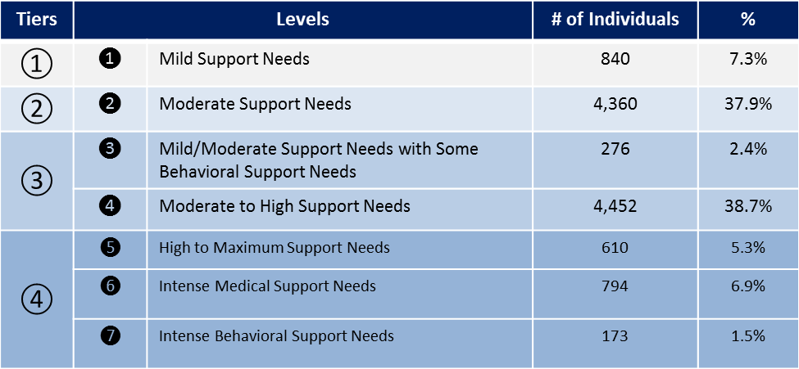
Supports Needs Levels/Tiers Projections
Levels and Tiers
Notes:
Notes:
This chart illustrates the projected percentage of individuals in the current waiver population who are expected to fall into each level/tier based on the HSRI SIS® study.

Slide 88
Reimbursement Video
Levels and Tiers
https://vimeo.com/114981312
Presented by Chip Dodd with Support Services of Virginia
Notes:
Notes:
This video explains the 344 day (vs. 365 day) billing structure for the residential services billed on a daily basis.

Slide 89

DD Waivers Services and Support Options
2016

Slide 90
Services & Support Options
Handouts: MLMC Options and MLMC Qualifications
Services and supports available in the DD Waivers can be considered across these categories.
Employment and Alternate Day Options
Self-Directed Options
Residential Options
Crisis Support Options
Medical and Behavioral Support Options
Additional Options
Notes:
NOTE:
The new services described here have not yet been approved by CMS. Similarly, changes to existing services have not yet been approved. Be aware that all additions and changes are still in the PROPOSED state for now.

Slide 91
Services & Support Options
Employment and Day Options | Building Independence | Family & Individual | Community Living
Individual Supported Employment | ✓ | ✓ | ✓
Group Supported Employment | ✓ | ✓ | ✓
Workplace Assistance Services |  | ✓ | ✓
Community Engagement | ✓ | ✓ | ✓
Community Coaching | ✓ | ✓ | ✓
Group Day Services | ✓ | ✓ | ✓

Slide 92
Employment and Day Options
Employment and Day Options cannot exceed 66 hours per week combined.

Slide 93

Employment and Day Options
Supported Employment
Applicable waivers
is training and support in a competitive job where persons without disabilities are employed.
Building Independence
Family & Individual
Informed choice needed between individual and group models.
Community Living
Unit
1 hour
Up to 40 hours/week
Individual
Group
No changes!
Notes:
Notes:
Supported employment services are ongoing supports to individuals who need intensive ongoing support to obtain and maintain a job in competitive, customized employment, or self employment (including home-based self employment) for which an individual is compensated at or above the minimum wage, but not less than the customary wage and level of benefits paid by the employer for the same or similar work performed by individuals without disabilities.
Individual supported employment is support usually provided one-on-one by a job coach to an individual in an integrated employment or self-employment situation. The outcome of this service is sustained paid employment at or above minimum wage in an integrated setting in the general workforce, in a job that meets personal and career goals.
Group supported employment is defined as continuous support provided by staff in a regular business, industry and community settings to groups of two to eight individuals with disabilities and involves interactions with the public and with co-workers without disabilities. Examples include mobile crews and other business-based workgroups employing small groups of workers with disabilities in the community. Group supported employment must be provided in a manner that promotes integration into the workplace and interaction between people with and without disabilities in those workplaces.

Slide 94
Employment and Day Options
Supported Employment
Individual
Group
Individual Model | Group Model
Provided 1:1 | Limited to 8 individuals per group
Both models are provided in integrated settings.

Slide 95

Employment and Day Options
Supported Employment
Documentation is required in record that DARS (and special education for school age children) won’t pay for these services.

Slide 96
Employment and Day Options
Supported Employment
The allowable activities include but are not limited to:
Job-related discovery or assessment
Person-centered employment planning
Job development
Negotiation with prospective employers
On-the-job training, evaluation and support
Developing work-related skills
Coverage for transportation when necessary
Notes:
Notes:
The allowable activities include, but are not limited to:
1. Vocational/job-related discovery or assessment; 2. Person-centered employment planning which results in employment related outcomes; 3. Individualized job development, with or without the individual present, that produces an appropriate job match for the individual and the employer to include job analysis and/or job carving; 4. Negotiation with prospective employers; 5. On-the-job training in work skills required to perform the job; 6. Ongoing evaluation, supervision, and monitoring of the individual's performance on the job but which do not include supervisory activities rendered as a normal part of the business setting; 7. Ongoing support services necessary to assure job retention; 8. Supports to ensure the individual's health and safety; 9. Development of work-related skills essential to obtaining and retaining employment, such as the effective use of community resources and break/lunch areas and transportation systems; and 10. Staff coverage for transportation between the individual's place of residence and the workplace when other forms of transportation are unavailable or inaccessible (i.e., time spent transporting).
The individual's assessment and individual support plan must clearly reflect the individual's need for employment-related skill building.

Slide 97

Employment and Day Options
New Service!
Applicable waivers
Workplace Assistance
Family & Individual
Includes support to individuals who have completed job development and job placement training (or near completed) but require more than typical follow-along services to maintain stabilization in their employment.
Community Living
Unit
1 hour
Up to 40 hours/week
Notes:
Notes:
Workplace Assistance services are supports provided to someone who has completed job development and completed or nearly completed job placement training but requires more than typical job coach services to maintain stabilization in their employment.
Workplace Assistance services are supplementary to the services rendered by the job coach services; the job coach still provides professional oversight and job coaching intervention.
The provider provides on-site habilitative supports related to behavior, health, time management or other skills that otherwise would endanger the individual’s continued employment. The provider is able to support the person related to personal care needs as well; however, this cannot be the sole use of Workplace Assistance services.
In order for an activity to qualify under Workplace Assistance services it must include all three of the following:
1. The activity must not be work skill training related which would normally be provided by a job coach; 2. Services are delivered in their natural setting (where and when they are needed);l3. Services must facilitate the maintenance of and inclusion in an employment situation ; 4. The ratio is 1:1

Slide 98
Employment and Day Options
Workplace Assistance
Are supplemental to job coach services.
Provides skill-building related to behavior, health, time management or other skills needed for successful employment.
Can include support with personal care.
Provided at a 1:1 ratio.
Notes:
Notes:
Workplace Assistance services are supplementary to the services rendered by the job coach services; the job coach still provides professional oversight and job coaching intervention and may provide this simultaneously with Workplace Assistance.
The provider provides on-site habilitative supports related to behavior, health, time management or other skills that otherwise would endanger the individual’s continued employment. The provider is able to support the person related to personal care needs as well; however, this cannot be the sole use of Workplace Assistance services.

Slide 99
Employment and Day Options
Workplace Assistance
In order for an activity to qualify, it must include all of the following:
Not be work skill training normally provided by a job coach
Be delivered in the natural setting (where and when they are needed)
Facilitate the maintenance of and inclusion in an employment situation

Slide 100
4. Safety supports to ensure the individual’s health and safety.
Employment and Day Options
Workplace Assistance
Allowable activities include: 1. Skill building and supports around non-work skills necessary for the individual to maintain employment 2. Skill building and supports in the home, community, or workplace of employment maintenance related skills 3. Support to make and strengthen community connections 4. Safety supports to ensure the individual’s health & safety

Slide 101
Employment and Day Options
Workplace Assistance
X
This service may not be provided simultaneously with on-the-job Personal Assistance services, nor may Workplace Assistance services be provided solely for the purpose of provision of assistance with personal care needs.

Slide 102

Employment and Day Options
Community Engagement
New Service!
Applicable waivers
Provides a wide variety of opportunities to facilitate and build relationships and natural supports in the community, while utilizing the community as a learning environment. These activities are conducted at naturally occurring times and in a variety of natural settings in which the individual actively interacts with persons without disabilities (other than those paid to support the individual).
Building Independence
Family & Individual
Community Living
Unit
1 hour
Up to 66 hours/week alone or in combination with other day options
Ratio of no more than 1:3
Notes:
Notes:
Community Engagement supports and fosters the ability of the individual to acquire, retain, or improve skills necessary to build positive social behavior, interpersonal competence, greater independence, employability and personal choice necessary to access typical activities and functions of community life such as those chosen by the general population. These may include community education or training, retirement, and volunteer activities.
Community engagement provides a wide variety of opportunities to facilitate and build relationships and natural supports in the community, while utilizing the community as a learning environment. These activities are conducted at naturally occurring times and in a variety of natural settings in which the individual actively interacts with persons without disabilities (other than those paid to support the individual). The activities enhance the individual's involvement with the community and facilitate the development of natural supports. Community Engagement must be provided in the least restrictive and most integrated settings according to the individual’s person-centered plan and individual choice.

Slide 103
Employment and Day Options
Community Engagement
The allowable activities include but are not limited to:
Activities and events in the community
Community, educational or cultural activities and events
Unpaid work experiences (i.e., volunteer opportunities)
Employment readiness activities including discovery of interests, abilities and skills
Maintaining contact with family and friends
Gives flexibility to various day activities
Notes:
Notes:
Allowable Activities:
Skill building, education, support and monitoring that assists the individual with the acquisition and retention of skills in the following areas:
• Activities and public events in the community
• Community educational activities and events
• Interests and activities that encourage meaningful use of leisure time (e.g., through participating in sports/exercise, a club or other social group, a class to learn a new hobby)
• Unpaid work experiences (i.e., volunteer opportunities)
• Maintaining contact with family and friends
Skill building and education in self-direction designed to enable the individual to achieve one or more of the following outcomes particularly through community collaborations and social connections developed by the program (e.g., partnerships with community entities such as senior centers, arts councils, etc.):
• Development of self advocacy skills
• Exercise of civil rights
• Acquisition of skills that promote the ability to exercise self control and responsibility over services and supports received or needed
• Acquisition of skills that enable the individual to become more independent, integrated, or productive in the community
• Development of communication skills and abilities
• Furthering spiritual practices
• Participation in cultural activities
• Participation in vocational pursuits
• Development of appropriate work attitudes
• Development of living skills
• Promotion of health and wellness
• Development of orientation to the community, mobility, and the ability to achieve the desired destination
• Access to and utilization of public transportation
• Interaction with volunteers from the community in program activities
• Career planning to include establishing a career goal;
• Developing a resume based on a career goal, personal interests and community experiences;
• Exploring community job prospects through internship or volunteer experiences.

Slide 104

Employment and Day Options
New Service!
Community Coaching
Applicable waivers
Building Independence
Designed for people who need 1:1 support to build a skill or set of skills to address a barrier to participating in Community Engagement.
Family & Individual
Community Living
Unit
1 hour
Up to 66 hours/week alone or in combination with other day options
Takes place solely in community settings
Notes:
Notes:
Community Coaching is a service designed for individuals who need one to one support in order build a specific skill or set of skills to address a particular barrier(s) preventing a person from participating in activities of Community Engagement.

Slide 105
Employment and Day Options
Community Coaching
The allowable activities include but are not limited to:
Skill building through participation in community activities and opportunities such as outlined in Community Engagement and encompassing:
Activities and events in the community, volunteering, etc
Community, educational or cultural activities and events
Skill-building and support in building positive relationships
Routine needs while in the community
Supports with self-management, eating, and personal needs of the individual while in the community
Assuring the individual’s safety
determined with age sensitivity in mind
and reflective of the person’s interests
Notes:
Notes:
Allowable activities:
Skill building through the implementation and participation in community activities and opportunities such as:
• Activities and public events in the community
• Community educational activities and events
• Utilization of public transportation
Skill building and support in positive behavior, relationship building and social skills.
Support with self-management, eating, and personal care needs of the individual while in the community
Assuring the individual’s safety through 1:1 supervision in a variety of community settings

Slide 106

Employment and Day Options
Group Day Services
Applicable waivers
At no more than 1:7 ratio, includes skill-building and support for the acquisition or retention of self-help, socialization, community integration, employability and adaptive skills.
Building Independence
Family & Individual
Community Living
Unit
1 hour
Up to 66 hours/week alone or in combination with other day options
Ratio of no more than 1:7
Notes:
Notes:
Group Day Services include skill building or supports for the acquisition, retention, or improvement of self-help, socialization, community integration, employability and adaptive skills. They provide opportunities for peer interactions, community integration, and enhancement of social networks. Supports may be provided to ensure an individual’s health and safety.
Skill building is a required component of this service unless the individual has a documented degenerative condition, in which case day support may focus on maintaining skills and functioning and preventing or slowing regression rather than acquiring new skills or improving existing skills.
Group Day Services should be coordinated with any physical, occupational, or speech/language therapies listed in the person-centered plan.

Slide 107
Employment and Day Options
Group Day Services
The allowable activities include but are not limited to skill development and support in order to:
Develop self, social, and environmental awareness skills
Develop positive behavior, using community resources
Volunteer and connect with others in the community
Engage in career planning to include establishing a career goal
Develop skills required for paid employment in a community setting
Notes:
Notes:
Because Prevocational services are NO LONGER INCLUDED in any of the DD waivers, some activities with a prevocational focus have been added to group day services.
NOTE: all individuals currently in Prevocational Services must transition to an alternate day service between 3/1/16 and 6/30/16.
The allowable group day support services include, but are not limited to:
1. Developing problem-solving skills;
2. Support with personal care tasks;
3. Developing self, social, and environmental awareness skills;
4. Developing sensory, gross, and fine motor skills;
5. Skill building and support as needed in communication and personal care;
6. Skill building and support as needed in positive behavior, the use of community resources, community safety, positive peer interactions, and social skills;
7. Safety supports to ensure the individual’s health and safety;
8. Supports to assist older adults in participating in meaningful retirement activities in their communities (e.g., support to participate in hobbies, clubs and/or other senior related activities in their communities).
Participation in community volunteer opportunities or education programs in integrated settings;
Staff coverage for transportation of the individual between service activity sites;
11. Support to make and strengthen community connections;
12. Developing skills required for paid employment in community settings (e.g., ability to communicate effectively; generally accepted community conduct and dress, ability to follow directions, ability to attend to tasks, consistent attendance, task completion, problem solving skills and strategies, interpersonal relations, general safety and mobility training);
13. Career planning to include establishing a career goal;
14. Developing a resume based on a career goal, personal interests and community experiences;
15. Exploring community job prospects through internship or volunteer experiences.

Slide 108
Crisis Support Options
Crisis Support Options | Building Independence | Family & Individual | Community Living
Community-Based Crisis Supports | ✓ | ✓ | ✓
Center-based Crisis Supports | ✓ | ✓ | ✓
Crisis Support Services | ✓ | ✓ | ✓
Notes:
Notes:
The existing Crisis Stabilization/Crisis Supervision services are replaced by these three new crisis services.

Slide 109

Crisis Support Options
New Service!
Applicable waivers
Community-based Crisis Supports
Building Independence
Family & Individual
Provides services to individuals experiencing crisis events which put them at risk for homelessness, incarceration, hospitalization, and/or danger to self or others.
Community Living
Unit
1 day
Up to six months per year in 30 day increments
Notes:
Notes:
Community-based crisis supports are ongoing supports to individuals who may have a history of multiple psychiatric hospitalizations; frequent medication changes; enhanced staffing required due to mental health or behavioral concerns; and/or frequent setting changes. Supports are provided in the individual’s home and community setting. Crisis staff work directly with and assist the individual and their current support provider or family. Techniques and strategies are provided via coaching, teaching, modeling, role-playing, problem solving, or direct assistance. These services provide temporary intensive services and supports that avert emergency psychiatric hospitalization or institutional placement or prevent other out-of-home placement.
To note about the unit billing limitations:
Service authorization/provision is subject to the following limits:
30 days per year of crisis prevention
90 days per year of crisis intervention
60 days per year of crisis stabilization (authorized in increments of no more than 15 days at a time)

Slide 110
Crisis Support Options
Community-based Crisis Supports
In order to receive community-based crisis supports, the individual shall:
a. Meet at least one of the following:
(i). Previous psychiatric hospitalization(s);
(ii). Previous incarceration;
(iii). Lost previous residential/day placements; or
(iv). Behaviors that have significantly jeopardized placement; and
b. Meet at least one of the following:
(i) be experiencing a marked reduction in psychiatric, adaptive, or behavioral functioning;
(ii) be experiencing an increase in extreme emotional distress;
(iii) need continuous intervention to maintain stability; or
(iv) be causing harm to himself or others; and
c. Be at risk of at least one of the following:
(i) psychiatric hospitalization;
(ii) emergency ICF/IID placement;
(iii) immediate threat of loss of a community service due to a severe situational reaction; or
(iv) causing harm to self or others.
Notes:
Notes:
In order to receive community-based crisis supports, the individual shall:
a. Have a history of at least one of the following:
(i). Previous psychiatric hospitalization(s);
(ii). Previous incarceration;
(iii). Lost previous residential/day placements; or
(iv). Behaviors that have significantly jeopardized placement; and
b. Meet at least one of the following:
(i) the individual shall be experiencing a marked reduction in psychiatric, adaptive, or behavioral functioning;
(ii) the individual shall be experiencing an increase in extreme emotional distress;
(iii) the individual shall need continuous intervention to maintain stability; or
(iv) the individual shall be causing harm to himself or others; and
b. Be at risk of at least one of the following:
(i) psychiatric hospitalization;
(ii) emergency ICF/IID placement;
(iii) immediate threat of loss of a community service due to a severe situational reaction; or
(iv) causing harm to self or others.

Slide 111
Crisis Support Options
Community-based Crisis Supports
The allowable activities include but are not limited to:
Assessments and stabilization techniques
Medication management and monitoring
Behavior assessment and positive behavior support
Intensive care coordination
Training of others in positive behavioral supports
Assisting with skill building as related to the behavior
Notes:
Notes:
The allowable activities include but are not limited to:
1. Psychiatric, neuropsychiatry, and psychological assessment, and other assessments and stabilization techniques;
2. Medication management and monitoring;
3. Behavior assessment and positive behavior support;
4. Intensive care coordination with other agencies and providers to assist the planning and delivery of services and supports to maintain community placement of the individual;
5. Training of family members and other caregivers and service providers in positive behavioral supports to maintain the individual in the community;
6. Assisting with skill building as related to the behavior creating the crisis in areas such as self-care/ADLs, independent living skills, self-esteem building activities, appropriate self-expression, coping skills, and medication compliance.

Slide 112

Crisis Support Options
Community-based Crisis Supports
Community-based Crisis Supports shall be provided by a Licensed Mental Health Professional (LMHP), LMHP-supervisee, LMHP-resident, LMHP-RP, a certified pre-screener, or QDDP.
Notes:
Notes:
Community-based crisis supports shall be provided by a Licensed Mental Health Professional (LMHP), LMHP-supervisee, LMHP-resident, LMHP-RP, a certified pre-screener, or QDDP.
The QDDP providing community-based crisis supports must have:
1. At least one year of documented experience working directly with individuals who have developmental disabilities,
2. A bachelor’s degree in a human services field including, but not limited to, sociology, social work, special education, rehabilitation counseling, or psychology; or a bachelor’s degree in another field in addition to an advanced degree in a human services field; and
3. The required Virginia or national license, registration, or certification, as is applicable, in accordance with his or her profession.
LMHP-RP = LMHP resident in psychology

Slide 113

Crisis Support Options
New Service!
Applicable waivers
Center-based Crisis Supports
Building Independence
Provide long term crisis prevention and stabilization in a residential setting (Crisis Therapeutic Home) through utilization of assessments, close monitoring, and a therapeutic milieu.
Family & Individual
Community Living
Unit
1 day
Up to six months per year in 30 day increments
Notes:
Notes:
Center-based Crisis Supports provide long term crisis prevention and stabilization in a residential setting (Crisis Therapeutic Home) through utilization of assessments, close monitoring, and a therapeutic milieu. Services are provided through planned and emergency admissions. Planned admissions will be provided to individuals who are receiving ongoing crisis services and need temporary, therapeutic interventions outside of their home setting in order to maintain stability. Crisis stabilization admissions will be provided to individuals who are experiencing an identified behavioral health need and/or a behavioral challenge that is preventing them from experiencing stability within their home setting.

Slide 114
Crisis Support Options
Center-based Crisis Supports
In order to receive center-based crisis supports, the individual shall:
a. Meet at least one of the following:
(i). Previous psychiatric hospitalization(s);
(ii). Previous incarceration;
(iii). Lost previous residential/day placements; or
(iv). Behaviors that have significantly jeopardized placement; and
b. Meet at least one of the following:
(i) be experiencing a marked reduction in psychiatric, adaptive, or behavioral functioning;
(ii) be experiencing an increase in extreme emotional distress;
(iii) need continuous intervention to maintain stability; or
(iv) be causing harm to himself or others; and
c. Be at risk of at least one of the following:
(i) psychiatric hospitalization;
(ii) emergency ICF/IID placement;
(iii) immediate threat of loss of a community service due to a severe situational reaction; or
(iv) causing harm to self or others.

Slide 115
Crisis Support Options
Center-based Crisis Supports
The allowable activities include but are not limited to:
Assessments and stabilization techniques;
Medication management and monitoring;
Behavior assessment and positive behavior support;
Intensive care coordination;
Training of others in positive behavioral supports;
Assisting with skill building as related to the behavior;
Supervision of the individual in crisis to ensure safety.
Notes:
Notes:
The allowable activities include but are not limited to:
1. Psychiatric, neuropsychiatry, and psychological assessment, and other assessments and stabilization techniques;
2. Medication management and monitoring;
3. Behavior assessment and positive behavior support;
4. Intensive care coordination with other agencies and providers to assist the planning and delivery of services and supports to maintain community placement of the individual;
5. Training of family members and other caregivers and service providers in positive behavioral supports to maintain the individual in the community
6. Assisting with skill building in the Crisis Therapeutic Home as related to the behavior creating the crisis in areas such as self-care/ADLs, independent living skills, self-esteem building activities, appropriate self-expression, coping skills, and medication compliance
7. Supervision of the individual in crisis to ensure his or her safety and that of others in the environment.

Slide 116

Crisis Support Options
Center-based Crisis Supports
Crisis intervention shall be provided by a Licensed Mental Health Professional (LMHP), LMHP-supervisee, LMHP-resident, LMHP-RP, a certified pre-screener, or QDDP.
Notes:
Notes:
Crisis intervention shall be provided by a Licensed Mental Health Professional (LMHP), LMHP-supervisee, LMHP-resident, LMHP-RP, a certified pre-screener, or QDDP.
The QDDP providing crisis intervention services must have:
1. At least one year of documented experience working directly with individuals who have developmental disabilities.
2. A bachelor’s degree in a human services field including, but not limited to, sociology, social work, special education, rehabilitation counseling, or psychology; or a bachelor’s degree in another field in addition to an advanced degree in a human services field; and
3. The required Virginia or national license, registration, or certification, as is applicable, in accordance with his or her profession.

Slide 117
Crisis Support Options
New Service!
Applicable waivers
Crisis Support Services
Building Independence
Provide intensive supports by appropriately trained staff in the area of crisis prevention, crisis intervention, and crisis stabilization.
This service is designed to stabilize the individual and strengthen the current living situation so the individual can be supported in the community during and beyond the crisis period.
Family & Individual
Community Living
Unit
1 day
Limits vary by component
Notes:
Notes:
Crisis Support services provide intensive supports by appropriately trained staff in the area of crisis prevention, crisis intervention, and crisis stabilization to an individual who may experience an episodic behavioral or psychiatric crisis in the community which has the potential to jeopardize their current community living situation. This service shall be designed to stabilize the individual and strengthen the current living situation so the individual can be supported in the community during and beyond the crisis period.

Slide 118
Crisis Support Options
Crisis Support Services
Requires a Qualified Developmental Disability Professional (QDDP) with:
At least one year of documented experience working directly with individuals who have developmental disabilities;
At least a bachelor's degree in a human services field including, but not limited to, sociology, social work, special education, rehabilitation counseling, or psychology; and
The required Virginia or national license, registration, or certification, as is applicable, in accordance with his or her profession.
Notes:
Notes:

Slide 119
Crisis Support Options
Crisis Support Services
Includes:
Crisis Prevention Services
Crisis Intervention Services
Crisis Stabilization Services
Notes:
Notes:

Slide 120
Crisis Support Options
Crisis Support Services
Crisis Prevention Services
Provides ongoing assessment of an individual’s medical, cognitive, and behavioral status as well as predictors of self injurious, disruptive, or destructive behaviors, with the initiation of positive behavior supports to prevent occurrence of crisis situations.
Notes:
Notes:
Crisis Prevention - Crisis prevention services provide ongoing assessment of an individual’s medical, cognitive, and behavioral status as well as predictors of self injurious, disruptive, or destructive behaviors, with the initiation of positive behavior supports to prevent occurrence of crisis situations. Crisis prevention also encompasses providing support to the family and the individual through facilitating team meetings, revising the behavior plan, etc. as they implement changes to the plan for support and address any residual concerns from the crisis situation. Staff will arrange to train and mentor staff or family members who will support the individual long term once the crisis has stabilized in order to minimize or prevent recurrence of the crisis. Crisis support staff will deliver such support in a way that maintains the individual's typical routine to the maximum extent possible.

Slide 121
Crisis Support Options
Crisis Support Services
Crisis Intervention Services
Used in the midst of the crisis to prevent the further escalation of the situation and to maintain the immediate personal safety of those involved.
Notes:
Notes:
Crisis Intervention - Crisis intervention services are used in the midst of the crisis to prevent the further escalation of the situation and to maintain the immediate personal safety of those involved. Crisis Intervention is a relatively short term service that provides a highly structured intervention that may include temporary changes to the person’s residence, removal of certain items from the setting, changes to the person’s daily routine, and emergency referrals to other care providers. Those providing crisis intervention services must also be well-versed and fluent in verbal de-escalation techniques, including active listening, reflective listening, validation, and suggestions for immediate changes to the situation.

Slide 122
Crisis Support Options
Crisis Support Services
Crisis Stabilization Services
Begin once the acuity of the situation has resolved and there is no longer an immediate threat to the health and safety of those involved. Geared toward gaining a full understanding of all of the factors that precipitated the crisis and may have maintained it until trained staff from outside the immediate situation arrived.
Notes:
Notes:
Crisis Stabilization - Crisis stabilization services begin once the acuity of the situation has resolved and there is no longer an immediate threat to the health and safety of those involved. Crisis stabilization services are geared toward gaining a full understanding of all of the factors that precipitated the crisis and may have maintained it until trained staff from outside the immediate situation arrived. Crisis stabilization plans are developed by staff trained in basic behavioral treatment and crisis management. These plans may include modifications to the environment, interventions to enhance communication skills, or changes to the individual’s daily routine or structure. Staff developing these plans must be able to train support staff, family, and other significant persons in the individual’s life.

Slide 123
The service is limited to a six month service authorization period per year.
The service is limited to a six month service authorization period per year.
Crisis Support Options
Crisis Support Services
90
Billing Considerations
30
60
30 days/ year of crisis prevention;
90 days/ year of crisis intervention;
60 days/ year of crisis stabilization (authorized in 15 day increments).

Slide 124
Self-Directed and Agency-Directed Support Options
Self-Directed and Agency-Directed Options | Building Independence | Family & Individual | Community Living
Consumer-Directed Services Facilitation |  | ✓ | ✓
CD Personal Assistance Services* |  | ✓ | ✓
CD Respite* |  | ✓ | ✓
CD Companion* |  | ✓ | ✓
* Can be consumer or agency-directed

Slide 125
Self-Directed and Agency-Directed Support Options
Personal Assistance, Respite and Companion
Applicable waivers
Can be self-directed under the consumer-directed model or provided under the agency-directed model.
Family & Individual
Community Living
Unit
1 hour
Consumer-directed
Agency- directed
No changes!
Notes:
Notes:
NO significant changes to these services.

Slide 126
Self-Directed and Agency-Directed Support Options
Personal Assistance
Applicable waivers
Family & Individual
Direct support with personal needs, typical daily tasks, community involvement and health & safety.
Community Living
Unit
1 hour
Personal Assistance is not compatible with congregate services
Notes:
Notes:
Personal assistance services mean direct support with activities of daily living, instrumental activities of daily living, access to the community, monitoring of self-administered medications or other medical needs, monitoring of health status and physical condition, and work-related personal assistance. These services may be provided in home and community settings to enable an individual to maintain the health status and functional skills necessary to live in the community or participate in community activities.
Each individual and family/caregiver, family, or caregiver shall have a back-up plan for the individual's needed supports in case the personal assistant does not report for work as expected or terminates employment without prior notice.

Slide 127
Self-Directed and Agency-Directed Support Options
Personal Assistance
Provides 1:1 support with…
personal needs
positive relationships
community involvement
medical supports
Notes:
Notes:
Allowable activities include:
1. Support with activities of daily living (ADLs), such as: bathing or showering, using the toilet, routine personal hygiene skills, dressing, transferring, etc.;
2. Support with monitoring health status and physical condition;
3. Support with medication and other medical needs;
4. Supporting the individual with preparation and eating of meals;
5. Support with housekeeping activities, such as bed making, dusting, and vacuuming, laundry, grocery shopping, etc.;
6. Support to assure the safety of the individual;
7. Support needed by the individual to participate in social, recreational and community activities;
8. Assistance with bowel/bladder programs, range of motion exercises, routine wound care that does not include sterile technique, and external catheter care when properly trained and supervised by an RN;
9. Accompanying the individual to appointments or meetings.

Slide 128
Self-Directed and Agency-Directed Support Options
Personal Assistance
Not available to individuals who receive…
group home residential services
sponsored residential services
live in Assisted Living Facilities
who have comparable services through another program

Slide 129
Self-Directed and Agency-Directed Support Options
Respite
Provides temporary supports during emergencies and at other times as needed by an unpaid caregiver.
Applicable waivers
Family & Individual
Community Living
Unit
1 hour
Can be in the individual’s home, a provider’s home or other community locations.
Respite: Up to 480 hours per fiscal year; for unpaid primary care givers only
Notes:
Notes:
Respite services are specifically designed to provide temporary, substitute care for that which is normally provided by the family or other unpaid, primary caregiver of an individual. Services are provided on a short-term basis because of the emergency absence or need for routine or periodic relief of the primary caregiver.
Such services may be provided in home and community settings to enable an individual to maintain the health status and functional skills necessary to live in the community or participate in community activities. When specified, such supportive services may include assistance with IADLs.

Slide 130
Self-Directed and Agency-Directed Support Options
Respite
Provides 1:1 support with…
personal needs
positive relationships
community involvement
medical supports
Notes:
Notes:
The allowable activities include, but are not limited to:
1) Support with activities of daily living such as: bathing or showering, toileting, routine personal hygiene skills, dressing, transferring, etc.;
2) Support with monitoring health status and physical condition;
3) Support with medication;
4) Support with medical needs;
5) Support with preparation and eating of meals;
6) Support with housekeeping activities, such as bed-making, dusting and vacuuming, laundry, grocery shopping, etc.;
7) Support to ensure the safety of the individual;
8) Support needed by the individual to participate in social, recreational, or community activities;
9) Assistance with bowel/bladder programs, range of motion exercises, routine wound care that does not include sterile technique, and external catheter care when properly trained and supervised by an RN;
10) Accompanying the individual to appointments or meetings.

Slide 131
Self-Directed and Agency-Directed Support Options
Companion
Applicable waivers
Provides non-medical care, socialization, or support to adults.
This service is provided in an individual’s home or at various locations in the community.
Family & Individual
Community Living
Unit
1 hour
Companion: up to 8 hours per day; for individuals 18 and older
Notes:
Notes:
Companion services provide nonmedical care, socialization, or support to adults, ages 18 and older. This service is provided in an individual's home or at various locations in the community.

Slide 132
Self-Directed and Agency-Directed Support Options
Companion
Provides 1:1 support with…
tasks such as meal preparation, laundry, and shopping
light housekeeping tasks
self-administration of medication
community access and recreational activities
support to assure the safety of the individual
Notes:
Notes:
The allowable activities include, but are not limited to:
1. Assistance or support with tasks such as meal preparation, laundry, and shopping;
2. Assistance with light housekeeping tasks;
3. Assistance with self-administration of medication;
4. Assistance or support with community access and recreational activities; and
5. Support to assure the safety of the individual.

Slide 133

Self-Directed and Agency-Directed Support Options
Companion
x
Companion services do not permit routine support with personal activities such as using the restroom, bathing or dressing.
x
Cannot be provided by adult foster care providers.
Notes:
Notes:
Unlike personal assistance and residential support, companion services do not permit routine support with activities of daily living (such as toileting, bathing, dressing, grooming). The allowable activities center on instrumental activities of daily living (meal prep, shopping, community integration, etc.).

Slide 134
Services & Support Options
Residential Options | Building Independence | Family & Individual | Community Living
Independent Living Supports | ✓
Shared Living | ✓ | ✓ | ✓
Supported Living |  | ✓ | ✓
In-home Support Services |  | ✓ | ✓
Sponsored Residential |  |  | ✓
Group Home Residential |  |  | ✓
Notes:
Notes:
When services are reimbursed on a daily basis, it eliminates considerations for general supervision, periodic supports, and safety (overnight) supports.

Slide 135
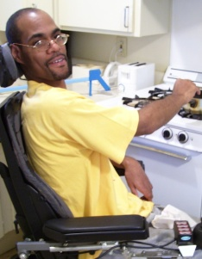
Residential Options
New Service!
Applicable waivers
Independent Living Supports
Building Independence
A service provided to adults (18 and older) that offers skill building and support to secure a self-sustaining, independent living situation in the community and/or may provide the support necessary to maintain those skills.
Unit
1 month
Up to 21 hours/week
Not provided in licensed homes
Notes:
Notes:
Individuals typically live alone or with roommates in their own homes or apartments.
These services are not provided in licensed homes. The supports may be provided in the individual's residence or in community settings.
Note about the billing unit: there will also be a rate for a partial month for when the service starts or ends mid-month.

Slide 136
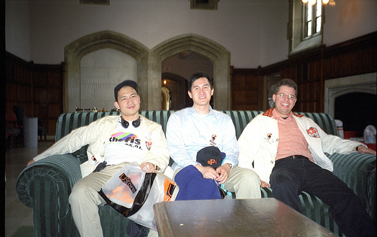
Residential Options
Independent Living Supports
Individuals typically…
live alone or with roommates in their own homes or apartments.
Notes:
Notes:
The individual must have a backup plan for times when Independent Living Supports cannot be provided as regularly scheduled.

Slide 137
Residential Options
Independent Living Supports
The allowable activities include but are not limited to:
Skill-building and support to promote community inclusion
Increasing social abilities and maintaining relationships
Increasing or maintaining health, safety and fitness
Improving decision-making and self-determination
Promoting meaningful community involvement
Developing and supporting with daily needs

Slide 138

Residential Options
Independent Living Supports
There must be a back-up plan in the event that supports are unavailable.

Slide 139

Residential Options
New Service!
Shared Living
Applicable waivers
Building Independence
Medicaid payment for a portion of the total cost of rent, food, and utilities that can be reasonably attributed to a person who has no legal responsibility to support the individual and resides in the same household as the individual.
Family & Individual
Community Living
Unit
1 Month
For individuals 18+
Notes:
Notes:
There shall be a DBHDS-licensed provider responsible for managing administrative aspects of service (roommate matching as needed, background checks, training, periodic monitoring, disbursing funds to the individual). This provider agency will receive a flat fee payment for completion of these activities.
The live-in companion is NOT an employee of the licensed coordinating agency.
The DBHDS licensed coordinating agency of Shared Living must meet one of the following provider categories:
1. An agency licensed by DBHDS as a provider of group home residential services
2. An agency licensed by DBHDS as a provider of supervised living residential services
3. An agency licensed by DBHDS as a provider of sponsored residential home services

Slide 140
Residential Options
Shared Living
Shared Living supports include:
Fellowship such as conversation, games, crafts, accompanying the person on walks, errands, appointments and social and recreational activities;
Enhanced feelings of security which means necessary social and emotional support inside or outside of the residence;
Personal care and routine daily living tasks that do not exceed 20% of companionship time such as meal preparation, light housework, assistance with and the physical taking of medications.
Notes:
Notes:
Companionship supports may include:
• The provision of fellowship, which means to engage the individual in social, physical or mental activities, such as conversation, games, crafts, accompanying the person on walks, errands, appointments and social and recreational activities.
• Enhanced feelings of security which means to provide necessary social and emotional support to the individual when inside or outside of the residence.
ADL and IADL supports may also be provided, but will account for no more than 20% of the anticipated companionship time, and may include:
• Assistance with Instrumental Activities of Daily Living (IADLs) which are tasks that enable a person to live independently at home, such as meal preparation, light housework, assistance with the physical taking of medications
• Assistance with Activities of Daily Living (ADLS), either with routine prompting and/or intermittently providing direct assistance for ADLS such as dressing, grooming, feeding, bathing, toileting and transferring.
The live-in roommate will not have the responsibility for providing habilitative (skill building) or medical services.

Slide 141
Residential Options
Shared Living
Match is based on individual choice and supports are arranged through a person-centered process.
The roommate has no responsibility for skill-building or medical services.
Notes:
Notes:
The individual will choose who lives with him/her and together, through a person centered process, determine the companionship supports provided based on preferences and need.

Slide 142

Residential Options
Shared Living
More about Shared Living supports:
Payment to the live-in companion occurs through the provider agency;
Shared Living is only available to individuals over 18 years of age;
Individuals must live in a home that they own or rent.
Shared Living cannot be provided in a provider-operated home, the live-in companion’s home, or any other arrangement where the individual is not directly responsible for that residence.
The Shared Living roommate cannot be a parent, spouse, or legal guardian.
Notes:
Notes:
Payment will not be made directly to the live-in roommate but to a provider agency that will in turn transfer the appropriate amount of funds to the individual. The service is available to adult individuals, aged 18 years of age or older.
The individual must reside in his or her own home or leased residence. Payment will not be made when the individual lives in the live-in companion’s home, in a residence that is owned or leased by the provider agency, or any other residential arrangement where the individual is not directly responsible for the residence.
The live-in companion must not be the individual's parent or spouse.

Slide 143

Residential Options
Shared Living
The live-in companion must:
complete and pass background checks, including criminal registry checks required by §§ 37.2-416, 37.2-506, and 37.2-607 of the Code of VA
successfully meet training requirements defined in the individual's person-centered plan such as CPR training, safety awareness, fire safety and disaster planning, conflict management and resolution, or any other necessary specialized training
Notes:
Notes:
The live-in companion must:
- complete and pass background checks, including criminal registry checks required by §§ 37.2-416, 37.2-506, and 37.2-607 of the Code of VA.
- successfully meet training requirements defined in the individual's person-centered plan such as CPR training, safety awareness, fire safety and disaster planning, conflict management and resolution, or any other necessary specialized training.

Slide 144
Residential Options
Shared Living
The coordinating agency must ensure that there is a back-up plan in the event that the live-in companion is unable to provide supports.

Slide 145
Residential Options
New Service!
Supported Living
Applicable waivers
Supported Living residential supports are provided in a licensed or DBHDS authorized apartment/house and enable the individuals to…
have access to ‘round the clock support
a timely response when needed
support to develop skills needed for daily life
Family & Individual
Community Living
Unit
1 day
Only in provider-controlled settings
Notes:
Notes:
This is technically not a new service, but is now broken out from “congregate residential” as its own service. NOTE: The daily/tiered reimbursement structure takes effect 7/1/16.
Supported living takes place in an apartment setting operated by a DBHDS licensed provider. These services shall consist of skill-building, routine supports, general supports, and safety supports, that enable an individual to acquire, retain, or improve the self-help, socialization, and adaptive skills necessary to reside successfully in home and community-based settings.
Service providers shall be reimbursed only for the amount and type of residential support services that are included in the individual's approved person-centered plan.
Residential services shall be authorized for Medicaid reimbursement in the person-centered plan only when the individual requires these services and when such needs exceed the services included in the individual's room and board arrangements with the service provider.
Supported Living residential services to the individual in the form of ‘round the clock availability of staff services performed by paid staff who have the ability to respond in a timely manner. These supports may be provided individually or simultaneously to more than one individual living in that home, depending on the required support.
Residential Support includes the expectation of the presence of a skills development (formerly called training) component, along with the provision of supports, as needed.

Slide 146
Residential Options
Supported Living
The allowable activities include but are not limited to:
Using community resources
Personal care activities
Developing friends and having positive relationships
Building skills
Daily activities in the home and community
Supporting to be healthy and safe
Notes:
Notes:
The allowable activities include, but are not limited to:
Skill-building related to personal care activities (toileting, bathing, and grooming; dressing; eating; mobility; communication; household chores; food preparation; money management; shopping, etc.);
2) Skill-building related to the use of community resources (transportation, shopping, dining at restaurants, participating in social and recreational activities, etc.);
3) Supporting the individual in developing the ability to replace challenging behavior with positive, accepted behavior for home and community environments, for example (not all inclusive):
- Developing a circle of friends;
- Handling social encounters with others; or
- Redirecting challenging behavior.
4) Monitoring health and physical conditions and providing supports with medication or other medical needs;
5) Providing supports with personal care, ADLs, and use of community resources, for example (not all-inclusive):
- Completing personal care or mealtime tasks when physically unable to do so; or
- Completing daily tasks, such as laundry, meal preparation, using the bank, or other tasks essential to the individual’s health and welfare
6) Supporting with transportation to and from training sites and community resources;
7) Providing general supports as needed; and
8) Providing safety supports to ensure the individual’s health and safety.

Slide 147
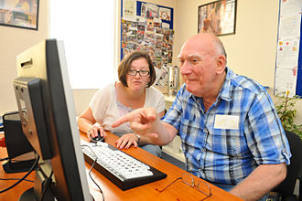
Residential Options
In-Home Support Services
Applicable waivers
Residential services that take place in the individual’s home, family home, or community settings and typically supplement the primary care provided by the individual, family or other unpaid caregiver.
Family & Individual
Community Living
Unit
1 hour
Support to no more than three individuals
Notes:
Notes:
In-Home Support services are residential services that take place in the individual’s home, family home, or community settings and typically supplement the primary care provided by the individual, family or other unpaid caregiver. In-Home Support services are designed to ensure the health, safety and welfare of the individual.
These services shall consist of skill-building, routine supports, and safety supports, that enable an individual to acquire, retain, or improve the self-help, socialization, and adaptive skills necessary to reside successfully in home and community-based settings.

Slide 148
Residential Options
In-Home Support Services
Change with amended waivers: permissible to bill this service for up to three individuals at a time (e.g., siblings); however, the per person reimbursement rate decreases with each additional individual.
Notes:
Notes:
The individual must have a backup plan for times when In-Home Supports cannot be provided as regularly scheduled.

Slide 149
Residential Options
Sponsored Residential
Applicable waivers
Residential supports provided to no more than two individuals in a licensed or DBHDS authorized sponsored residential home and enable the individuals to…
improve or maintain his or her health,
live at home and use the community,
improve abilities and acquire new skills,
be safe at home and in the community.
Community Living
Unit
1 day
Support to no more than two individuals
New rates begin 1/1/17
Notes:
Notes:
The new daily billing/tiered reimbursement structure takes effect for this service on 1/1/17.
Sponsored Residential Services take place in a licensed or DBHDS authorized sponsored residential home.
These services shall consist of skill-building, routine supports, general supports, and safety supports, provided in a licensed or approved residence that enable an individual to acquire, retain, or improve the self-help, socialization, and adaptive skills necessary to reside successfully in home and community-based settings.
Service providers shall be reimbursed only for the amount and type of sponsored residential support services that are included in the individual's approved person-centered plan.
Sponsored residential services shall be authorized for Medicaid reimbursement in the person-centered plan only when the individual requires these services and when such needs exceed the services included in the individual's room and board arrangements with the service provider.
Sponsored residential services to the individual in the form of continuous (up to 24 hours per day) services performed by the sponsor family who shall be physically present in the home. These supports may be provided individually or simultaneously to up to two individuals living in that home, depending on the required support.
Sponsored residential support includes the expectation of the presence of a skills development (formerly called training) component, along with the provision of supports, as needed.

Slide 150

Residential Options
Group Home Residential
Applicable waivers
Consist of skill-building, routine supports, general supports, and safety supports, provided primarily in a licensed or approved residence that enable an individual to acquire, retain, or improve the self-help, socialization, and adaptive skills necessary to reside successfully in home and community-based settings.
Community Living
Unit
1 day
New rates begin 8/1/16
Notes:
Notes:
The daily/tiered/size of group home reimbursement structure takes effect 8/1/16.
These services shall consist of skill-building, routine supports, general supports, and safety supports, provided primarily in a licensed or approved residence that enable an individual to acquire, retain, or improve the self-help, socialization, and adaptive skills necessary to reside successfully in home and community-based settings.
Group Residential services shall be authorized for Medicaid reimbursement in the person-centered plan only when the individual requires these services and when such needs exceed the services included in the individual's room and board arrangements with the service provider.
Group home residential services to the individual in the form of continuous (up to 24 hours per day) services performed by paid staff who shall be physically present in the home. These supports may be provided individually or simultaneously to more than one individual living in that home, depending on the required support. These supports are typically provided to an individual living (i) in a group home or (ii) in the home of an adult foster care provider.
Residential Support includes the expectation of the presence of a skills development (formerly called training) component, along with the provision of supports, as needed.

Slide 151
Medical & Behavioral Options
Medical and Behavioral Support Options | Building Independence | Family & Individual | Community Living
Skilled Nursing |  | ✓ | ✓
Private Duty Nursing |  | ✓ | ✓
Therapeutic Consultation |  | ✓ | ✓
Personal Emergency Response System (PERS) | ✓ | ✓ | ✓

Slide 152
Medical & Behavioral Options
Skilled Nursing
Applicable waivers
Defined as part-time or intermittent care that may be provided concurrently with other services due to the medical nature of the supports provided.
Medical services that are ordered by a physician, nurse practitioner or physician assistant and that are not otherwise available under the State Plan for Medical Assistance.
Family & Individual
Community Living
Unit
15 minutes
No changes!
Notes:
Notes:
Skilled nursing is defined as part-time or intermittent care that may be provided concurrently with other services due to the medical nature of the supports provided. These services shall be provided for individuals enrolled in the waiver having serious medical conditions and complex health care needs who do not meet home health criteria but who require specific skilled nursing services which cannot be provided by nonnursing personnel. Skilled nursing services may be provided in the individual's home or other community setting on a regularly scheduled or intermittent basis. It may include consultation, nurse delegation as appropriate, oversight of direct support staff as appropriate, and training for other providers.
Services listed in the supports plan must be within the scope of the State s Nurse Practice Act and are provided by a registered professional nurse (RN), or licensed practical nurse (LPN) under the supervision of a RN licensed to practice in the Commonwealth of Virginia.
Skilled nursing services under the waiver differ in scope from skilled nursing services in the State plan. Skilled nursing services provided under the waiver are those that do not meet home health criteria of acute, time-limited care. Skilled nursing services under this waiver are available to individuals with serious medical conditions and complex health care needs, who require specific skilled nursing services ordered by a physician which cannot be accessed under the State Plan for Medical Assistance. These services must be necessary to enable an individual to live in a noninstitutional setting in the community and cannot be provided by nonnursing personnel. Services are provided in an individual's home or community setting, or both, on a regularly scheduled or intermittent need basis.

Slide 153

Medical & Behavioral Options
Skilled Nursing
For individuals who:
Have chronic medical conditions and complex health needs
Have needs that cannot be met by non-nursing personnel without additional training or oversight
Do not meet the criteria of acute, time-limited care, unless it is an acute episode of a known chronic condition, or in the best interest of the individual
Need skilled nursing services to maintain in a non-institutional setting
If an individual has skilled nursing needs that are expected to be longer-term, but intermittent in nature, the case manager may assist the individual in accessing skilled nursing services under the waiver.
Notes:
Notes:
If an individual has skilled nursing needs that are expected to be longer-term, but intermittent in nature, the case manager may assist the individual in accessing skilled nursing services under the waiver. Note: Regarding “in the best interest of the individual” this is meant to mean that if the individual already has Skilled Nursing approved, goes into the hospital for an acute care need, and will do better from consistency of care perspective to have the existing SN provider care for him post-hospital (vs. a home health provider), that this should be OK.

Slide 154
Medical & Behavioral Options
Skilled Nursing
The allowable activities include but are not limited to:
Assessment and/or monitoring of an individual's medical status
Administering medications and other medical treatments that are too complex to delegate
Education, consultation, delegation and clinical oversight of LPNs
Consultation, education, and skill development for the individuals, family members and direct care staff
Services must be consistent with the Nurse Practice Act [18VAC90-20-10 et seq., by statutory authority of Chapter 30 of Title 54.1, Code of Virginia]
Notes:
Notes:
NO changes to this service.
The allowable activities include, but are not limited to:
1. Monitoring of an individual's medical status;
2. Administering medications and other medical treatment; or
3. Training, consultation, nurse delegation or oversight of family members, staff, and other persons responsible for carrying out an individual's support plan for the purpose of monitoring the individual's medical status and administering medications and other medically- related procedures consistent with the Nurse Practice Act [18VAC90-20-10 et seq., by statutory authority of Chapter 30 of Title 54.1, Code of Virginia].

Slide 155
Medical & Behavioral Options
Skilled Nursing
The medical provider’s orders must:
Define the skilled services;
Specify the frequency, amount, type and duration of services;
Be signed by the physician, nurse practitioner, or physician assistant.
Separate Service Authorization requests are needed for LPN and RN services.

Slide 156
Medical & Behavioral Options
New Service!
Private Duty Nursing
Applicable waivers
Family & Individual
Individual and continuous care (in contrast to part-time or intermittent care) for individuals with a medical condition and/or complex health care need, certified by a physician, nurse practitioner, or physician assistant as medically necessary to enable the individual to remain at home, rather than in a hospital, nursing facility or ICF-IID.
Community Living
Unit
15 minutes
For some individuals, a change to Private Duty Nursing may be appropriate if their needs are individual and continuous.
Notes:
Notes:
Distinction from Skilled Nursing: these are services that are delivered in larger blocks of time. Some individuals currently authorized for a full shift/day of Skilled Nursing will need to be switched over to Private Duty Nursing when this becomes available.
Individual and continuous care (in contrast to part-time or intermittent care) for individuals with a serious medical condition and/or complex health care need, certified by a physician as medically necessary to enable the individual to remain at home, rather than in a hospital, nursing facility or ICF-IID. Care is provided by a registered nurse (RN) or a licensed practical nurse (LPN) under the direct supervision of a registered nurse.
These services are provided to an individual at their place of residence or other community settings.

Slide 157
Medical & Behavioral Options
Private Duty Nursing
The allowable activities include but are not limited to:
Assessment and/or monitoring of an individual's medical status
Administering medications and other medical treatment that are too complex to delegate
Services must be consistent with the Nurse Practice Act [18VAC90-20-10 et seq., by statutory authority of Chapter 30 of Title 54.1, Code of Virginia]
Notes:
Notes:
Assessment or monitoring” (the RN does assessment; the LPN would do monitoring according to scope of practice); Training Education, consultation, education. . . Is not listed because the PDN is there doing the work the whole time, she would not be doing this for DSPs (that would be something a SN would do).
The allowable activities include, but are not limited to:
1. Monitoring of an individual's medical status;
2. Administering medications and other medical treatment; or
3. Training, consultation, nurse delegation or oversight of family members, staff, and other persons responsible for carrying out an individual's support plan for the purpose of monitoring the individual's medical status and administering medications and other medically- related procedures consistent with the Nurse Practice Act [18VAC90-20-10 et seq., by statutory authority of Chapter 30 of Title 54.1, Code of Virginia].

Slide 158
Medical & Behavioral Options
Private Duty Nursing
The medical provider’s orders must:
Define the skilled services;
Specify the frequency, amount, type and duration of services;
Be signed by the physician, nurse practitioner, or physician assistant.
Separate Service Authorization requests are needed for LPN and RN services.

Slide 159
Medical & Behavioral Options
Therapeutic Consultation
Applicable waivers
Provide expertise, training, and technical assistance in the home or community, to assist family members, caregivers, and other service providers in supporting the individual and to facilitate the individual’s desired outcomes as identified in the ISP.
Family & Individual
Community Living
Unit
1 hour

Slide 160
Medical & Behavioral Options
Therapeutic Consultation
There will be different service authorization/billing codes/reimbursement rates (if approved) for:
Therapists, Behavior Analysts, Rehab Engineers
Psychologists/Psychiatrists
Other Professionals (e.g. PBSFs)
Notes:
Notes:
NEW: There will be different service authorization/billing codes/reimbursement rates (if approved) for groups of these services:
Therapists, Behavior Analysts, Rehab Engineers
Psychologists/Psychiatrists
Other Professionals (e.g. Positive Behavioral Support Facilitators)
Therapeutic consultation is covered services designed to assist the individual and the individual's family/caregiver, as appropriate, with assessments, plan design, and teaching for the purpose of assisting the individual enrolled in the waiver.
This service shall provide expertise, training, and technical assistance in any of the following specialty areas to assist family members, caregivers, and other service providers in supporting the individual. The specialty areas shall be:
(i) psychology,
(ii) behavioral consultation,
(iii) therapeutic recreation,
(iv) speech and language pathology,
(v) occupational therapy,
(vi) physical therapy, and
(vii) rehabilitation engineering.
The need for any of these services shall be based on the Individual Support Plan and shall be provided to those individuals for whom specialized consultation is clinically necessary and who have additional challenges restricting their abilities to function in the community. Therapeutic consultation services may be provided in individuals' homes, and in appropriate community settings (such as licensed or approved homes or day support programs) as long as they are intended to facilitate implementation of individuals' desired outcomes as identified in their Individual Support Plans.

Slide 161
Medical & Behavioral Options
Personal Emergency Response System (PERS)
Applicable waivers
Personal Emergency Response System (PERS) is an electronic device that enables certain individuals to secure help in an emergency. When appropriate, PERS may also include medication-monitoring.
Building Independence
Family & Individual
Community Living
Unit
one-month
No changes!
Notes:
Notes:
NO CHANGES to this service.
Personal Emergency Response System (PERS) is an electronic device and monitoring service that enable certain individuals to secure help in an emergency. PERS services shall be limited to those individuals who live alone or are alone for significant parts of the day and who have no regular caregiver for extended periods of time and who would otherwise require extensive routine supervision.
PERS is a service that monitors individuals' safety in their homes, and provides access to emergency assistance for medical or environmental emergencies through the provision of a two-way voice communication system that dials a 24-hour response or monitoring center upon activation and via the individuals' home telephone system. PERS may also include medication monitoring devices.
PERS services may be authorized when there is no one else in the home with the individual who is competent or continuously available to call for help in an emergency.
Medication monitoring units must be physician ordered and are not considered a stand-alone service. Individuals must be receiving PERS services and medication monitoring service simultaneously.
A home health provider,
A personal care provider,
DME provider,
A hospital or
A PERS manufacturer.
A unit of service is the one-month rental price set by DMAS.

Slide 162
Additional Options
Additional Options | Building Independence | Family & Individual | Community Living
Assistive Technology | ✓ | ✓ | ✓
Individual and Family Caregiver Training |  | ✓
Electronic Home-Based Services | ✓ | ✓ | ✓
Environmental Modifications | ✓ | ✓ | ✓
Transition Services | ✓ | ✓ | ✓

Slide 163
Additional Options
Assistive Technology
Applicable waivers
Specialized equipment that increase abilities in daily living or assists with enhancing communication. May also include items for life support.
Building Independence
Family & Individual
Community Living
Limit
Up to $5000/per calendar year
No changes!
Notes:
Notes:
NO CHANGES to this service.
Assistive technology is specialized medical equipment, supplies, devices, controls, and appliances, not available under the State Plan for Medical Assistance, which enable individuals to increase their abilities to perform activities of daily living (ADLs), or to perceive, control, or communicate with the environment in which they live, or which are necessary for life support, including the ancillary supplies and equipment necessary to the proper functioning of such technology.
In order to qualify for these services, the individual shall have a demonstrated need for equipment or modification for remedial or direct medical benefit primarily in the individual's home, vehicle, community activity setting, or day program to specifically improve the individual's personal functioning. AT shall be covered in the least expensive, most cost-effective manner.
Equipment or supplies already covered by the State Plan may not be purchased under the waiver. The case manager is required to ascertain whether an item is covered through the State Plan before requesting it through the waiver.

Slide 164
Additional Options
New Service!
Applicable waivers
Electronic Home-Based Services
Building Independence
Goods and services based on Smart Home© technology.
This includes the purchases of electronic devices, software, services, and supplies that enable individuals to access technology that can be used in the individual’s residence to support greater independence and self-determination.
Family & Individual
Community Living
Limit
Up to $5000 annually
Notes:
Notes:
Goods and services based on Smart Home© technology. This includes purchases of electronic devices, software, services, and supplies not otherwise provided through this waiver or through the State Plan, that would allow individuals to access technology that can be used in the individual’s residence to support greater independence and self-determination.
The service will support the assessment for determining appropriate equipment/devices, acquisition, training in the use of these goods and services, ongoing maintenance and monitoring services to address an identified need in the individual’s person-centered service plan (including improving and maintaining the individual’s opportunities for full participation in the community) and meet the following requirements: the item or service will decrease the need for other Medicaid services (e.g., reliance on staff supports); AND/OR promote inclusion in the community; AND/OR increase the individual’s safety in the home environment.

Slide 165

Additional Options
Electronic Home-Based Services
The allowable activities include:
Preliminary assessment related to needs
Acquisition, training and use of goods and services
Ongoing maintenance and monitoring of services to facilitate outcomes in person-centered plan
Notes:
Notes:
These electronic goods and services are purchased for the individual. Examples are electronic devices that verbally prompt the individual to turn off the stove or lock the front door and sensors that provide a family member or provider with information about the individual's movements around his/her living area. This service also includes ongoing electronic monitoring, which is the provision of oversight and monitoring within the home of the adult individual (18 years and older) through off-site monitoring which includes live video feed; live audio feed; motion sensing system; radio frequency identification (RFID); web-based monitoring system; or other devices approved by DBHDS/DMAS. The system shall include devices to engage in live, two-way communication with the individual being monitored. Also included is the provision of stand-by intervention staff prepared for prompt engagement with the individual and/or immediate deployment to the residential setting in critical situations.

Slide 166
Additional Options
Electronic Home-Based Services
The items and services must….
decrease the need for other Medicaid services (e.g., reliance on staff supports)
AND/OR
promote inclusion in the community
AND/OR
increase the individual’s safety in the home environment

Slide 167
Additional Options
Electronic Home-Based Services
The provider of ongoing electronic monitoring systems must provide an emergency response center with fully trained operators 24-hours a day, 365, or 366, days per year as appropriate.
When emergencies occur the provider must notify the appropriate responding organization or an emergency responder that the individual needs help.
The provider is responsible to furnish, install, maintain, test and train family/caregivers on the items and services and replace or repair items within 24 hours of notice.
Notes:
Notes:
The provider of ongoing electronic monitoring systems must provide an emergency response center with fully trained operators who are capable of receiving signals for help from an individual's equipment 24-hours a day, 365, or 366, days per year as appropriate, of determining whether an emergency exists, and of notifying the appropriate responding organization or an emergency responder that the individual needs help.
The EHBS provider shall have the primary responsibility to furnish, install, maintain, test, and service the equipment, as required, to keep it fully operational. The provider shall replace or repair the device within 24 hours of the individual's notification of a malfunction of the unit or device.
The EHBS provider must properly install all equipment and must furnish all supplies necessary to ensure that the system is installed and working properly.
An EHBS provider shall install, test, and demonstrate to the individual and family/caregiver, as appropriate, the unit or device before submitting his claim for services to DMAS.

Slide 168
Additional Options
Electronic Home-Based Services
The technology specialist conducting the preliminary assessment may be:
An occupational therapist who is certified by the Commonwealth of Virginia and specializes in assistive technologies, mobile technologies and smart home accommodations for people with developmental disabilities or
other similarly credentialed specialist
Notes:
Notes:
The technology specialist conducting the preliminary assessment may be:
- an occupational therapist who is certified by the Commonwealth of Virginia and specializes in assistive technologies, mobile technologies and smart home accommodations for people with developmental disabilities or other similarly credentialed specialist

Slide 169
Additional Options
Individual and Family/Caregiver Training
Applicable waivers
Training and counseling to individuals, families and caregivers to improve supports or educate the individual to gain a better understanding of his/her disability or increase his/her self-determination/self-advocacy abilities.
Family & Individual
Limit
Up to 80 hours per ISP year
No changes!
Notes:
Notes:
“Individual and Family/Caregiver Training is a service that provides training and counseling services to individuals, families or caregivers of individuals receiving waiver services. For purposes of this service, “family” is defined as the unpaid people who live with or provide supports to an individual receiving waiver services, and may include a parent, spouse, children, relatives, foster family, authorized representative, or in-laws. All individual and family/caregiver training must be included in the individual’s written person-centered plan.
Allowable activities:
Participation in educational opportunities designed to improve the family's or caregiver’s ability to give care and support
Participation in educational opportunities designed to enable the individual to gain a better understanding of his/her disability or increase his/her self-determination/self-advocacy abilities.”

Slide 170
Additional Options
Electronic Home-Based Services
24
Not available to individuals receiving residential supports that are reimbursed on a daily basis (e.g., group home, sponsored or supported living residential services).

Slide 171
Additional Options
Environmental Modifications
Applicable waivers
Physical adaptations to a home, vehicle, and, in some instances, a workplace which provide direct medical or remedial benefit .to the individual.
Building Independence
Family & Individual
Community Living
Limit
Up to $5000/per calendar year
No changes!
Notes:
Notes:
NO CHANGES to this service
Environmental modifications physical adaptations to the individual's primary home, primary vehicle, or work site that are necessary to ensure the health and welfare of the individual, or that enable the individual to function with greater independence. Such adaptations may include, but shall not necessarily be limited to, the installation of ramps and grab-bars, widening of doorways, modification of bathroom facilities, or installation of specialized electric and plumbing systems that are necessary to accommodate the medical equipment and supplies that are necessary for the individual. Modifications may be made to a primary automotive vehicle in which the individual is transported if it is owned by the individual, a family member with whom the individual lives or has consistent and ongoing contact, or a nonrelative who provides primary long-term support to the individual and is not a paid provider of services.

Slide 172
Additional Options
Transition Services
Applicable waivers
Nonrecurring set-up expenses for individuals who are transitioning from an institution or licensed or certified provider-operated living arrangement to a living arrangement in a private residence where the person is directly responsible for his or her own living expenses.
Building Independence
Family & Individual
Community Living
Limit
Up to $5000 Lifetime
Expended within 9 months of authorization
No changes!
Notes:
Notes:
NO CHANGES to this service.
Transition services are nonrecurring set-up expenses for individuals who are transitioning from an institution or licensed or certified provider-operated living arrangement to a living arrangement in a private residence where the person is directly responsible for his or her own living expenses.
Allowable costs include, but are not limited to:
a. Security deposits that are required to obtain a lease on an apartment or home;
b. Essential household furnishings required to occupy and use a community domicile, including furniture, window coverings, food preparation items, and bed and bath linens;
c. Set-up fees or deposits for utility or services access, including telephone, electricity, heating and water;
d. Services necessary for the individual's health, safety, and welfare such as pest eradication and one-time cleaning prior to occupancy;
e. Moving expenses;
f. Fees to obtain a copy of a birth certificate or an identification card or driver's license; and
g. Activities to assess need, arrange for, and procure needed resources.
Transition services are furnished only to the extent that they are reasonable and necessary as determined and clearly identified in the service plan, and the person is unable to meet such expenses or when the services cannot be obtained from another source. Transition services do not include monthly rental or mortgage expenses; food; regular utility charges; and/or household items that are intended for purely diversional/recreational purposes. This service does not include services or items that are covered under other waiver services such as environmental modifications or assistive technology.

Slide 173
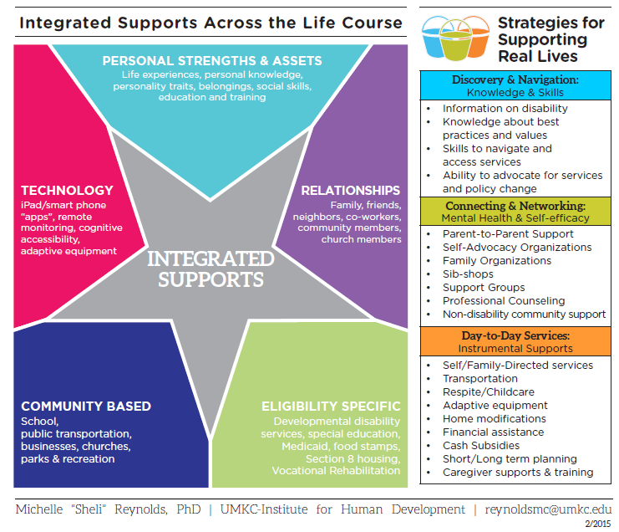
Integrated Supports
Notes:
Notes:
This is the Integrated Support Star – it is similar to the circles of support, for those of you familiar with that reference.
Individuals and families access an array of integrated supports to achieve the envisioned good life, including those that are publicly or privately funded and based on eligibility; community supports that are available to anyone; relationship-based Supports; technology; and that take into account the assets and strengths of the individual and family.
In the past, conversations about supporting people with disabilities and their families mainly revolved around the supports offered by the disability service system. We are trying to help families as well as organizations and policymakers understand that we ALL access a variety of supports to make it through our daily lives.
All people have supports in their lives. Using a combination of different types of supports helps a person achieve an inclusive, quality life. This tool can help individuals and families identify partnerships to support their vision for a good life. With the person in the center, he or she can identify the different types of supports available, including the personal strengths that the person has.

Slide 174
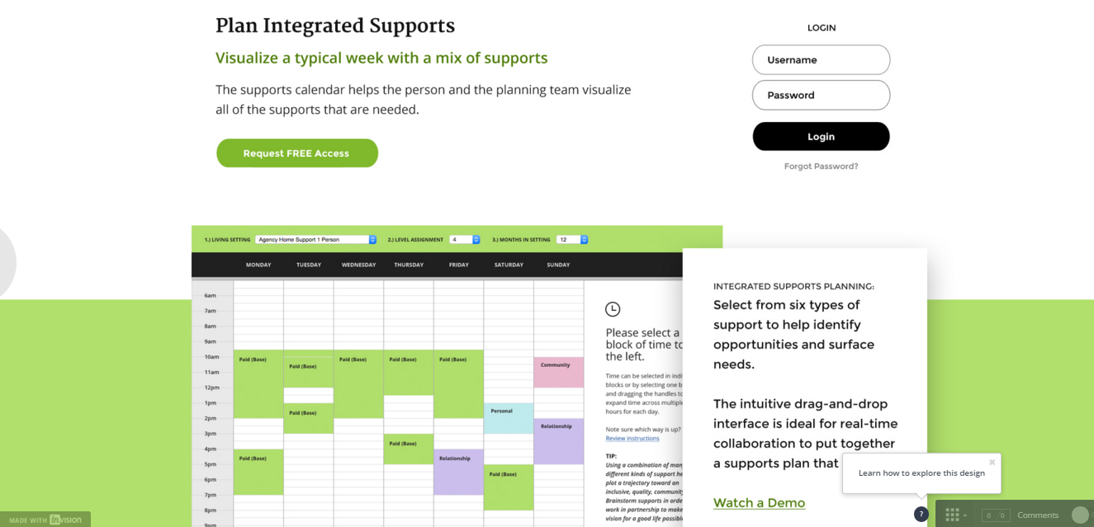
Integrated Supports
Notes:
Notes:
Once people have figured out the types of supports needed and/or existing, this template is a way to apply the supports to a daily/weekly schedule. The calendar is used during shared planning as the team identifies “who’s going to support me?” It reflects the variety of supports (both paid and natural) that the individual has selected to pursue his or her outcomes. Using the calendar while thinking about the integrated supports star allows for individuals, families, and teams to visually identify that variety of supports that are in place, not just paid supports through the Medicaid system. Service authorization is requested after completing the calendar for any paid services included and which are necessary for achieving the life he or she wants (the Good Life).

Slide 175
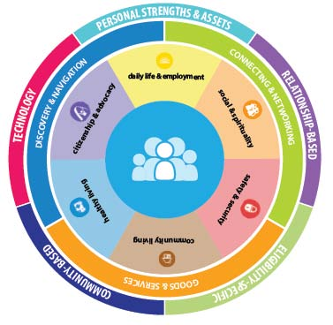
Integrated Supports
This work is part of a larger overall effort pertaining to system redesign to improve services to people with IDD
The demonstration illustrates a planning tool website that is being developed
Several of the concepts underlying the planning tool are inspired by LifeCourse principles and related work undertaken by Dr. Sheli Reynolds at the University of Missouri – Kansas City (UMKC).
Many of the materials shown are also available for download at http://www.lifecoursetools.com/
Notes:
Notes:
MMIS will pay on July 1 if WaMS is not operating

Slide 176

Provider Competencies

Slide 177
Competencies
The Provider Record
Establishing standards:
• Two key areas (Quality Service & Expertise)
Quality Service includes indicators related to meeting policy and regulation
requirements.
Expertise focuses on staff competency in supporting individuals with DD from basic to more advanced
levels.
Notes:
Notes:
We are moving toward a system in which all direct support professionals and supervisors must demonstrate knowledge and competencies required to effectively support individuals receiving their services. This includes demonstrating the ability to support the individual’s unique needs. Two areas of focus are Quality Service and Expertise. Quality Service relates to a providers standing in relation to meeting policy and regulation requirements. Expertise focuses on DSP and Supervisor abilities’ to meet the preferences and needs of those supported.

Slide 178
Competencies
A basic level process applies to all providers and includes a DD orientation manual, related training content, testing and a Direct Support Professional competency checklist.
An advanced level process provides the option for providers to report expertise in the areas of medical supports, behavioral supports, autism and/or accessibility.
Expertise focuses on staff competency in supporting individuals with DD from basic to more advanced
levels.
Notes:
Notes:
There are two levels of expertise.

Slide 179
Competencies
Direct Support Professional and Supervisor Competencies
Competencies are demonstrated based on type and intensity of service
• Beginning August 1, 2016
• Needed to meet DBHDS requirements for person-centered practices and keeping individuals healthy and safe
• All direct support professionals and supervisors must demonstrate knowledge and competencies required to effectively support individuals receiving their services (including unique needs)
Notes:
Notes:
Quality Improvement
Providers must demonstrate that they have competencies according to the type and intensity of the service(s)
they provide to assure key elements needed to achieve desired outcomes for the individuals they support. In order to
accomplish this:
• Providers must comply with DBHDS requirements for person-centered practices and keeping individuals healthy and safe.
• All direct support professionals and supervisors must demonstrate knowledge and competencies required to effectively
support individuals receiving their services. This includes demonstrating the ability to support the individual’s unique needs.
• Providers must use the DBHDS competency-based training materials or another recognized curriculum that includes
knowledge-based testing, coaching, regular, observational competency checks and a corrective action process.
• Supports to individuals with intense medical or behavioral needs may only be provided by DSPs and supervisors
demonstrating additional competencies.

Slide 180
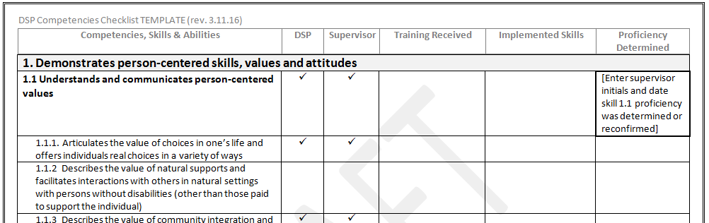
Competencies
Direct Support Professional and Supervisor Competencies
Competencies are demonstrated based on type and intensity of service
• Providers may use the DBHDS competency-based training materials or another recognized curriculum that includes knowledge-based testing, coaching, regular, observational competency checks and a corrective action process
• Supports to individuals with intense medical or behavioral needs may only be provided by DSPs and supervisors demonstrating additional competencies

Slide 181
Competencies
Direct Support Professional and Supervisor Competencies
Competencies are demonstrated based on type and intensity of service
• Advanced behavioral and autism competencies are currently available
http://www.dbhds.virginia.gov/professionals-and-service-providers/developmental-disability-services-for-providers/provider-development
http://autismtrainingva.vcu.edu/competencies/competencies-resources/

Slide 182

Waiver Management System (WaMS)

Slide 183
Waiver Management System (WaMS)
A data management system to manage waivers
Interfaces with the Virginia Medicaid Management Information System (VAMMIS)
Improves data about individual costs for state budgeting
Notes:
Notes:
DBHDS is developing a new data management system to manage the new waivers. An RFP has been developed to locate a data provider to build the system. It is anticipated that the system will interface with VAMIS and eventually be able to establish the assessment levels (of care) based on an individual’s needs and automate the preauthorization process. The new system will help DBHDS collect data to more accurately predict an individual’s costs for services versus using aggregated costs across all individuals for state budgeting purposes.

Slide 184
Waiver Management System (WaMS)
Role of Pre-Authorization
Review calendars submitted through new WaMS
Support CMs with developing ISPs that
include accessing community resources and ongoing natural supports which are appropriate to assessed needs
Monitor trends and perform analyses on:
Utilization of new waiver services
The potential impact of service mix packages
Adjustments needed to service mix packages to test with 5 to 8 CSBs in FY 18
Notes:
Notes:
DBHDS will be responsible for service authorization
DBHDS will analyze the correlation between supports levels and /service mix through the service authorization process and request supporting documentation if question of matching needs
Preauthorization staff will assemble dashboards that will be posted per region/CSB/providers on types of services utilized, particularly integrated & supported employment

Slide 185

Takeaways…
Changes are needed so that…
There will be one process to qualify for and access DD supports.
Handout: MLMC Benefits
Notes:
Notes:
Serves individuals across the entire spectrum of I/DD using a single DD eligibility criterion and a single point of entry for accessing services.

Slide 186
Takeaways…
Changes are needed so that…
Services and funding are based on individual needs and preferences.
Notes:
Notes:
Establishes a needs-based service delivery and reimbursement system tailored to individuals’ specific levels of support needs.
Balances resources to better serve the needs of individuals with disabilities in the Commonwealth.

Slide 187

Takeaways…
Changes are needed so that…
New services create more choices and opportunities.
Notes:
Notes:
Introduces new services and rates advocated by VA stakeholders which support choice of services and providers and incentivize services delivered in integrated settings in the community, with smaller ratios.

Slide 188

Takeaways…
Changes are needed so that…
There is consistency, equity, quality and accountability across the waivers.
Notes:
Notes:
Creates new systems and infrastructure designed to promote consistency, equity, quality and accountability of service delivery and provider practices.

Slide 189
My Life, My Community
Updates at
My Life, My Community
at DBHDS.virginia.gov
http://www.dbhds.virginia.gov/individuals-and-families/developmental-disabilities/my-life-my-community

Slide 190
Thank you!

